Slide 1

Scientific writing (81-933) Lecture 1: Introduction
Dr. Avraham Samson
Faculty of Medicine

Slide 2
Course website
http://odem.md.biu.ac.il/sw933

Slide 3
Why?
I don’t agree with the notion that students should learn writing out of thin air.
I believe “Scientific writing” is one of the most important courses of I took during my graduate studies.
You need to write a research proposal and thesis.

Slide 4
How is a paper constructed?
Title
Abstract
Introduction
Methods
Results (Tables/Figures)
Discussion
In essence:
– Tell them what you are about to tell them.
– Then, tell them
– and then, tell them what you’ve told them.

Slide 5
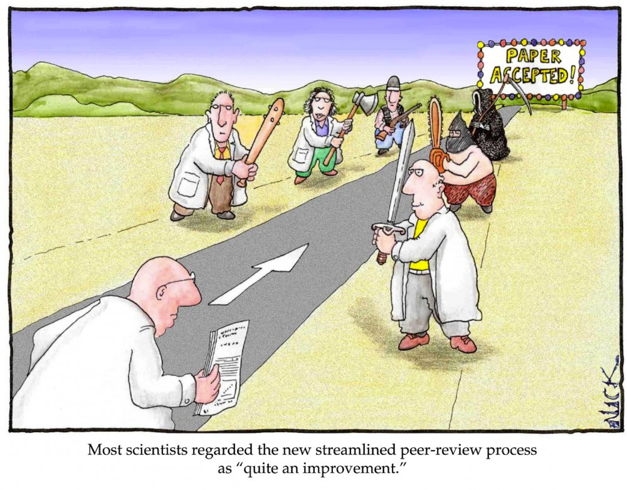

Slide 6
Scientific writing is a learnt art.
Good news!
"Writing is an art. But when it is writing to inform it comes close to being a science as well.“
--Robert Gunning,The Technique of Clear Writing
Take home message: Clear, effective writing can be learned!

Slide 7
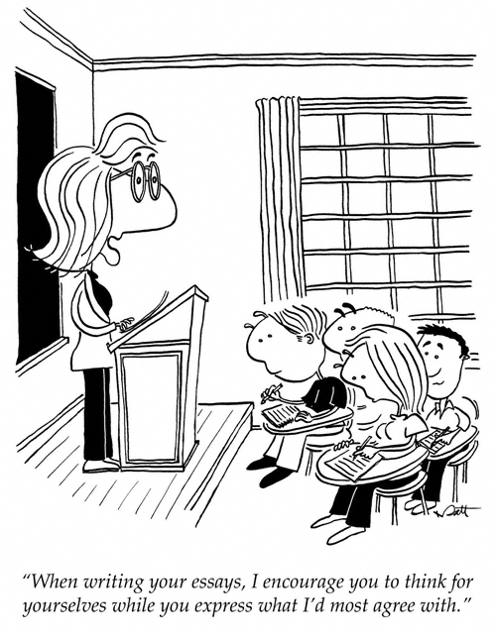

Slide 8
Introduction (I)
Typically, introductions are ⅓ of the length of a paper.
Introductions provide a background of the field (system, facts, and technology) for the non-expert scientist.
The last paragraph of the introduction, should clearly state the problem, and explain how the paper will resolve it.

Slide 9
Introduction (II)
Introductions should not contain assumptions, methods, results, and discussion (except in the last paragraph).
Cite all relevant references. Don’t forget anyone, as they will probably end up reviewing you.
Introduction paragraphs are usually untitled.
Always tense one tense. Past or present

Slide 10
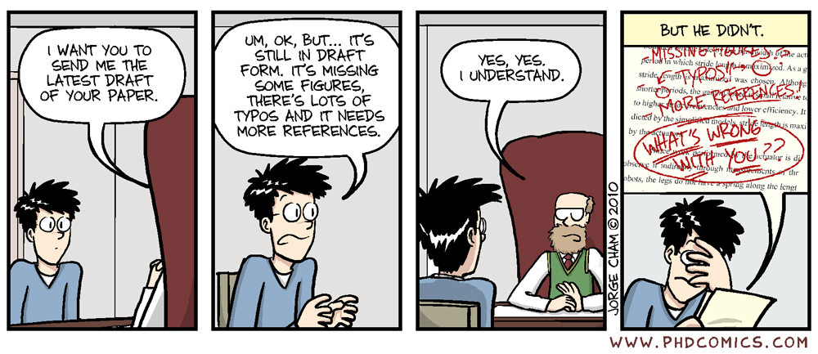

Slide 11
Clear writing starts with clear thinking.
Before you start writing, ask:
“What am I trying to say?”
-Too often, we start writing sentences, without thinking, and wait for divine inspiration to finish them. This is not the way!
When you finish writing, ask:
“Have I said it?”
-If yes, great. If not, erase and rewrite.

Slide 12
But aren’t long sentences and complex phrases with difficult words nice?
NO

Slide 13
“The secret of good writing is to strip every sentence to its cleanest components. Every word that serves no function, every long word that could be a short word, every adverb that carries the same meaning that’s already in the verb, every passive construction that leaves the reader unsure of who is doing what—these are the thousand and one adulterants that weaken the strength of a sentence. And they usually occur in proportion to the education and rank.”
-- William Zinsser in On Writing Well, 1976

Slide 14
Today’s introduction to writing well:
Words:
1. Reduce dead weight words and phrases
2. Cut, cut, cut; learn to part with your words
3. Be specific
Sentences:
4. Follow: subject + verb + object (SVO)
5. Use strong verbs and avoid turning verbs into nouns
6. Eliminate negatives; use positive constructions instead

Slide 15
Example
“I would like to assert that the author should be considered to be a buffoon.”
→ “The author is a buffoon.”

Slide 16
Another example
“The expected prevalence of mental retardation, based on the assumption of a normal distribution of intelligence in the population, is stated to be theoretically about 2.5%.”
→“The expected prevalence of mental retardation, if intelligence is normally distributed, is 2.5%.”

Slide 17
Yet another example
“To control infection with Mycobacterium tuberculosis (M. tb), a robust cell-mediated immune response is necessary, and deficiency in this response predisposes an individual towards active TB.”
→“Deficiency in T-cell-mediated immune response predisposes individuals to active TB.”

Slide 18
Very, really, quite, basically, generally
These words seldom add anything useful. Try the sentence without them and see if it improves.

Slide 19
Watch out for the verb “to be”
Often “there are” is extra weight.
There are many students who like writing.
Many students like writing.

Slide 20
Dead weight phrases
in the event that
in the nature of
it has been estimated that
it seems that
the point I am trying to make
what I mean to say is
it may be argued that

Slide 21
Dead weight phrases
for the most part
for the purpose of
in a manner of speaking
in a very real sense
in my opinion
in the case of
in the final analysis

Slide 22
Dead weight phrases
Clunky phrase Equivalent
A majority of most
A number of many
Are of the same opinion agree
At the present moment now
By means of by
Less frequently occurring rare

Slide 23
Dead weight phrases
Clunky phrase Equivalent
All three of the the three
Fewer in number few
Give rise to cause
In all cases always
In a position to can
In close proximity to near
In order to to

Slide 24
Dead weight phrases
Beware of Use instead
Referred to as named
With the possible exception of except
Due to the fact that because
He totally lacked the ability to he could not
Until such time as until
For the purpose of for
Optimum best

Slide 25
Wordy To the point
3 am in the morning 3 am
absolutely spectacular spectacular
a person who is honest an honest person
a total of 14 birds 14 birds
circle around circle
completely unanimous unanimous
consensus of opinion consensus
cooperate together cooperate
each and every each
end result result
he is a man who he
in spite of the fact that although
in the event that if
period of four days four days
personally, I think/feel I think/feel
shorter/longer in length shorter/longer

Slide 26
Constantly be on the lookout for extraneous words that crop up like weeds….
Ask yourself, is this word or phrase necessary?
What happens if I take it out?
Most of the time, you’ll find you don’t need it!

Slide 27
Today’s introduction to writing well:
Words:
1. Reduce dead weight words and phrases
2. Cut, cut, cut; learn to part with your words
3. Be specific
Sentences:
4. Follow: subject + verb + object (SVO)
5. Use strong verbs and avoid turning verbs into nouns
6. Eliminate negatives; use positive constructions instead

Slide 28
Be vigilant and ruthless
After investing much effort to put words on a page, we often find it hard to part with them.
But fight their seductive pull…
Try the sentence without the extra words and see how it’s better—conveys the same idea with more power

Slide 29
Parting with your words…

Slide 30
Example:
“The incidence of brain injury shows two peak periods in almost all reports: rates are the highest in young people and the elderly.”
More punch→
“The incidence of brain injury peaks in the young and the elderly.”

Slide 31
Today’s introduction to writing well:
Words:
1. Reduce dead weight words and phrases
2. Cut, cut, cut; learn to part with your words
3. Be specific
Sentences:
4. Follow: subject + verb + object (SVO)
5. Use strong verbs and avoid turning verbs into nouns
6. Eliminate negatives; use positive constructions instead

Slide 32
Be specific
“Prefer the specific to the general, the definite to the vague, the concrete to the abstract.”--Strunk and White
“Some words and phrases are blobs.”
--Zinsser
Vague: A period of unfavorable weather set in.
Specific: It rained every day for a week.
Vague: He showed satisfaction as he took possession of his well earned reward.
Specific: He grinned as he pocketed the coin.
Vague: Because of stress, the blood pressure changes.
Specific: Upon stress, blood pressure rises.

Slide 33
Be specific
Vague:
If the manners, customs, and amusements of a nation are cruel and barbarous, then the regulations of its penal code will be severe.
Specific:
If men delight in battles, bullfights, and combats of gladiators, then they will punish by hanging, burning, and the rack.
From: Strunk and White

Slide 34
Today’s introduction to writing well:
Words:
1. Reduce dead weight words and phrases
2. Cut, cut, cut; learn to part with your words
3. Be specific
Sentences:
4. Follow: subject + verb + object (SVO)
5. Use strong verbs and avoid turning verbs into nouns
6. Eliminate negatives; use positive constructions instead

Slide 35
Follow: subject + verb + object
We will talk more about this in future classes. For now, just beat the following into your head…
“Subject verb object”
“Subject verb object”
“Subject verb object”
“Subject verb object”
or just…
“Subject verb”

Slide 36
Example
Flowers were bought by Mickey and given to Minnie. In return, Mickey received a kiss and a hug.
Mickey bought Minnie flowers. In return, Mickey received a kiss and a hug.

Slide 37
Another example
The nicotinic acetylcholine receptor is a ligand gated ion channel. The neurotransmitter acetylcholine opens it.
The nicotinic acetylcholine receptor is a ligand gated ion channel. It is opened by the neurotransmitter acetylcholine.

Slide 38
Active vs. passive voice
"Cigarette ads were designed to appeal especially to children."
vs.
"We designed the cigarette ads to appeal especially to children.”

Slide 39
Active or passive voice?
Which is better, active or passive voice?
Well, it depends:
Use passive voice for others. (It was determined…)
Use active voice for yourself. (We determined…)

Slide 40
Today’s introduction to writing well:
Words:
1. Reduce dead weight words and phrases
2. Cut, cut, cut; learn to part with your words
3. Be specific
Sentences:
4. Follow: subject + verb + object (SVO)
5. Use strong verbs and avoid turning verbs into nouns
6. Eliminate negatives; use positive constructions instead

Slide 41
Use strong verbs and avoid turning verbs into nouns
A sentence uses one main verb to convey its central action; without that verb the sentence would collapse.
The verb is the engine that drives the sentence. Dull, lifeless verbs slow the sentence down.
Action verbs reflect the action they were chosen to describe, and help bring the reader into the story.

Slide 42
Use strong verbs and avoid turning verbs into nouns
Compare:
“Loud music came from speakers embedded in the walls, and the entire arena moved as the hungry crowd got to its feet.”
With:
“Loud music exploded from speakers embedded in the walls, and the entire arena shook as the hungry crowd leaped to its feet.”

Slide 43
Use strong verbs and avoid turning verbs into nouns
Pick the right verb!
The WHO reports that approximately two-thirds of the world’s diabetics are found in developing countries, and estimates that the number of diabetics in these countries will double in the next 25 year.
→
The WHO estimates that two-thirds of the world’s diabetics are found in developing countries, and projects that the number of diabetics in these countries will double in the next 25 years.

Slide 44
Use strong verbs and avoid turning verbs into nouns
Don’t kill verbs and adjectives by turning them into nouns.

Slide 45
Use strong verbs and avoid turning verbs into nouns
estimate
has expanded
emphasizes methodology
assess
Obtain estimates of
Has seen an expansion in
Provides a methodologic emphasis
Take an assessment of

Slide 46
Use strong verbs and avoid turning verbs into nouns
review
confirm
decide
peaks
Provide a review of
Offer confirmation of
Make a decision
Shows a peak

Slide 47
Today’s introduction to writing well:
Words:
1. Reduce dead weight words and phrases
2. Cut, cut, cut; learn to part with your words
3. Be specific
Sentences:
4. Follow: subject + verb + object (SVO)
5. Use strong verbs and avoid turning verbs into nouns
6. Eliminate negatives; use positive constructions instead

Slide 48
Eliminate negatives; use positive constructions instead
He was not often on time
He usually came late.
She did not think that studying writing was a sensible use of one’s time.
She thought studying writing was a waste of time.
Please do not hesitate to contact us.
Please contact us.

Slide 49
Eliminate negatives; use positive constructions instead
Not honest dishonest
Not important trifling
Does not have lacks
Did not remember forgot
Did not pay attention to ignored
Did not have much confidence distrusted
Did not succeed failed

Slide 50
Recap:
1. Reduce dead weight words and phrases
2. Cut, cut, cut; learn to part with your words
3. Be specific
4. Follow: subject + verb + object (active voice!)
5. Use strong verbs and avoid turning verbs into nouns
6. Eliminate negatives; use positive constructions instead

Slide 51
But first… A little writing humor… or “the importance of careful grammar…”
Spotted in a toilet of a London office: TOILET OUT OF ORDER. PLEASE USE FLOOR BELOW
In a Laundromat: AUTOMATIC WASHING MACHINES: PLEASE REMOVE ALL YOUR CLOTHES WHEN THE LIGHT GOES OUT.
In a London department store: BARGAIN BASEMENT UPSTAIRS.
In an office: WOULD THE PERSON WHO TOOK THE STEPLADDER YESTERDAY PLEASE BRING IT BACK OR FURTHER STEPS WILL BE TAKEN.

Slide 52
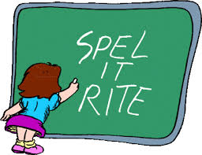
Single most important tip
Use spell check!!!

Slide 53
A Little Poem Regarding Computer Spell Checkers...
Eye halve a spelling chequer It came with my pea sea It plainly marques four my revue Miss steaks eye kin knot sea.
Eye strike a key and type a word And weight four it two say Weather eye am wrong oar write It shows me strait a weigh.
As soon as a mist ache is maid It nose bee fore two long And eye can put the error rite Its rare lea ever wrong.
Eye have run this poem threw it I am shore your pleased two no Its letter perfect awl the weigh My chequer tolled me sew.

Slide 54
Top 5 spelling errors:
1. The word “data” is plural.
ex: These data are important.
The data are important.
(v. datum, singular form)

Slide 55
Top 5 spelling errors:
2. Affect v. effect
Affect is the verb “to influence”
The class affected her.
As a noun, affect denotes feeling or emotion shown by facial expression or body language, as in “The soldiers seen on television had been carefully chosen for blandness of affect” (Norman Mailer).
Effect is the noun form of this influence
The class had an effect on her.
As a verb, effect means to bring about or to cause, as in “to effect a change”

Slide 56
Top 5 spelling errors:
3. More than v. over
Do not use over to describe relative amounts.
More than = greater than
Over = physically above
wrong: She raised over $500.
right: She raised more than $500.

Slide 57
Top 5 spelling errors:
4. Do v. due v. due
Do is a verb that means to perform an action.
ex: What can I do to help you?
Due is an adjective that means expected or planned.
ex: My assignment was due at 5 p.m., but I did not submit it until 5:21 p.m.
Due is a noun that refers to membership payments
ex: I pay dues to the student union, who use the money to defend students who fell asleep on the job.

Slide 58
More writing humor…
In an office: AFTER TEA BREAK STAFF SHOULD EMPTY THE TEAPOT AND STAND UPSIDE DOWN ON THE DRAINING BOARD. Outside a secondhand shop: WE EXCHANGE ANYTHING -- BICYCLES, WASHING MACHINES, ETC. WHY NOT BRING YOUR WIFE ALONG AND GET A WONDERFUL BARGAIN? Notice in health food shop window: CLOSED DUE TO ILLNESS. Spotted in a safari park: ELEPHANTS PLEASE STAY IN YOUR CAR.

Slide 59
Top 5 spelling errors:
5. Ensure, assure, vs. insure
“Ensure” is used for things
“Assure” is used for people
“Insure” is used for money
What’s the difference between them?→
-The USDA must act to ensure safety in school lunch programs.
-"Do not worry about your problems with mathematics. I assure you mine are far greater." (Albert Einstein)
-”She could not insure her Lamborghini”

Slide 60
More writing humor…
Seen during a conference: FOR ANYONE WHO HAS CHILDREN AND DOESN'T KNOW IT, THERE IS A DAY CARE ON THE FIRST FLOOR.
Notice in a farmer's field: THE FARMER ALLOWS WALKERS TO CROSS THE FIELD FOR FREE, BUT THE BULL CHARGES.

Slide 61
More humor…
Irving and Jessica were married on October 24 in the church. So ends a friendship that began in their school days.
Scouts are saving aluminum cans, bottles and other items to be recycled.Proceeds will be used to cripple children.
Please place your donation in the envelope along with the deceased person you want remembered.
Don't let worry kill you off – let the Church help.

Slide 62
More humor…
This evening at 7 PM there will be a hymn singing in the park across from the Church. Bring a blanket and come prepared to sin. (Do you think they meant sing?)
The pastor would appreciate it if the ladies of the congregation would lend him their electric girdles for the pancake breakfast next Sunday.

