Slide 1

Scientific writing (81-933)
Lecture 10: Ethics
Dr. Avraham Samson
Faculty of Medicine in the Galilee

Slide 2
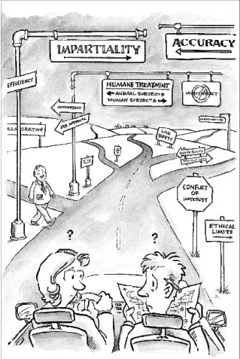
Where do grad students learn ethics?
Mentor, advisor
Fellow graduate students
Family
Friends not in graduate school
Other faculty
Religious beliefs
Discussions in courses, labs, seminars
Professional organizations
Courses dealing with ethical issues
Setting off on the road to the
responsible conduct of research

Slide 3
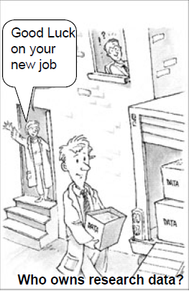
Research Ethics
Part I. Sharing Scientific Knowledge
Research publication
Authorship and collaborative Research
Scientific Misconduct
Examples of scientific misconduct in literature
Part II Laboratory Practice and Conflict of interest
Practices of Image and Data Manipulation
Data Ownership & Intellectual Property Guidelines
Conflict of Interest & Commitment
Government vs. Industry Sponsored Research
Sharing data in thesis
Who owns research data?

Slide 4
Scientific Knowledge
The object of research is to extend human knowledge beyond what is already known.
But an individual’s knowledge enters the domain of science only after it is presented to others in such a fashion that they can independently judge its validity
(NAP, “On Being a Scientist” 1995)

Slide 5
Sharing Scientific Knowledge
“Science is a shared knowledge based on a common understanding of some aspect of the physical or social world” (NAP, “On Being a Scientist” 1995)
Presentations
Social conventions play an important role in establishing the reliability of scientific knowledge
Publications in peer reviewed journals
Research results are privileged until they are published
Thesis

Slide 6
Why Publish?
“A paper is an organized description of hypotheses, data and conclusions, intended to instruct the reader. If your research does not generate papers, it might just as well not have been done” (G. Whitesides, Adv. Mater., 2004, 16, 1375)
“If it wasn’t published, it wasn’t done” (Michael Levitt, Chemistry Nobel prize 2013)

Slide 7
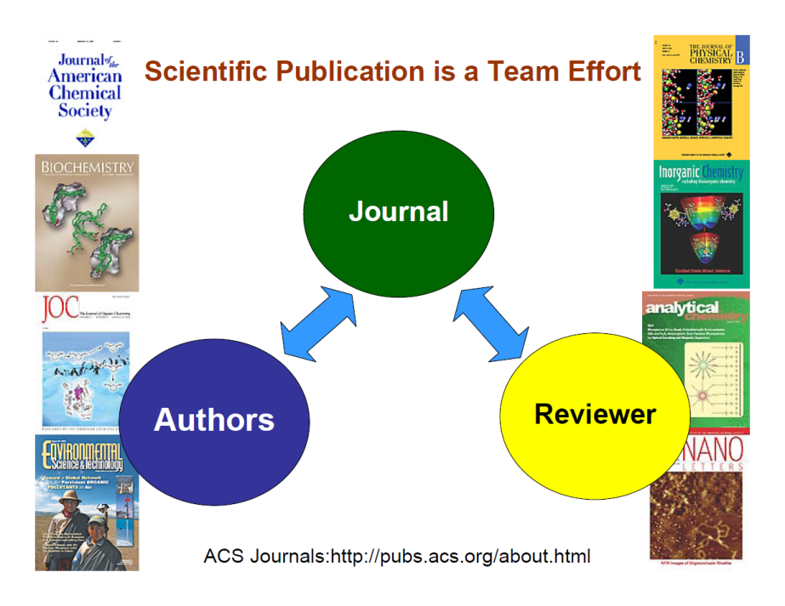

Slide 8
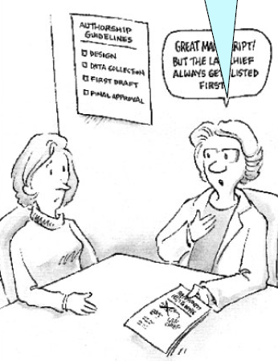
Authorship
The list of authors establishes accountability as well as credit.
Policies at most scientific journals state that a person should be listed as the author of a paper only if that person made a direct and substantial intellectual contribution to the design of the research, the interpretation of the data, or the drafting of the paper.
The acknowledgments section can be used to thank those who indirectly contributed to the work.
Including “honorary,” “guest,” or “gift” authors dilutes the credit due the people who actually did the work, inflates the credentials of the added authors, and makes the proper attribution of credit more difficult.
Great manuscript! But the lab chief always gets listed as first author

Slide 9
Author Responsibilities
Preparation and Submission of Manuscripts:
Follow General Rules:
Ensure work is new and original research
All authors are aware of submission and agree with content and support submission
Agree that the manuscript can be examined by anonymous reviewers.
Provide copies of related work submitted or published elsewhere.
Obtain copyright permission if figures/tables need to be reproduced. Include proper affiliation

Slide 10
What is publishable…
Journals like to publish papers that are going to be widely read and useful to the readers
Papers that report “original and significant” findings that are likely to be of interest to a broad spectrum of its readers
Papers that are well organized and well written, with clear statements regarding how the findings relate to and advance the understanding/development of the subject
Papers that are concise and yet complete in their presentation of the findings

Slide 11
What is not acceptable…
Papers that are routine extensions of previous reports and that do not appreciably advance fundamental understanding or knowledge in the area .
Incremental / fragmentary reports of research results
Verbose, poorly organized, papers cluttered with unnecessary or poor quality illustrations
Violations of ethical guidelines, including plagiarism of any type or degree (of others or of oneself) and questionable research practices.

Slide 12

Research Misconduct
Research misconduct means Fabrication, Falsification, or Plagiarism in proposing, performing, or reviewing research, or in reporting research results.
(a) Fabrication is making up data or results and recording or reporting them.
(b) Falsification is manipulating research materials, equipment, or processes, or changing or omitting data or results such that the research is not accurately represented in the research record.
(c) Plagiarism is the appropriation of another person's ideas, processes, results, or words without giving appropriate credit.
(d) Research misconduct does not include honest error or differences of opinion.
http://ori.hhs.gov/definition-misconduct

Slide 13
Definitions:
Plagiarism and Self-Plagiarism
Plagiarism: using the ideas or words of another person without giving appropriate credit (Nat. Acad. Press document)
Self-Plagiarism: The verbatim copying or reuse of one’s own research (IEEE Policy statement)
Both types of plagiarism are considered to be unacceptable practice in scientific literature

Slide 14
ACS Publication Policy
Plagiarism statement for Ethical Guidelines
B. 9. It is the responsibility of the author to ensure that the submitted manuscript is original and shall not contain plagiarized material. Plagiarism is passing off another person’s work as one’s own, i.e., reusing text, results, or creative expression without explicitly acknowledging or referencing the original author or publication.
Authors should be aware this includes self-plagiarism, defined as the reuse of significant portions of the author’s own published work or works, without attribution to the original source. Examples of plagiarism include verbatim copying of published articles; verbatim copying of elements of published articles (e.g., figures, illustrations, tables); verbatim copying of elements of published articles with crediting, but not clearly differentiating original work from previously published work; and self-plagiarism.
It is the responsibility of the author to obtain proper permission and to appropriately cite or quote the material not original to the author. In this context, “quote” is defined as reusing other works with proper acknowledgement. Appropriate citation applies whether the material was written by another author or the author him or herself.

Slide 15
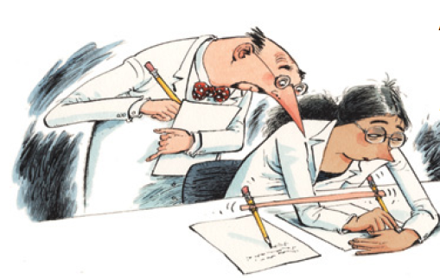
A tale of two citations
Mounir Errami & Harold Garner
Nature 451, 397-399 (2008)
"It is the best of times, it is the worst of times". Scientific productivity, as measured by scholarly publication rates, is at an all-time high. However, high-profile cases of scientific misconduct remind us that not all those publications are to be trusted — but how many and which papers?
The most unethical practices involve substantial reproduction of another study (bringing no novelty to the scientific community) without proper acknowledgement. If such duplicates have different authors, then they may be guilty of plagiarism, whereas papers with overlapping authors may represent self-plagiarism.
Simultaneous submission of duplicate articles by the same authors to different journals also violates journal policies.

Slide 16
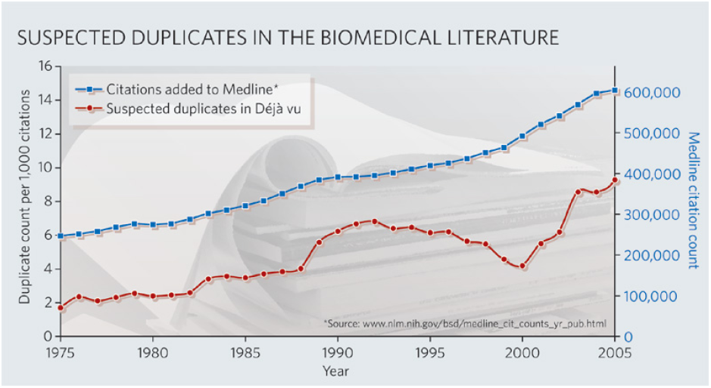
Mounir Errami & Harold Garner (2008) Nature 451, 397-399
China and Japan, have estimated duplication rates that are roughly twice that expected for the number of publications they contribute to Medline. Perhaps the complexity of translation between different scripts, differences in ethics training and cultural norms contribute to elevated duplication rates in these two countries.

Slide 17
Other Types of Ethical Violations
Duplicate publication/submission of research findings; failure to inform the editor of related papers that the author has under consideration or “in press”
Unrevealed conflicts of interest that could affect the interpretation of the findings (i.e. advisor to pharmaceutical company)
Misrepresentation of research findings -use of selective or fraudulent data to support a hypothesis or claim

Slide 18
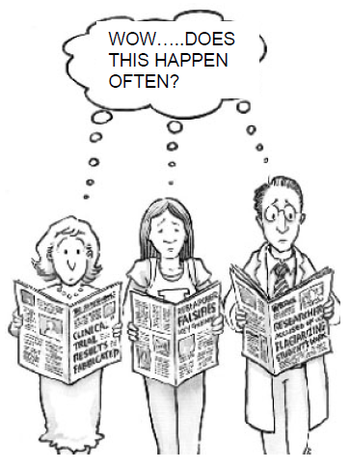
Data Manipulation
Researchers who manipulate their data in ways that deceive others are violating both the basic values and widely accepted professional standards of science.
They mislead their colleagues and potentially impede progress in their field or research.
They undermine their own authority and trustworthiness as researchers.
Misleading data can also arise from poor experimental design or careless measurements as well as from improper manipulation.
When a mistake appears in a journal article or book, it should be corrected in a note, erratum (for a production error), or Additions/Corrections

Slide 19
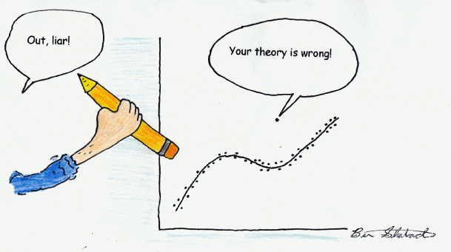

Slide 20
Sooner or later …….
ethical violations get exposed
Some recent examples

Slide 21
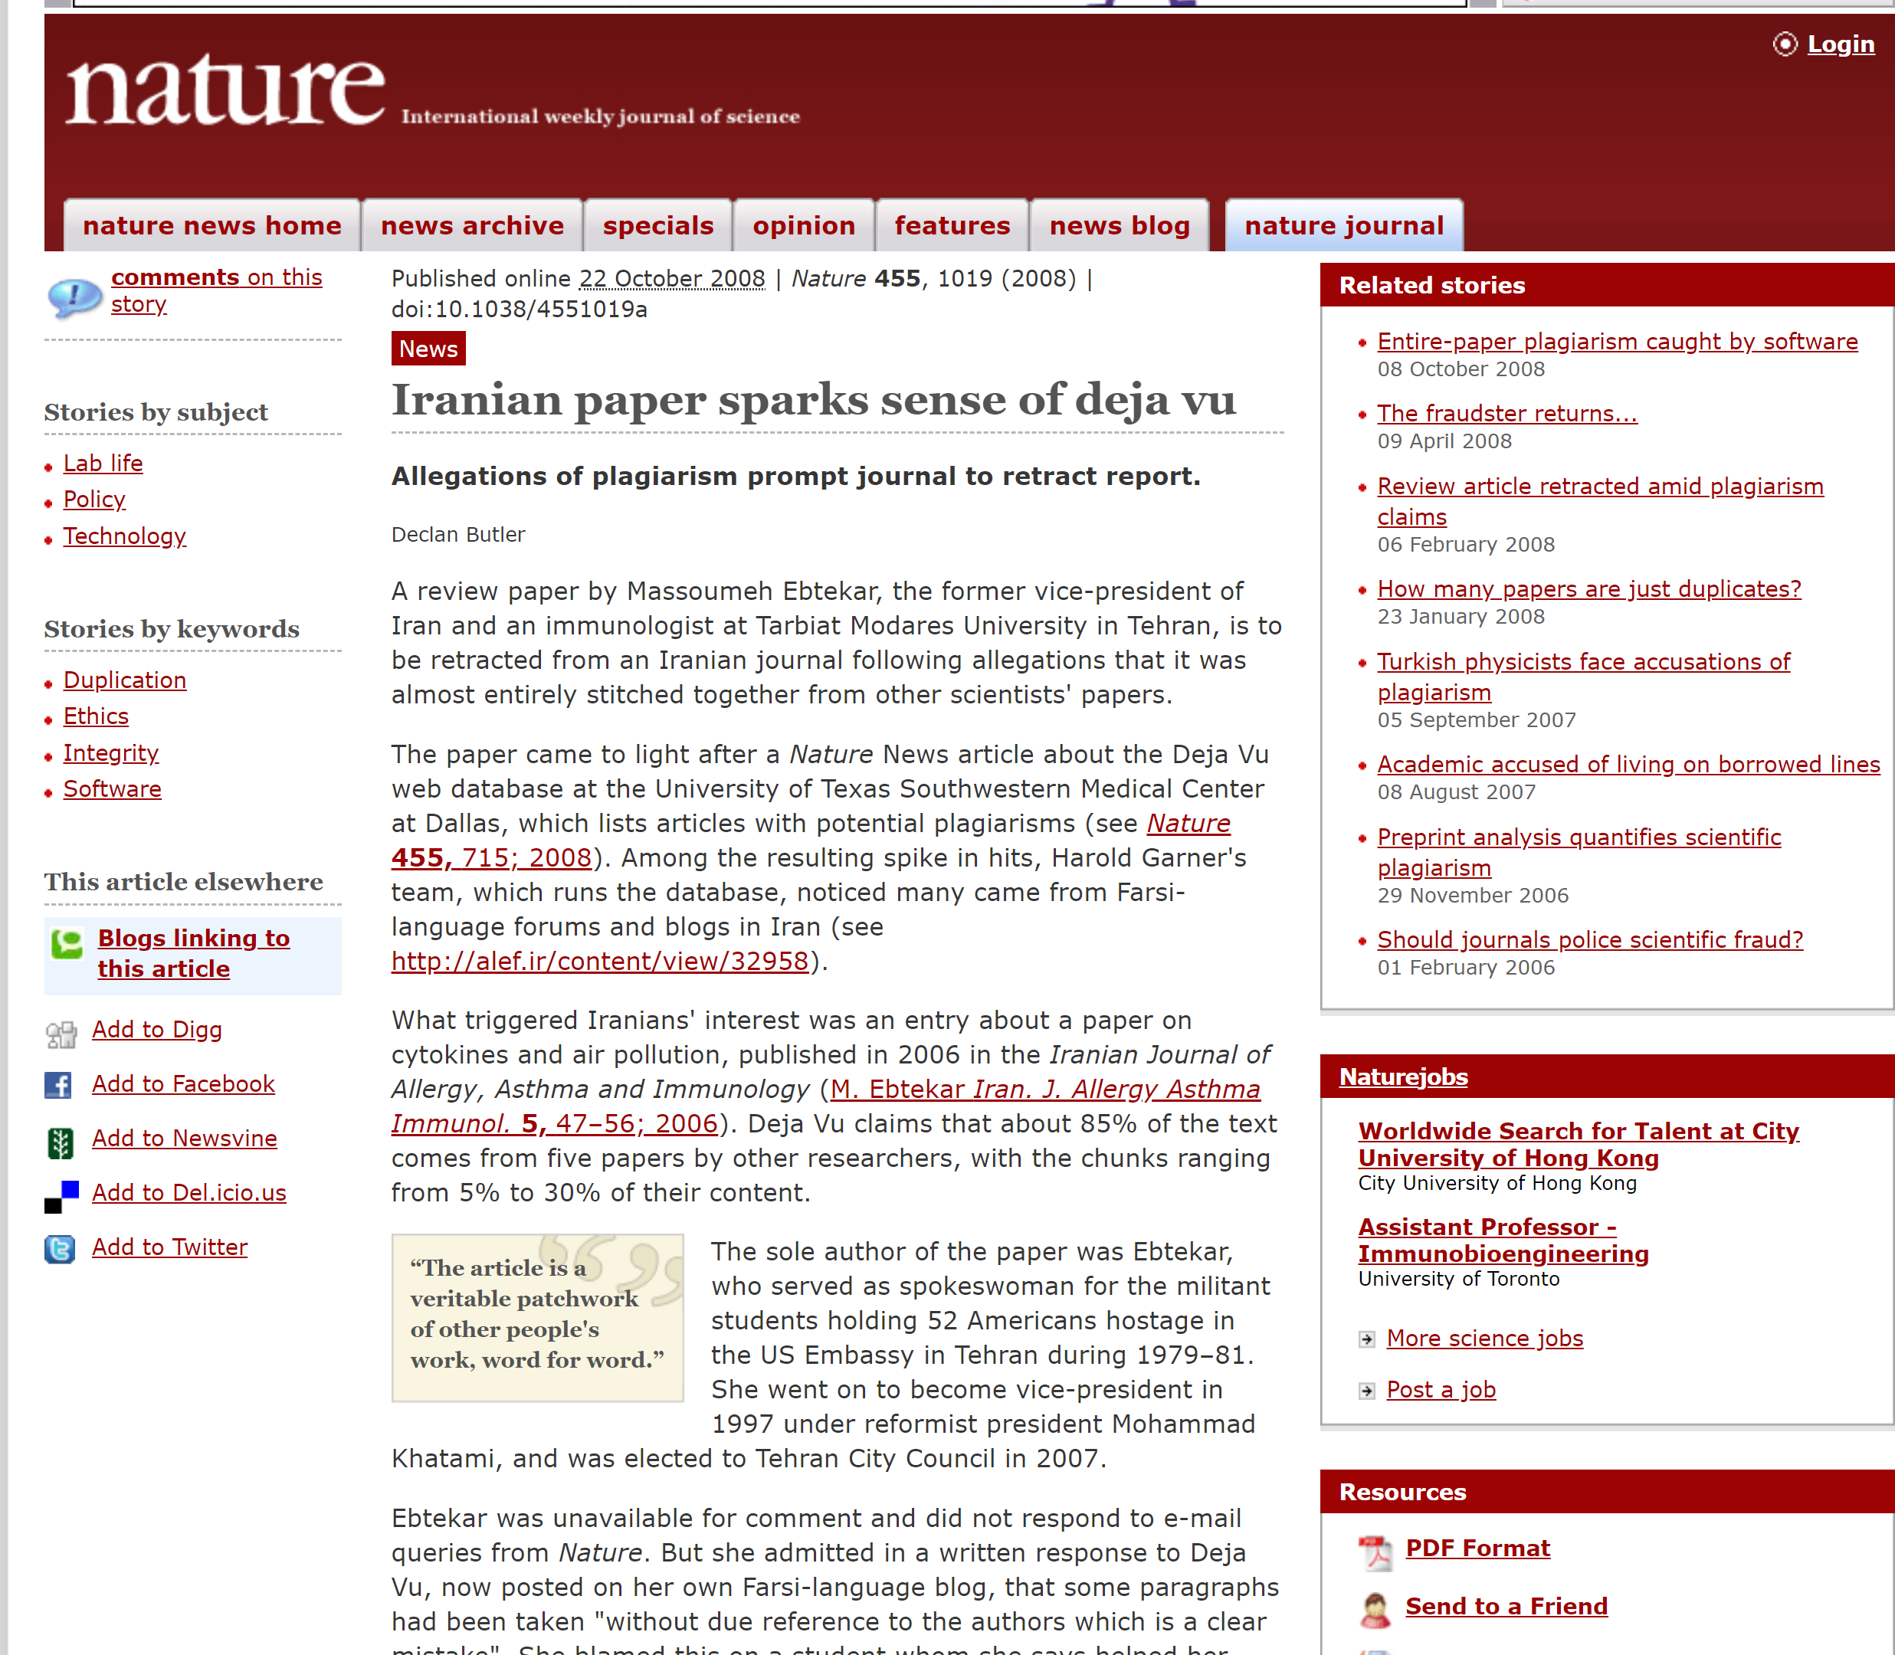

Slide 22
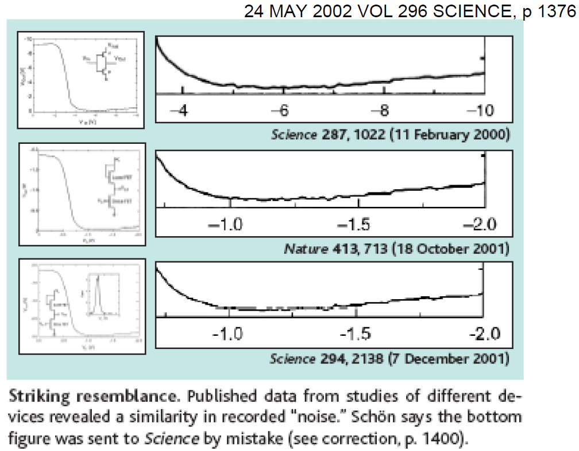

Slide 23
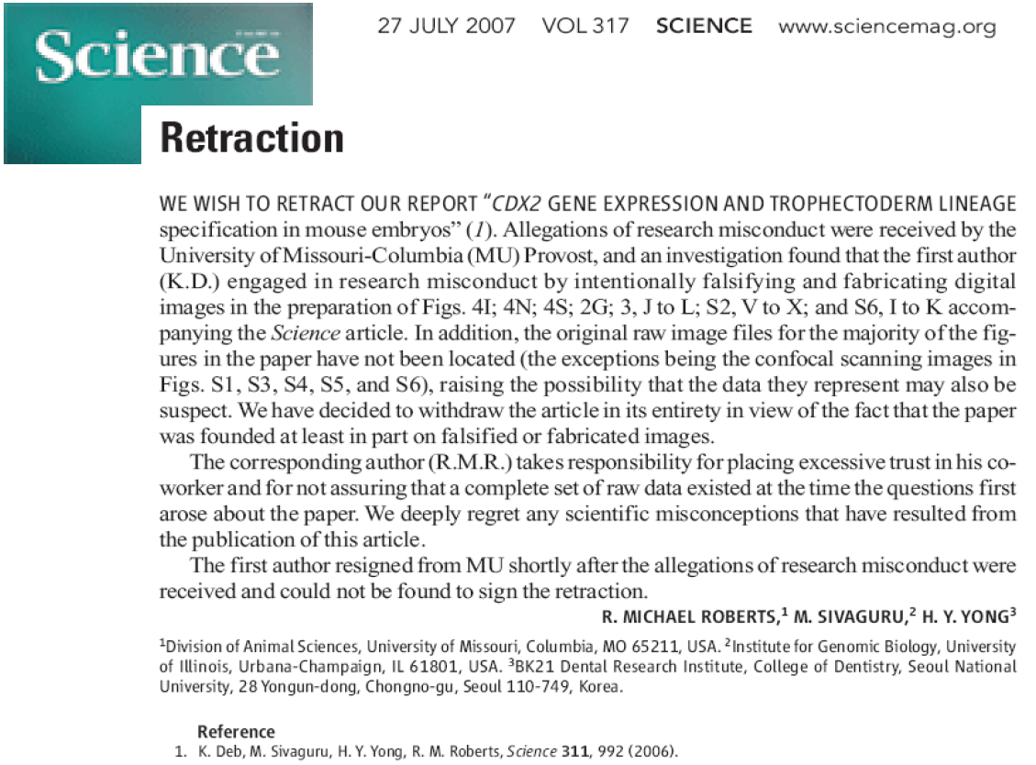

Slide 24
Recent cases
http://ori.hhs.gov/case_summary

Slide 25
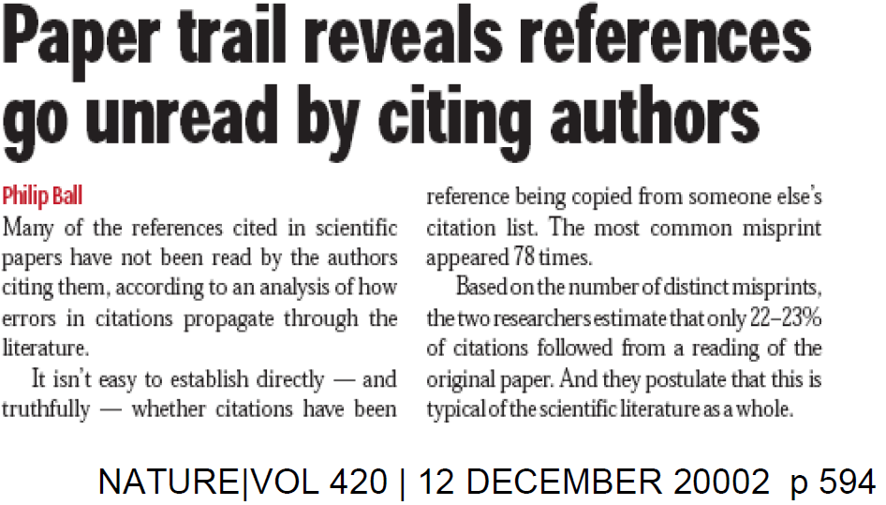
Citations
-Read the study before you cite
-Cite studies correctly and completely

Slide 26
The Plagiarism Hunter. When one graduate student went to the library, he found copycats — lots of them
By PAULA WASLEY, Athens, Ohio
In Ohio University's Library, Thomas A. Matrka takes just 15 minutes to hit pay dirt. Scattered before him on a table are 16 chemical-engineering master's theses on "multiphase flow.“ Identical diagrams in two theses from 2007 and 2008 strike him as suspicious. Turning a few more pages, he confirms what he suspected………..
Most of the plagiarism found at Ohio occurred in introductory chapters describing research methods and reviewing the previous literature in the field, for which there is little expectation of originality. And all but a few cases involved international students who, he says, whether through ignorance, laziness, or cultural misunderstanding, may have either not known correct citation practices or, struggling to write in a foreign language, been tempted to borrow another student's words.

Slide 27
How Journals Detect and Handle Problem Papers
Detection
Information received from reviewers or other editors.
Literature search for related papers by the author.
Withdrawal of a paper from publication
Action
Banning authors from publication in the journal for 3-5 years and informing the co-authors and editors of related journals of our action
For less serious cases, placing the author on a “watch list” for careful examination of their submissions prior to requesting reviews

Slide 28
A recent retraction ….
Ethical Responsibilities for Authors in The Journal of Physical Chemistry
I recently took the step of retracting from the scientific record a letter published in The Journal of Physical Chemistry C, as it is emblematic of a type of author misconduct that we as research professionals must seek to avoid if we are to uphold the integrity of the scientific literature.
The letter in question was a publication by Fang et al., J. Phys. Chem. C 2007, 111, 1065-1070. After publication of the letter, it was brought to our attention that the paper by Fang et al., as submitted and subsequently published by the journal after peer review, included a number of figures that duplicated those contained within previously published papers by other authors ……... I judged such misconduct by the authors to constitute a serious instance of plagiarism.
George Schatz
Editor in Chief
J. Phys. Chem. A/B/C

Slide 29
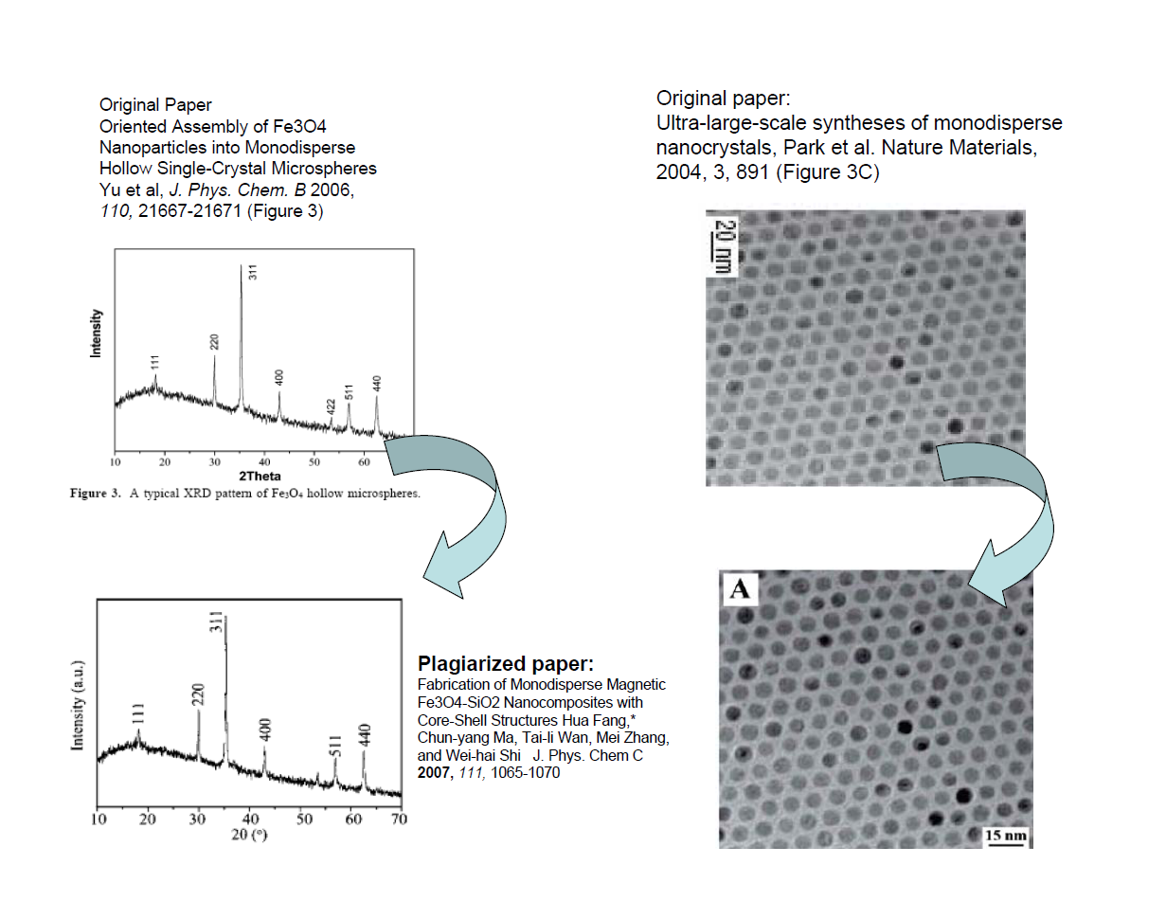

Slide 30
Double retraction
Fluorescence lifetime increase by introduction of F⁻ ions in ytterbium-doped TeO₂-based glasses (2005). Journal of Alloys and Compounds, 393:279-282 Guonian Wang, Shixun Dai, Junjie Zhang, Shiqing Xu and Zhonghong Jiang
Effect of F⁻ ions on spectroscopic properties of Yb³⁺-doped zinc–tellurite glasses (2005) Journal of Physics and Chemistry of Solids, 66:1107-11 Guonian Wang, Junjie Zhang, Shixun Dai, Jianhu Yang and Zhonghong Jiang

Slide 31
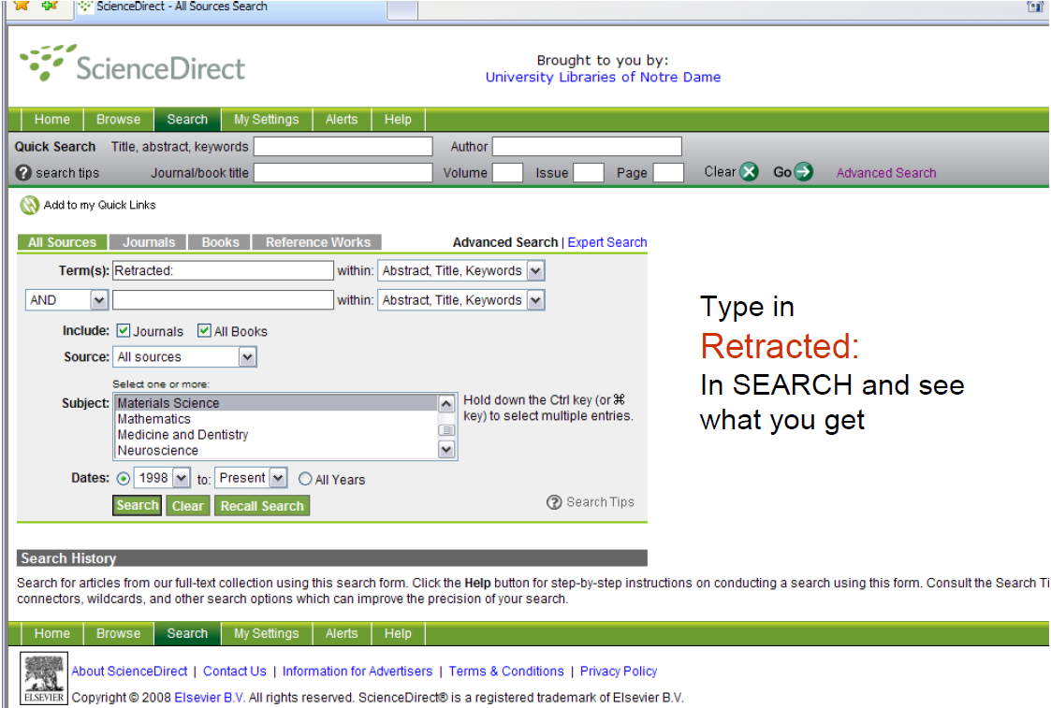

Slide 32
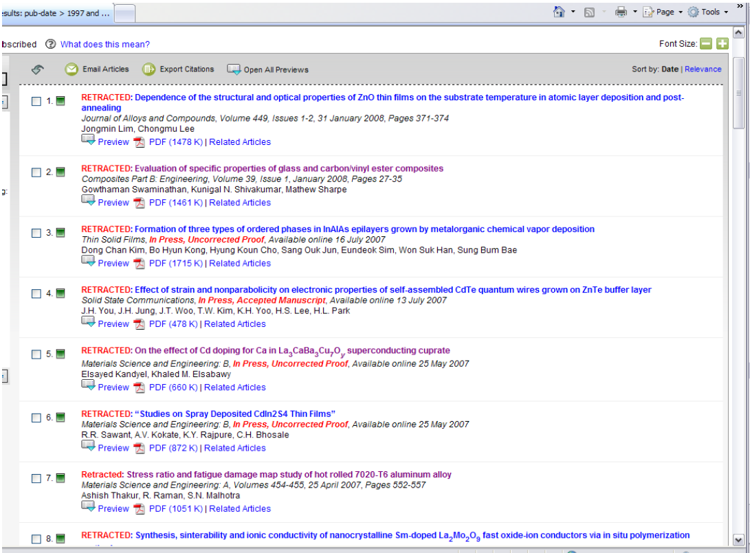

Slide 33
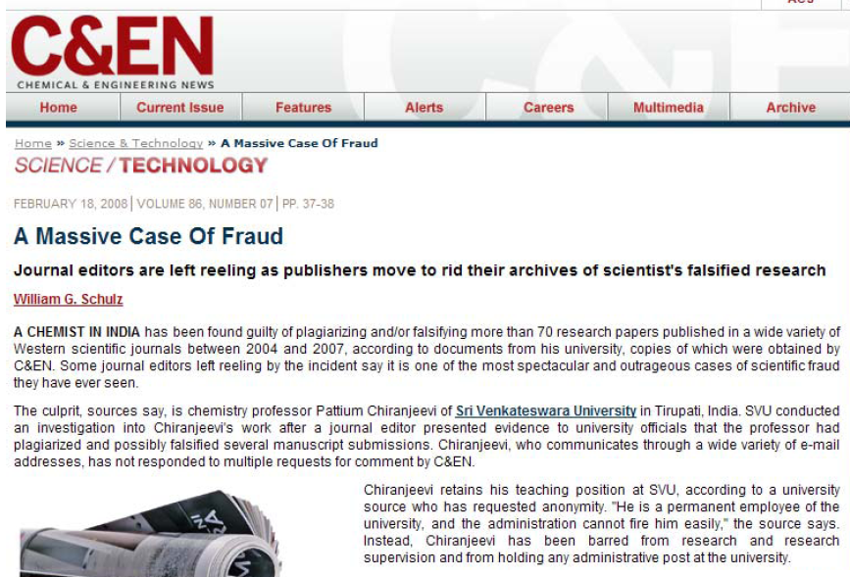

Slide 34
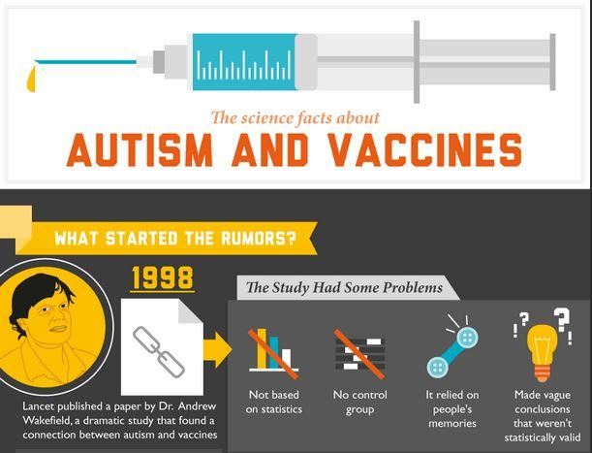

Slide 35
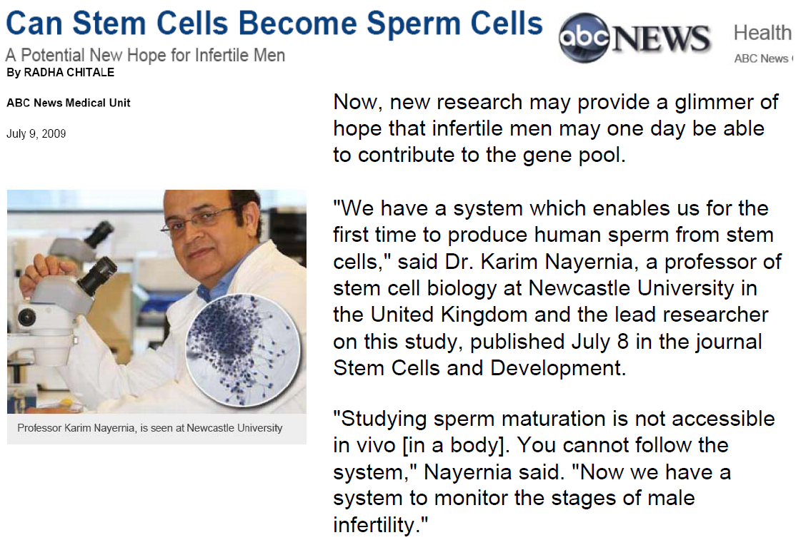

Slide 36
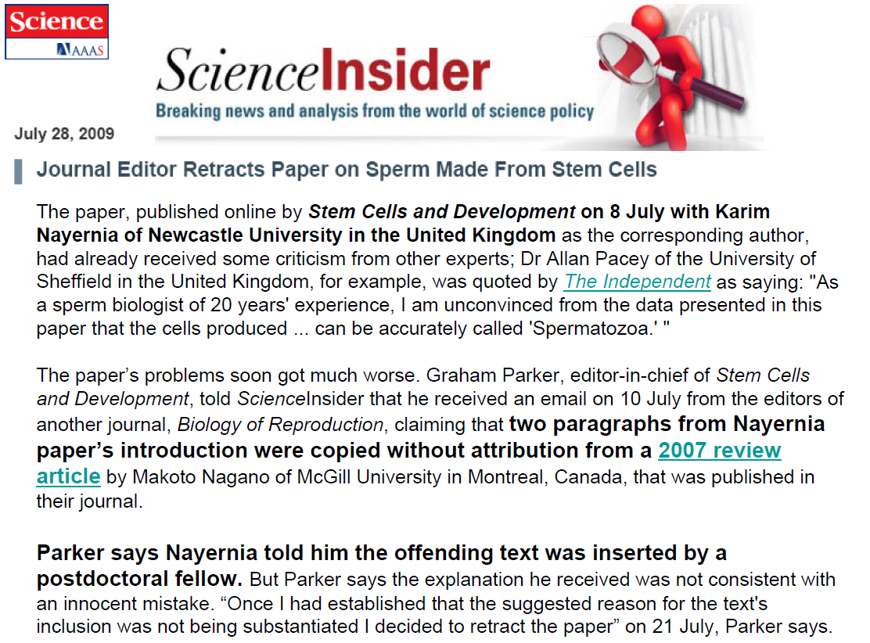

Slide 37
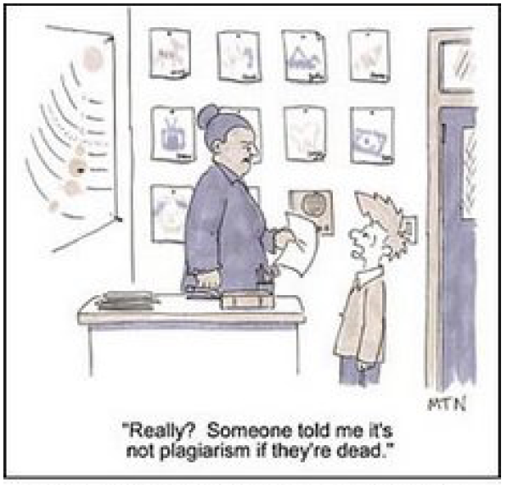

Slide 38
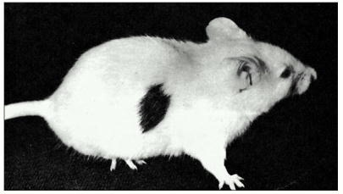
Skin graft

Slide 39
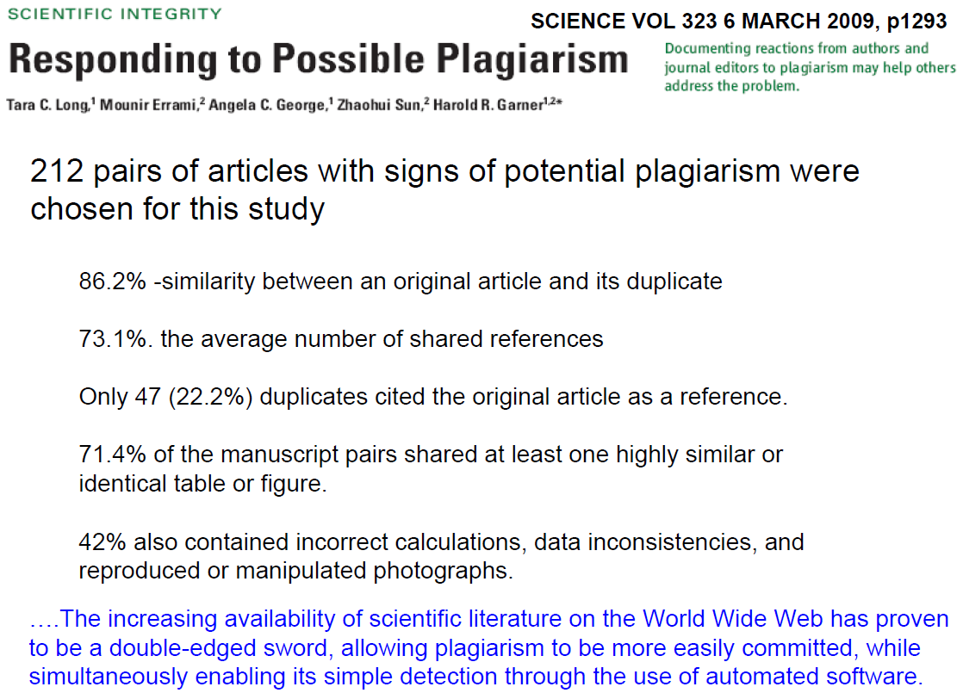

Slide 40
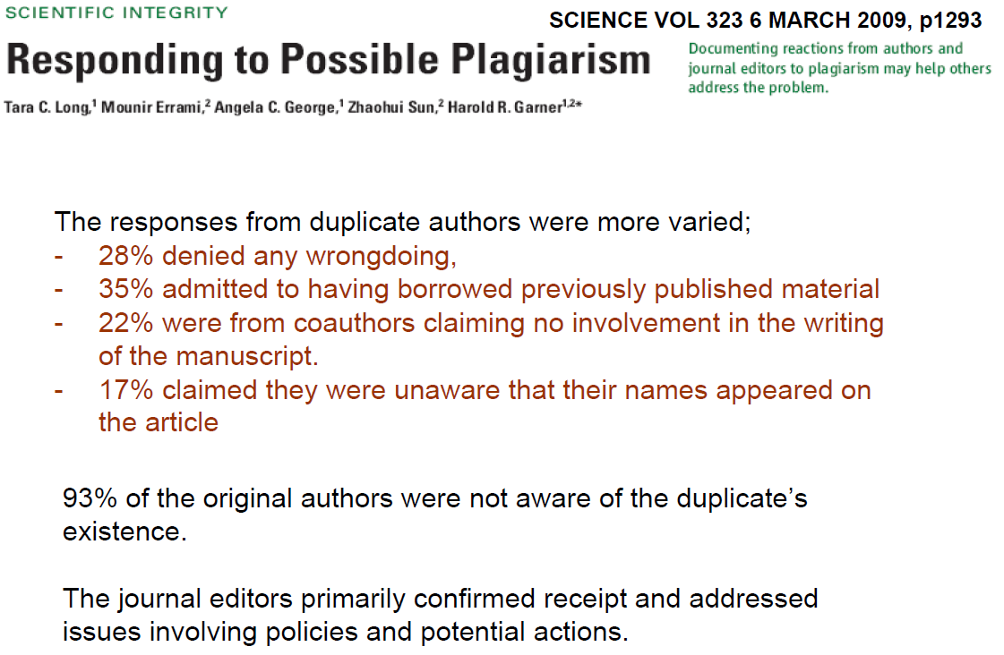

Slide 41
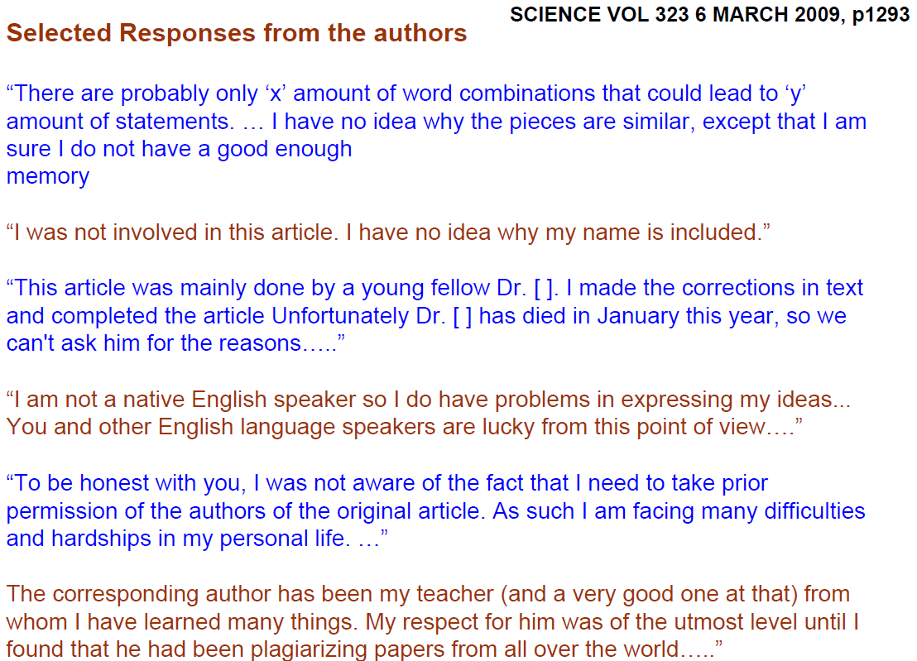

Slide 42
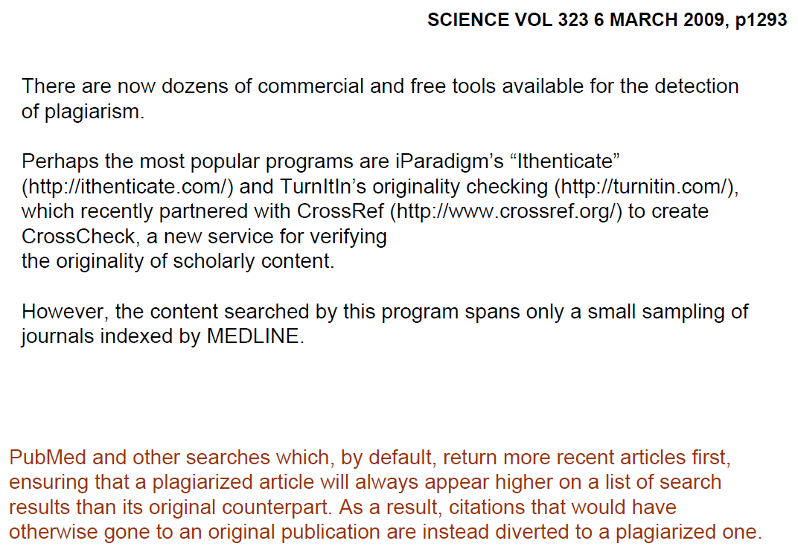

Slide 43
Or simply google a nice sentence…

Slide 44
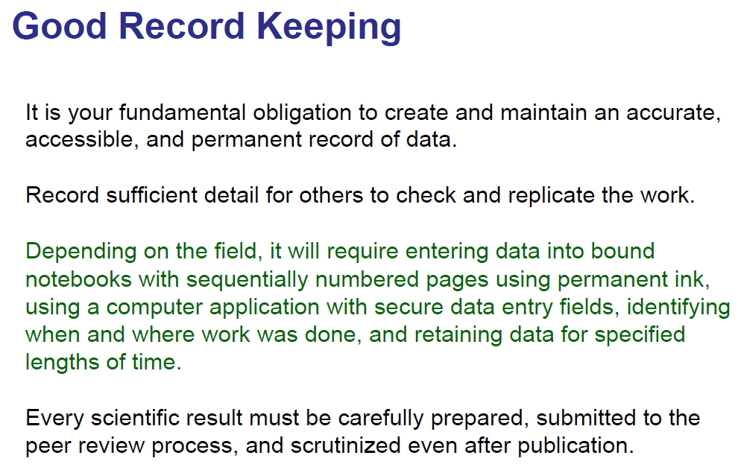

Slide 45
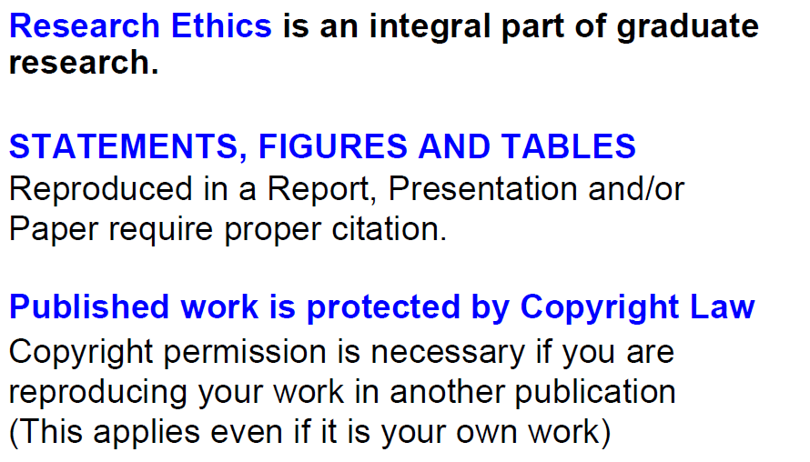

Slide 46
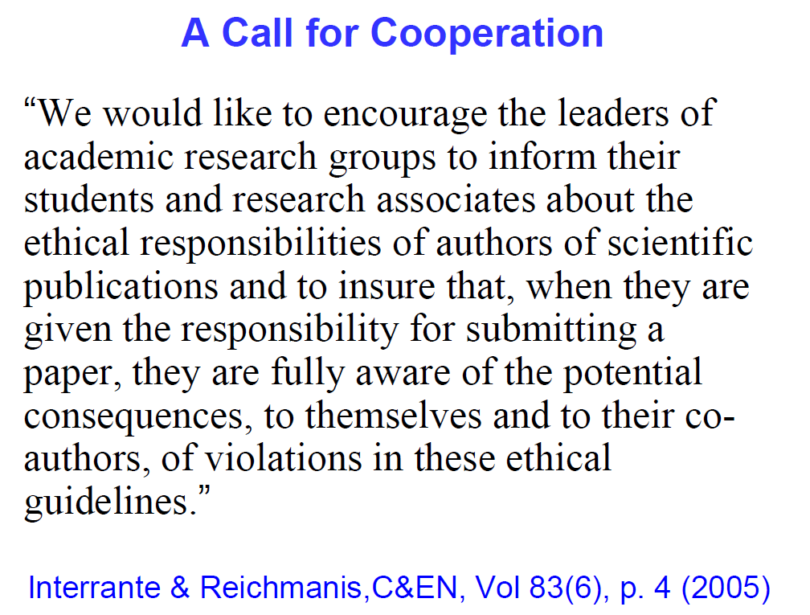

Slide 47
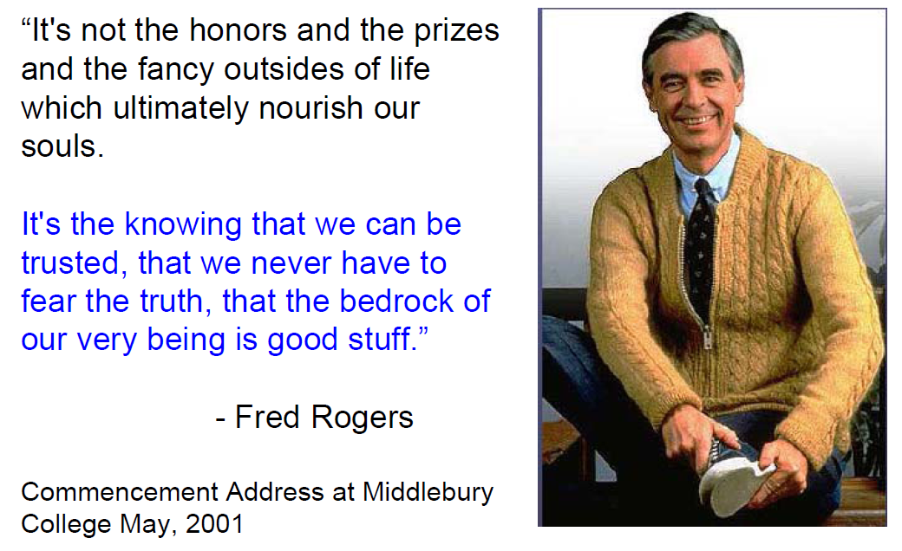

Slide 48
