Slide 1

Scientific writing (81-933) Lecture 11: Grants
Dr. Avraham Samson
Faculty of Medicine in the Galilee

Slide 2
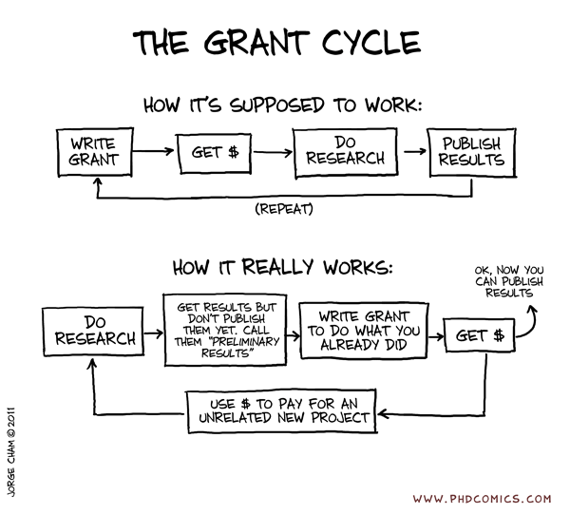

Slide 3
Funding agencies (few examples)
National (Israel)
Israel Science foundation (ISF)
National Science foundation (NSF)
Ministry of Science and Technology (MOST)
Israel cancer association
Binational
US-Israel Binational Science Foundation (BSF)
Binational Agricultural Research and Development (BARD)
German Israel foundation (GIF)
International
National Institute of Health (NIH)
European Research Council (ERC)

Slide 4
NIH grants overview
NIH funding criteria:
Significance: ability of the project to improve health
Approach: feasibility of your methods and appropriateness of the budget
Innovation: originality of your approach
Investigator: training and experience of investigator(s)
Environment: suitability of facilities and adequacy of support from your institution

Slide 5
grants overview
NIH Grant Proposals:
Title
Abstract
Specific Aims
Background & Significance
Preliminary Studies
Experimental Design and Methods
Appendix

Slide 6
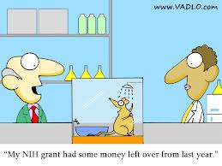

Slide 7
Grants help online
NIH Grant Proposals
http://grants1.nih.gov/grants/oer.htm
“All About Grants” tutorials:
http://www.niaid.nih.gov/ncn/grants/default.htm

Slide 8
Grant-writing tips
Writing tips straight from the NIH website:

Slide 9
Summary of grant-writing tips
1. Write to Your Audience
A few reviewers will be familiar with your techniques or field, but the majority will not be
Write to teach your audience (like a Scientific American article)
Write and organize your application so the primary reviewer can readily grasp and explain what you are proposing.
Most likely the other reviewers will read only your abstract, significance, and specific aims. Keep these simple and nontechnical (big picture).
All reviewers are important because each reviewer gets one vote.

Slide 10
grant-writing tips
Caveat: “Be very careful with your highly technical material. Some of the reviewers may be better informed about your field than you. To succeed, you will have to be at least as savvy as the savviest reviewer in the group. Leave out anything that's not critical. The more you put in, the more information there is for reviewers to find fault or disagree with.”

Slide 11
grant-writing tips
2. “Be Persuasive, But Be Careful of Being Too Innovative”
Tell the reviewers:
why testing your hypothesis is worth funding
why you are the person to do it
how your institution can give you the support you'll need
The innovation criterion can be tricky:
Beware of being far outside the mainstream of thought.
If your proposal is highly innovative, you'll need to make a very strong case for why you are challenging the existing paradigm and have data to support your innovative approach.

Slide 12
grant-writing tips
3. Make Life Easy for Reviewers
~Make your application user friendly (reviewers get worn out having to read 10 to 15 applications!):
Label all materials clearly
Keep it short and simple
Start with basic ideas and move progressively to more complex ones (recall inverted pyramid!)
Guide reviewers with graphics (visually appealing)
Edit and proofread

Slide 13
grant-writing tips
4. Familiarize yourself with the primary reasons projects don’t get funded:
Problem not important enough.
Study not likely to produce useful information.
Studies based on a shaky hypothesis or data.
Alternative hypotheses not considered.
Methods unsuited to the objective.
Problem more complex than investigator appears to realize.
Not significant to health-related research.
Too little detail in the research plan to convince reviewers the investigator knows what he or she is doing (no recognition of potential problems and pitfalls).

Slide 14
grant-writing tips
Proposal driven by technology (i.e., a method in search of a problem).
Issue is scientifically premature.
Over-ambitious research plan with an unrealistically large amount of work.
Direction or sense of priority not clearly defined (i.e., the experiments do not follow from one another), lack a clear starting or finishing point.
Lack of original or new ideas.
Investigator too inexperienced with the proposed techniques.
Proposed project a fishing expedition lacking solid scientific basis (i.e., no basic scientific question being addressed).

Slide 15
grant-writing tips
Rationale for experiments not provided (why important, or how relevant to the hypothesis).
Experiments too dependent on success of an initial proposed experiment. Lack of alternative methods in case the primary approach does not work out.
Proposed model system not appropriate to address the proposed questions.
Relevant controls not included.
Proposal lacking enough preliminary data or preliminary data do not support project's feasibility.
Insufficient consideration of statistical needs.
Not clear which data were obtained by the investigator and which reported by others.

Slide 16
grant-writing tips
Write with these pitfalls in mind! Convince the reviewers that your project doesn’t have one of these fatal flaws (cover all your bases).

Slide 17
grant-writing tips
Write, Edit, and Proof Like a Pro (apply what you’ve learned in this course)
Straight from the NIH website:
Start with an outline.
Write a topic sentence for each main topic.
Make one point in each paragraph.
Paragraphs have two functions: they aggregate information point by point and they break up the page, creating much-needed white space. Keep them short.
Divide the document into sections and subsections.
Include bullets and lists.
Use short sentences with a basic structure: subject, verb, object.
Keep sentence average to 20 words or less. Keep subject, verb, and object together at the beginning of the sentence.

Slide 18
grant-writing tips
More tips from the NIH…
Keep related ideas and information together
Use strong, active verbs
Use verbs instead of abstract nouns. Turn abstract nouns ending in 'ion' and 'ment' into verbs. For example, say 'creating the assay leads to...' rather than 'the creation of the assay leads to...'
If writing is not your forte, get help.

Slide 19
grant-writing tips
6. Edit Before Sending in Your Application
Edit out redundant words and phrases (cut, cut, cut!)
Get outside opinions on the writing and presentation.
Cross-check all data and information for consistency.
After you're finished, leave it for a few days, then go back and read it again.
Highlight and review your conclusions.
Is there any way your supporting facts might lead a reader to different conclusions?
Make sure you've supported all facts with citations.
Edit and proofread thoroughly.
Have others proofread as well, including nonscientists with strong English skills (work with a good editor!)

Slide 20


Slide 21
NIH grants overview
NIH Grant Proposals:
Title
Abstract
Specific Aims
Background & Significance
Preliminary Studies
Experimental Design and Methods
Appendix

Slide 22
NIH Grant Proposals
Title

Slide 23
Title
Keep to word or character limit (NIH has 56-character limit, including the spaces between words and punctuation).
Identify topics, purpose, and novel aspects or methodology
Choose a title that is specifically descriptive, rather than general.
Be accurate, complete, specific, and concise.
Avoid jargon, unnecessary details, and abbreviations.
A new application must have a different title from any other PHS project with the same principal investigator/program director.

Slide 24
NIH Grant Proposals
Abstract

Slide 25
Abstract
Abstract
200 word limit for NIH
Keep it simple and broad. The abstract is read by all of the reviewers and is of critical importance.
Includes:
Broad research question
Hypothesis to be tested (*remember NIH primarily funds hypothesis-driven research)
Overview of specific aims
Statement of the significance of the research and how it is innovative
Outline of the methods
Excludes
confidential or proprietary information

Slide 26
NIH Grant Proposals
Specific Aims

Slide 27
Specific Aims
Specific Aims
One page is recommended.
Limit to 3 or 4 specific aims.
The specific aims are read by all of the reviewers and are of critical importance. Write in clear, focused, non-technical terms.
The Specific Aims are a list of:
The broad, long-term objectives and what the specific research proposed in this application is intended to accomplish, e.g..:
to test a stated hypothesis,
to create a novel design,
to solve a specific problem, OR
to develop new technology

Slide 28
Alternative 1
State overall objective
. . . We propose to address this objective by testing the following hypotheses:
1. <hypothesis 1> 2. <hypothesis 2> 3. <hypothesis 3>
4. <hypothesis 4> (maximum of 3-4 hypotheses)
. . . To test these hypotheses, we will address the following specific aims:
1. <specific aim 1> 2. <specific aim 2> 3. <specific aim 3>
4. <specific aim 4> (maximum of 3-4 specific aims)

Slide 29
Alternative 2
The primary study objective is to <describe>, and will address 3 hypotheses of interest:
Hypothesis 1: Describe hypothesis or state as question.
Briefly describe method or approach to address hypothesis
State expected gains in knowledge by addressing hypothesis
Hypothesis 2: Describe hypothesis or state as question.
Briefly describe method or approach to address hypothesis
State expected gains in knowledge by addressing hypothesis
Hypothesis 3: Describe hypothesis or state as question.
Briefly describe method or approach to address hypothesis
State expected gains in knowledge by addressing hypothesis
Can include 1-2 secondary hypotheses if absolutely necessary.

Slide 30
Alternative 3
State overall objective
Specific Aim # 1: To <describe primary aim>
Put specific aim in context of literature or state significance
State hypothesis (can do in form of a question)
Briefly describe method or innovative approach to address SA
Specific Aim # 2: To <describe primary aim>
Put specific aim in context of literature or state significance
State hypothesis (can do in form of a question)
Briefly describe method or innovative approach to address SA
Specific Aim # 3: (try to limit to 2-3 primary aims)
Can include 1-2 secondary specific aims if absolutely necessary.

Slide 31
NIH Grant Proposals
Background & Significance

Slide 32
Background & Significance
Background and Significance
One to two pages recommended
This is NOT a literature review
Do not attempt to be exhaustive; limit to 30-50 key citations
Tell it like a story
Critical Elements:
Briefly sketch the pivotal work leading up to yours
Critically evaluate existing knowledge
Specifically identify the gaps that the project is intended to fill
State concisely the importance and health relevance of the research.
Note: this does not mean convincing the researchers that the disease to which the research relates is significant.

Slide 33
NIH Grant Proposals
Preliminary Studies

Slide 34
Preliminary Studies
Preliminary Studies
Preliminary data are an essential part of a research grant application. They establish the ability of you and your research team to carry out the proposed studies.
Critical Elements:
Provide an account of the principal investigator/program director's preliminary studies pertinent to the application
Establish the experience and competence of the investigator
Help reviewers assess the likelihood of success of the proposed project.

Slide 35
NIH Grant Proposals
Experimental Design and Methods

Slide 36
Experimental Design and Methods
Experimental Design and Methods
Describe the research design and the procedures to be used to accomplish the specific aims of the project.
Note: 12-page limit for the complete “Research Plan” (background & significance, preliminary studies, and experimental design and methods).

Slide 37
Experimental Design and Methods
Experimental Design and Methods
Describe:
How the data will be collected
How the data will be analyzed and interpreted (statistics)
Data sharing plans as appropriate
Any new methodologies and their advantages
Potential difficulties and limitations of the proposed procedures
Any hazardous procedures, situations, or materials that may be and the precautions that will be followed to maximize safety
Also, provide a tentative sequence or timetable for the project.

Slide 38
NIH Grant Proposals
Appendix

Slide 39
Appendix
Appendix materials may include:
Up to 10 publications, manuscripts (accepted for publication), abstracts, patents, or other printed materials directly relevant to this project.
Surveys, questionnaires, data collection instruments, and clinical protocols.
Original glossy photographs or color images of gels, micrographs, etc., IF a photocopy (may be reduced in size) is also included within the 12-page limit of the research plan.
Note: Do not use the appendix to circumvent the page limitations of the research plan.

Slide 40
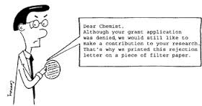
Never give up! For every grants received, ten are rejected

