Slide 1

Scientific writing (81-933)
Lecture 12: Summary
Dr. Avraham Samson
Faculty of Medicine in the Galilee

Slide 2
TIP 1: Write cleanly…
“The secret of good writing is to strip every sentence to its cleanest components. Every word that serves no function, every long word that could be a short word, every adverb that carries the same meaning that’s already in the verb, every passive construction that leaves the reader unsure of who is doing what—these are the thousand and one adulterants that weaken the strength of a sentence. And they usually occur in proportion to the education and rank.”
-- William Zinsser in On Writing Well, 1976

Slide 3
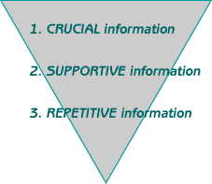
TIP 2: Use inverted pyramid style

Slide 4
TIP 3: Use subject verb object
Subject verb object.
Subject verb object.
Subject verb object…

Slide 5
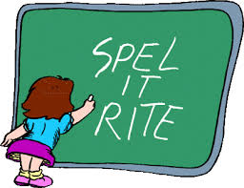
TIP 4: Use spell check
Use spell check!!!

Slide 6
Grand Finale Quiz…

Slide 7
Question 1.
A. She eluded to the fight that occurred earlier.
B. She alluded to the fight that occurred earlier.

Slide 8
Question 2.
A. Receptor activation is triggered by agonists, and inhibiting is mediated by antagonists.
B. Receptor activation is triggered by agonists, and inhibition is mediated by antagonists.
Can you think of something shorter?

Slide 9
Question 3
A. She eluded the fight.
B. She alluded the fight.

Slide 10
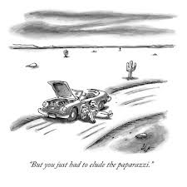

Slide 11
Question 4.
A. The corpus callosum is located in close proximity to the amygdala.
B. The corpus callosum is located near the amygdala.

Slide 12
Question 5.
A. The close friendship that existed between them was quickly dissolved.
B. The close friendship that existed among them was quickly dissolved.

Slide 13
Question 6.
A. The cells divide rapidly.
B. The cells divide in a flash.

Slide 14
Question 7
A. She lies out in the sun.
B. She lays out in the sun.

Slide 15
Question 8.
A. P53 was phosphorylated and the cell undergoes apoptosis.
B. P53 was phosphorylated and the cell underwent apoptosis.

Slide 16
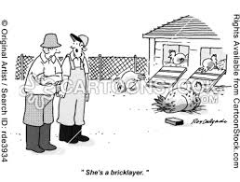

Slide 17
Question 9.
A. She is lying out in the sun.
B. She is laying out in the sun.

Slide 18
Question 10.
A. He writes english well.
B. He writes english good.

Slide 19
Question 11.
A. She lies the book on the table.
B. She lays the book on the table.

Slide 20
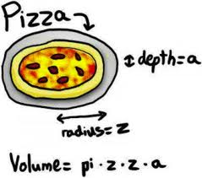

Slide 21
Question 12.
A. The atomic radiuses of Mg⁺² and Mn⁺² are similar.
B. The atomic radii of Mg⁺² and Mn⁺² are similar.

Slide 22
Question 13.
A. She is lying the book on the table.
B. She is laying the book on the table.

Slide 23
Question 14.
The student is irresponsible.
The student is unresponsible

Slide 24
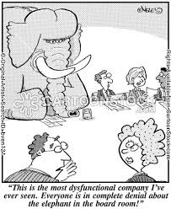

Slide 25
Question 15.
A. The mouse is dysfunctional
B. The mouse is disfunctional.

Slide 26
Question 16.
A. The author is misinformed
B. The author is dysinformed

Slide 27
Question 16.
A. The dean disapproves of mistakes.
B. The dean dysapproves of mistakes.

Slide 28
Question 17.
The mouse is transgenic. It expresses green fluorescent protein. The mouse glows.
The mouse is transgenic. Green fluorescent protein is expressed. It glows.

Slide 29
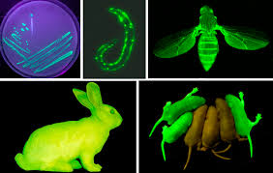

Slide 30
Question 18.
A. We studied the affects of the gene on signaling.
B. We studied the effects of the gene on signaling.

Slide 31
Question 19.
Gram positive bacteria were died purple.
Gram positive bacteria were dyed purple.

Slide 32
Question 19.
A. He owed over $1000 to the doctor.
B. He owed more than $1000 to the doctor.

Slide 33
Question 20.
Here, we study the interaction of ligands A, B, and C with receptor D.
Here, we study the interaction between ligands A, B, C, and receptor D.

Slide 34
Question 21.
A. Your procrastination had an averse effect on your grade.
B. Your procrastination had an adverse effect on your grade.

Slide 35
Question 21.
The phenomenon remains unexplained.
The phenomena remains unexplained.

Slide 36
Question 22.
A. The bacteria were treated gently.
B. The bacteria was treated gently.

Slide 37
Question 23.
The mass spectrum was collected overnight.
The mass spectra was collected overnight.

Slide 38
Question 24.
A. That man and I were talking.
B. That man and me were talking.

Slide 39
Question 25.
A. She told Bob and me that the end was near.
B. She told Bob and I that the end was near.

Slide 40
Question 26.
A. That 17th-century pot is a historical piece.
B. That 17th-century pot is a historic piece.

Slide 41
Question 27.
It is estimated that no more than a dozen albino crocodiles live in the wild.
Less than 12 albino crocodiles are estimated to live in the wild.

Slide 42
Question 27.
A. Enzyme levels are different in healthy and sick populations.
B. Enzyme levels are higher in healthy subjects than in the sick population.

Slide 43
Question 28.
Compared to the wild type, the transgenic mouse moves slowly.
In comparison to the wild type, the transgenic mouse moves slower.

Slide 44
Question 28.
A. He died of unknown causes.
B. He died from unknown causes.

Slide 45
Question 29.
A. To whom did you betray my secret?
B. To who did you betray my secret?

Slide 46
Question 30.
A. The person about who you speak is a fool.
B. The person about whom you speak is a fool.

Slide 47
Question 31.
A. It’s my head on the line.
B. Its my head on the line.

Slide 48
Question 32.
A. He’s not rational at that time of the day.
B. He’s not rationale at that time of the day.

Slide 49
Question 32.
A. Her rationale was that the drugs would help alleviate the pain.
B. Her rational was that the drugs would help alleviate the pain.

Slide 50
Question 33.
A. That action violated her principles.
B. That action violated her principals.

Slide 51
Question 34.
A. Each person is responsible for their grade.
B. Each person is responsible for his grade.

