Slide 1

Scientific writing (81-933) Lecture 2: Materials and methods
Dr. Avraham Samson
Faculty of Medicine in the Galilee

Slide 2
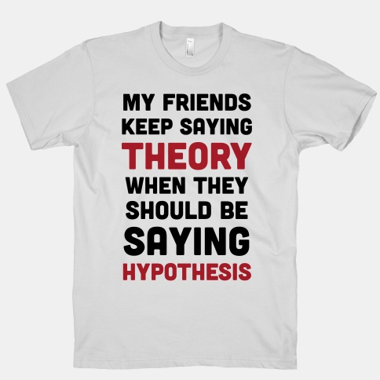

Slide 3
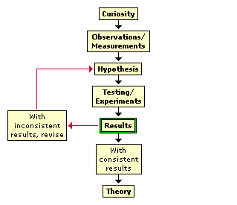
The scientific method

Slide 4
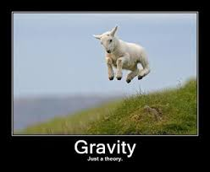
Listen to the Feinman lectures

Slide 5
Materials and methods
M&M has many names:
Experimental procedures
Methods
Computational methods
Methodology

Slide 6
Materials and methods
Always use the past tense.
Use subheadings.
Provide enough details for reproducibility. (Else submit to “Journal of Irreproducible Results”.)
How much detail is too much? Depends! For brevity, refer to methods already published.
For long protocols use: First, Then, Following, and Finally.

Slide 7
Materials and Methods
Materials: quantity, (purity, purveyor, brand, machine type, gift)
For example:
-Cell pellets were resuspended in 300 μl of SDS lysis buffer (1% SDS, 10 mM EDTA, 50 mM Tris-HCl, pH 8.1) and agitated intermittently for 10 min on ice.
-Protein samples were concentrated to 10 mg/ml (0.32 mM) in 50 mM sodium phosphate (pH 7.4) and heated to 37 °C.
-Images were taken on a Zeiss Axiovert 200 microscope equipped with a Sensicam PCO camera and analyzed using Image Pro Plus (version 6.1).
-6.02 x 10²³

Slide 8
Materials and Methods
Software: publisher, (computer type, operating system)
For example:
Solvent accessible surface was calculated using PyMOL (Schrödinger)
The program was run on a 2.3 GHz PC equipped with 4 GB RAM.

Slide 9
Materials and methods
-Calculation of solvent accessible surface was carried out using the DSSP program.
→ To calculate solvent accessible surface, the DSSP program was used.
→ Solvent accessible surface was calculated using the DSSP program.

Slide 10
Protocols
EDTA buffer (0.5 M, pH 8.0)
dissolve 186.1 g EDTA (disodium salt) in 800 ml H₂O
while stirring, gradually add 20.0 g NaOH
adjust with water to 950 ml
adjust the pH to 8.0 using 1.0 M NaOH
adjust with water to 1.0 l
autoclave

Slide 11
Material and methods
To prepare the EDTA buffer (0.5 M, pH 8) 186 g EDTA and 20 g NaOH were dissolved in 800 mL water. Then, the buffer was adjusted to pH 8 using 1 M NaOH. Then, the buffer was adjusted to a final volume of 1 L with water. Finally, the buffer was autoclaved.
-> Then, 5 ml EDTA buffer (0.5 M, pH 8) were added to the sample.

Slide 12
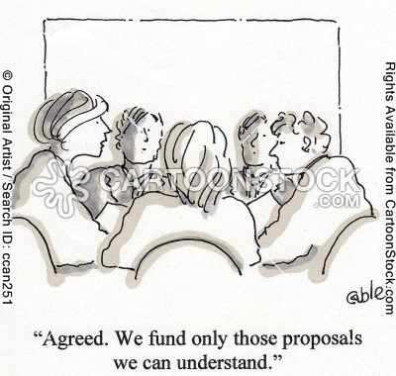

Slide 13
What scientific writers can learn from journalists…
That a clear, succinct, informative writing style is best and…
That holding your reader’s attention matters!

Slide 14
That a clear, succinct, informative writing style is best and…
We were introduced to many of these principles last time.

Slide 15
More principles of news writing…
Don’t use a complicated word when a simple one will do.
Avoid jargon, clichés, and euphemisms.
Don’t cram too much into one sentence.
Avoid redundancy and repetition.
Use active verbs and follow the usual conversational flow of words
Use facts, not opinion.
Be specific.

Slide 16
Don’t use a complicated word when a simple one will do.
→see last week’s lesson.
Has anyone ever counted the average number of letters per word in the newspaper?

Slide 17
More principles of news writing…
Don’t use a complicated word when a simple one will do.
Avoid jargon, clichés, and euphemisms.
Don’t cram too much into one sentence.
Avoid redundancy and repetition.
Use active verbs and follow the usual conversational flow of words
Use facts, not opinion.
Be specific.

Slide 18
Avoid jargon
Jargon is the specialized vocabulary of any profession, trade, or scientific field.
Beware of your audience!
Examples:
Gnorimoschema gallaesolidaginis (henceforth ‘gall moth’)…
Some organisms have life histories characterized by death after first reproduction (i.e. semelparity).

Slide 19
Avoid jargon
Don’t overestimate your reader’s knowledge and don’t underestimate their intelligence.
Original:
Genetic abnormalities often result in sterility, such as in Turner syndrome.
Possible Revision:
Genetic abnormalities often result in sterility, such as in Turner syndrome, a condition in which a female is missing an X chromosome.

Slide 20
Scientific Phrase | Translation
“It has long been known” | I didn't look up the original reference.
“A definite trend is evident” | These data are practically meaningless.
“Three of the samples were chosen for detailed study” | The other results didn't make any sense.
“Typical results are shown” | This is the prettiest graph.
“These results will be in a subsequent report” | I might get around to this sometime, if pushed/funded.
“The most reliable results are obtained by Jones” | He was my graduate student; his grade depended on this.
“In our experience” | Once.
“In case after case” | Twice.
“In a series of cases” | Thrice.
“It is believed that” | I think.
“It is generally believed that” | A couple of other guys think so too.
“According to statistical analysis” | Rumor has it.
“A statistically oriented projection of the significance of these findings” | A wild guess.
“It is clear that much additional work will be required before a complete understanding of this phenomena occurs” | I don't understand it.
“A highly significant area for exploratory study” | A totally useless topic selected by my committee.
“It is hoped that this study will stimulate further investigation in this field” | I quit.
Schingman D. Scientific Jargon. Western Journal of Medicine. 2000;172(2):106.

Slide 21
Avoid clichés like the plague…
In a jiffy: This means something will happen soon
The time of my life: This refers to a really great time
At the speed of light: This means something done very quickly.
As old as the hills: This describes someone very old
Fit as a fiddle: This describes someone in great shape
Without a care in the world: This describes someone who is not plagued by problems or worries
A diamond in the rough: This describes someone who has a great future.
http://examples.yourdictionary.com/examples-of-cliches.html

Slide 22
Euphemisms
-accept the resignation of
-economically disadvantaged
-limited success
-pre-owned
-underachiever
-collateral damage

Slide 23
Euphemisms
“Collateral damage is one of those antiseptic sounding euphemisms that are sometimes more chilling than plain language, so hard do they labor to conceal their human meaning.”--Hendrik Hertzberg in the New Yorker

Slide 24
More principles of news writing…
Don’t use a complicated word when a simple one will do.
Avoid jargon, clichés, and euphemisms.
Don’t cram too much into one sentence.
Avoid redundancy and repetition.
Use active verbs and follow the usual conversational flow of words
Use facts, not opinion.
Be specific.

Slide 25
This is a single sentence…
Because septin filaments mark the site for cytokinesis, and because there is a specific cell cycle checkpoint that monitors the state of septin filament assembly, that we also discovered such knowledge may allow, ultimately, the development of therapeutic agents and clinically valuable strategies, on the one hand, to impose a permanent checkpoint arrest as a means of halting the growth of malignant cells in various cancers, including breast cancer, and, on the other, to overcome such checkpoints to re-activate proliferation of quiescent differentiated cells (for example, to stimulate multiplication of the residual beta-cells in patients suffering from Type 1 diabetes as a means to repopulate the pancreatic islets with insulin-producing cells).

Slide 26
Avoid using two or more words that mean the same thing (redundancy).
The hero begins to behave strangely and in odd ways following his tryst with a witch he meets secretly at midnight.
→ The hero begins to behave strangely following his tryst with a witch he meets secretly at midnight.

Slide 27
Do not repeat a word unless you need it again for clarity or emphasis (i.e., avoid repetition)
When he was a student, his favorite classes were the classes that gave no homework.
→ When he was a student, his favorite classes were those that gave no homework.
When he was a student, his favorite classes gave no homework.

Slide 28
Caveat: Keep your sentences short but not too short that they are choppy.
Example: (from Successful Science Writing)
Two canine cadavers with orthopedic abnormalities were identified. The first dog had an unusual deformity. It was secondary to premature closure of the distal ulnar physis. The second dog had a hypertrophic nonunion of the femur. The radius and femur of both dogs were harvested. They were cleaned of soft tissue.
**News writers use the dash, semicolon, and colon to merge choppy sentences together (we’ll learn how craft deft sentences with these tools next time).

Slide 29
More principles of news writing…
Don’t use a complicated word when a simple one will do.
Avoid jargon, clichés, and euphemisms.
Don’t cram too much into one sentence.
Avoid redundancy and repetition.
Use active verbs and follow the usual conversational flow of words
Use facts, not opinion.
Be specific.

Slide 30
STRONG VERBS carry the main idea of the sentence and sweep the reader along
Put your sentences on a “to be” diet…
Is, are, was, were, be, been, am…

Slide 31
There are many ways in which we can arrange the Petri dishes.
→We can arrange the Petri dishes many ways.
There was a long line of bacteria on the plate.
→Bacteria lined the plate.

Slide 32
Again, this doesn’t mean never use “to be”—it has a distinct purpose in the English language…
Just use it purposefully and sparingly.
“The logic was perverse.”
“..and a few months later the Spanish Empire was gone.”

Slide 33
Recall from last time…
“Subject verb object”
“Subject verb object”
“Subject verb X”

Slide 34
MYTH: The passive voice is more objective.
It’s not more objective, just more vague.
Active=claiming responsibility

Slide 35
Passive:
Major differences in the reaction times of the two study subjects were found.
→
Active:
We found major differences in the reaction times of the two study subjects.

Slide 36
Passive:
Migraine was defined as a headache that lasts for more than 1 hour.
→
Active:
We defined migraine as a headache that lasts for more than 1 hour.

Slide 37
The active voice is direct, vigorous, natural, and informative.

Slide 38
A note about breaking the rules…
Most writing rules are guidelines, not laws, and can be broken when the occasion calls for it.

Slide 39
For example, sometimes it is appropriate to use the passive voice.
When the action of the sentence is more important than who did it (e.g., materials and methods)
Three liters of fluid were filtered through porous glass beads.
To emphasize someone or something other than the agent that performed the action
The Obamas were honored at the banquet.
When the subject is unknown
“The professor was assaulted in the hallways”– they do not know the perpetrator of this heinous crime.

Slide 40
More principles of news writing…
Don’t use a complicated word when a simple one will do.
Avoid jargon, clichés, and euphemisms.
Don’t cram too much into one sentence.
Avoid redundancy and repetition.
Use active verbs and follow the usual conversational flow of words
Use facts, not opinion.
Be specific.

Slide 41
Watch out for loaded words (which suggest an opinion):
savage, primitive, conniving, lazy, superstitious, wily, crafty, docile, backward, bitter, pompous, working class, communist, eco-freak, others?…

Slide 42
More principles of news writing…
Don’t use a complicated word when a simple one will do.
Avoid jargon, clichés, and euphemisms.
Don’t cram too much into one sentence.
Avoid redundancy and repetition.
Use active verbs and follow the usual conversational flow of words
Use facts, not opinion.
Be specific.

Slide 43
Be specific…
Police arrested Willie Deeds, an elderly man, after he used a note to rob the bank earlier this year.
Police arrested Willie Deeds, 72, after he used a note to rob the bank in January.

Slide 44
What scientific writers should learn from journalists
That a clear, succinct, informative writing style is best and…
That holding your reader’s attention matters.

Slide 45


Slide 46
“My professor friend told me that in his academic world, “publish or perish” is really true. He doesn’t care if nobody reads it or understands it as long as it’s published.” --The joys and pains of writing, Le Bon Journal
Is there a hint of truth here?

Slide 47
What makes stories newsworthy?
Impacts lots of people
Breaking news
Timeliness
Prominence
Proximity
Conflict
Trends
Humor/Surprise

Slide 48
Inverted pyramid style
Place the most important and surprising facts at the beginning and work "down" from there. The rest of the article explains and expands on the beginning.
A good approach is to assume that the story might be cut off at any point due to space limits. Does the story work if we only include the first two paragraphs? If not, re-arrange it so that it does.

Slide 49
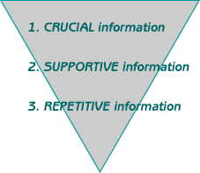
Inverted pyramid style

Slide 50
Crucial Information
Journalism: The Five "W"s and the "H"
Who? What? Where? When? Why? How? Any good news story provides answers to each of these questions.

Slide 51
The kick line
The ending.
Leaves the reader feeling satisfied.
Often circles back to the lead.

Slide 52
Beware of these no/no’s…
Leave out names that mean nothing to the reader
Never start with a quote unless it’s the President or the Pope speaking (or it’s as evocative as “Francis Crick is an idiot.…”)
Never “fool” your reader (i.e. start with something that you’re later going to retract or contradict).

Slide 53
Attribution
“Blah, blah, blah, blah,” Professor Smith said.
NOT: “Blah, blah, blah, blah,” said Professor Smith.
SV!
Unless: “Blah, blah, blah, blah,” said Professor Smith, the really boring professor that we all had to take English from (long attribution—sounds awkward to say Prof. Smith, the really boring professor that we all had to take English from, said!).

Slide 54
Attribution
Prefer “said” to most other possibilities, such as “noted” and “remarked,” which have particular connotations…
Noted implies that whatever the person’s statement was fact.

Slide 55
And finally…
This week’s top 5 countdown:

Slide 56
1. Fewer vs. less
Fewer goes with a countable number
Less goes with a mass quantity
I’m trying to eat fewer calories.
I’m trying to eat fewer grams of fat.
BUT…
I’m trying to eat less fat.
→“Use less if there’s no ‘S’”

Slide 57
2. “You and I” or “You and me”?
Use XX and I for the subject of the sentence (“nominative case”)
You and I went to the park.
Use XX and me for the object of a verb or preposition (“objective case”)
Just between you and me, I think that this professor is boring.
Trick: If you’d use “him” or “her” instead of “he” or “she” → then use “me” instead of “I.”

Slide 58
3. Who vs. whom
Same idea→ who is the subject and whom is the object
Again, if you’d use him/her, use whom.
Who is it?
She called to Beth, who (she believed) was nearby.
[To] whom did you mean to call?
The message was meant for whom?

Slide 59
3. Who vs. whom
“Then he’ll buy a plane ticket to Baghdad, to visit his mother and his sisters and his eighteen-year-old girlfriend, whom he has never seen, except in the picture that his mother sent when she selected the girl for him.”
‘he has never seen her.’
‘∴ ‘he has never seen whom.’

Slide 60
4. It’s vs. its
It’s is the contraction of “it is.”
It’s true.
Its is possessive.
The car stopped working after its battery died.
→ If you can substitute “it is” or “tis”use it’s.
‘Tis true.

Slide 61
5. As vs. like
Use “as” to introduce clauses (compare action)
We spent the evening as (we did) in the old days.
We wrote down every step, as good scientists should.
Use “like” (sparingly—more formal to use “similar to”) to compare nouns and pronouns
OK: Her cat is like a dog.
More formal: Her cat is similar to a dog.
BUT…
Her cat acts as a dog would.
Note: “Her cat acts similar to a dog” does not work. Therefore, don’t use ‘like’!

Slide 62
A useful note…
As Bar Ilan University students, you have online access to journals
https://auth.athensams.net
If you like, you may use my username and password 332679968

Slide 63

Another useful note…
It doesn’t matter how much time you spent writing. What matters is how much of it was uninterrupted.

