Slide 1

Scientific writing (81-933)
Lecture 3: Results
Dr. Avraham Samson
Faculty of Medicine in the Galilee

Slide 2
Results describe data
Results = the written form of data
Data are figures and tables

Slide 3
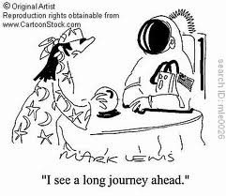
Nothing is self evident

Slide 4
Results
Cite figures or tables that present supporting data (Shown in figure 1 is…)
Report results pertinent to the main question asked (Our results confirm the hypothesis…)
Summarize the data (Our data suggest…)

Slide 5
Results
Present or past tense (Do not to switch between tenses)
Use inverted pyramid style
Use subheadings
Include negative and control results, and provide a clear idea of the magnitude of a response or a difference by reporting percent change or the percentage of difference rather than by quoting exact data

Slide 6
Results
Do results belong in the text or in a table or figure? –Both!
*text is used to elaborate results described in the figure legend. Tables do not have legends.

Slide 7
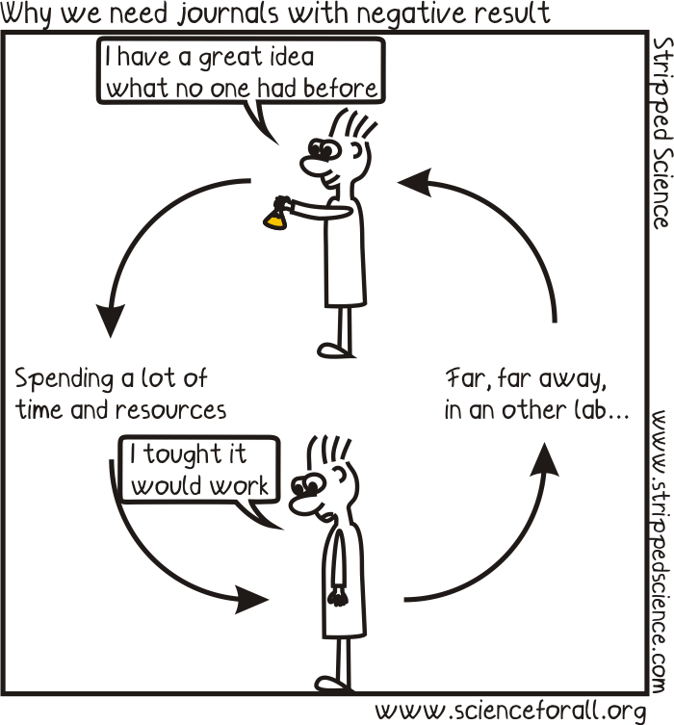

Slide 8
Writing Results: tense
Use past or present tense. Don’t mix:
We found that…
Women were more likely to…
Men smoked more cigarettes than…
Except for:
Figure 1 shows…
Table 1 displays…
The data suggest

Slide 9
Exception
Example:
Information was available for 7766 current cigarette smokers. Of these, 1216 (16%) were classified as hardcore smokers. Table 1 gives characteristics of all the smokers. The most striking difference was that hardcore smokers were about 10 years older on average and tended to be more dependent on tobacco. Significantly more hardcore smokers had manual occupations, lived in rented accommodation, and had completed their full time education by the age of 16 years. There was no difference by sex.
Jarvis et al. Prevalence of hardcore smoking in England, and associated attitudes and beliefs: cross sectional study BMJ 2003;326:1061 (17 May)

Slide 10
Results
Use active voice:
-more lively (i.e. we find…)
-since you can talk about the subjects of your experiments, “we” can be used sparingly while maintaining the active voice (i.e. the data show…)

Slide 11
Results: Active voice
Comparison with Californian estimates
Using the same definition of hardcore smoking as adopted in the Californian study, we found a prevalence of 17% across all age groups and 19% among smokers aged 26 compared with a figure of 5% for this group in the US study. When we added the Californian requirement of 15 cigarettes a day to our criteria we found a prevalence of 10% among smokers aged 26, still twice the prevalence in California
Jarvis et al. Prevalence of hardcore smoking in England, and associated attitudes and beliefs: cross sectional study BMJ 2003;326:1061 (17 May)

Slide 12
Use adjectives for highlighting results
Remarkably >> interestingly > surprisingly > unexpectedly are OK.
Excitingly < Fascinatingly < Captivatingly <Curiously << Mysteriously are not.

Slide 13
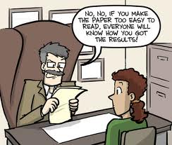

Slide 14
Punctuation, Parallelism, and the Good Sentence.

Slide 15
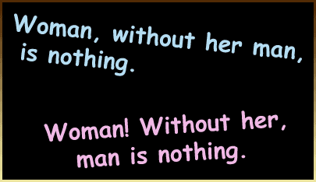
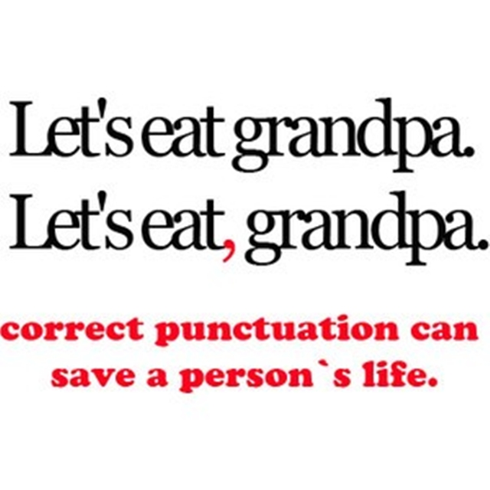

Slide 16
  Increasing power to separate:
  Comma
  Colon
  Dash
  Parentheses
  Semicolon
  Period

Slide 17
  Increasing formality:
  Dash
  Parentheses
  The Others (Comma, Colon, Semicolon, Period)

Slide 18
Period
Used at the end of a sentence.
For abbreviations: Washington, D.C. Dahan et al., J. Biol. Chem., E. Coli, etc.
In numbers: To separate units from decimals (i.e. 234,567.891)

Slide 19
Comma
1. Used to separate elements in a series
“He hit the ball, dropped the bat, and ran to first base."
“The buffer solution contained 5 mM HCl, 10 mM TRIS, and 3 mM H₂SO₄.”

Slide 20
Comma
2. Used to connect independent actions (and, but, for, nor, yet, or, so).
“He read from the book, but no one was listening."

Slide 21
Comma
3. Use a comma to set off introductory elements.
"Running into class, he suddenly realized how stupid he looked."

Slide 22
Comma
4. Use a comma to set off parenthetical elements.
"London Bridge, which spans the Thames, is falling down."

Slide 23
Parenthetical Comma (example)
  One study of 930 adults with multiple sclerosis (MS) receiving care in one of two managed care settings or in a fee-for-service setting found that only two-thirds of those needing to contact a neurologist for an MS-related problem in the prior 6 months had done so (Vickrey et al 1999).
confusing garbage

Slide 24
Parenthetical Comma (example)
  One study found that, of 930 adults with multiple sclerosis (MS) who were receiving care in one of two managed care settings or in a fee-for-service setting, only two-thirds of those needing to contact a neurologist for an MS-related problem in the prior six months had done so (Vickrey et al 1999).

Slide 25
Comma
5. Use a comma to avoid confusion.
For most the year is already finished.
For most, the year is already finished.
Luckily labs are equipped with fire extinguishers.
Luckily, labs are equipped with fire extinguishers

Slide 26
Comma
6. Typographical Reasons:
Between a city and a country (Safed, Israel), a date and the year (June 15, 2012), a name and a title (Bob Callahan, Professor of English), in long numbers (5,456,783 and $14,682), etc.

Slide 27
Comma
Use Commas With Caution
The biggest problem that most students have with commas is their overuse. Some essays look as though the student loaded a shotgun with commas and blasted away.
If you are unsure, don’t use it.

Slide 28
Semicolon (;)
Semicolon:
Indicates a pause, typically between two main clauses, that is more pronounced than that indicated by a comma.
Example:
I completed my master degree; now I have to do a PhD.
Or as a double comma:
We had students from Lima, Peru; Santiago, Chile; and Caracas, Venezuela.

Slide 29
Parentheses ()
Parenthesis (parenthetical expression):
A word, clause, or sentence inserted as an explanation or afterthought into a passage that is grammatically complete without it.
Example: The drug donepezil (Azilect) is an acetylcholine esterase inhibitor.
→ If you remove the material within the parentheses, the main point of the sentence should not change.

Slide 30
The Colon (:)
  Use a colon after an independent clause to introduce a list of items, an explanation, an amplification, or an illustrative quotation.
  “The colon has more effect than the comma, less power to separate than the semicolon, and more formality than the dash.”--Strunk and White

Slide 31
The Colon (list examples)
  “The hydrogen bonds are as follows: purine position 1 to pyrimidine position 1; purine position 6 to pyrimidine position 6.”
  “These pairs are: adenine (purine) with thymine (pyrimidine), and guanine (purine) with cytosine (pyrimidine).”
  From: “A structure for Deoxyribose Nucleic Acid”—Watson and Crick 1953

Slide 32
The Colon (list examples)
  Often, the colon is used in titles as well.
  Example:
  Acetylcholine Receptor Inhibition by Neurotoxins: Structure and Mechanism by NMR

Slide 33
NOTE: The “rule of three’s” for lists and examples.
Example:
They dramatically reduced the number of series in production: in 1935, fourteen series were circulating; in 1940, nine; by 1980, when the syndicate was in its final years, only four.

Slide 34
Colon misuse
EXAMPLE, what not to do!
“In one project we have a nutritionist, a psychologist, statisticians, a computer specialist, and dietitians: a whole range of specialties.”
→ “In one project we have a whole range of specialties: a nutritionist, a psychologist, statisticians, a computer specialist, and dietitians.

Slide 35
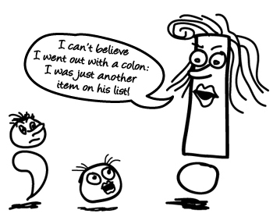

Slide 36
Rarely if ever used in scientific papers
Speech marks(“”), questions mark (?), and exclamation mark (!).
The gentleman said: “Shall we dance?”.
The lady replied: “Let’s!”.
-> The gentleman asked the lady if she would dance, to which she replied they should.

Slide 37
The Dash
  Use a dash to set off an abrupt break or interruption and to announce a long explanation or summary. Helps add emphasis.
  → Reserve this tool for the really tough jobs!

Slide 38
The Dash
  The drugs did more than prevent new fat accumulation. They also triggered overweight mice to shed significant amounts of fat—up to half their body weight. (emphasis)
  To establish that the marrow cells—also called adult stem cells or endothelial precursor cells—can colonize the eye, Friedlander and his colleagues first transplanted stem cells from an adult mouse into the eyes of newborn mice. (long summary)
  How would the feel of these sentences change with parentheses or commas?

Slide 39
The Dash
  With commas instead…(clunky and long…)
  The drugs did more than prevent new fat accumulation. They also triggered overweight mice to shed significant amounts of fat, up to half their body weight.
  To establish that the marrow cells, also called adult stem cells or endothelial precursor cells, can colonize the eye, Friedlander and his colleagues first transplanted stem cells from an adult mouse into the eyes of newborn mice.

Slide 40
The Dash
  With parentheses instead…(buries the info.)
  The drugs did more then prevent new fat accumulation. They also triggered overweight mice to shed significant amounts of fat (up to half their body weight).
  To establish that the marrow cells (also called adult stem cells or endothelial precursor cells) can colonize the eye, Friedlander and his colleagues first transplanted stem cells from an adult mouse into the eyes of newborn mice.

Slide 41
The Dash
  While all these steps are small and easily reversible—Syria is still ruled by a wacky megalomaniac—there is some real movement here.
  Comma instead…
  While all these steps are small and easily reversible, Syria is still ruled by a wacky megalomaniac, there is some real movement here. (run-on sentence)
  Parentheses instead…
  While all these steps are small and easily reversible (Syria is still ruled by a wacky megalomaniac) there is some real movement here. (buries the best part of the sentence!)

Slide 42
The Dash: some technical details
HYPHEN (1 unit): to connect compound words or non-range numbers; to break word that will continue on next line:
→ little-known fact, en-dash, 723-8222
EN-DASH (2 units): to indicate range (numbers, dates, time) or collaboration:
→ pages 1 – 9 , open 9 am – 5 pm, Morris–Hayes lab, Sino–Soviet pact
EM-DASH (3 units): to represent a sudden break in thought that causes an abrupt change in sentence structure:
→ The m-dash is longer—the length of the letter m.

Slide 43
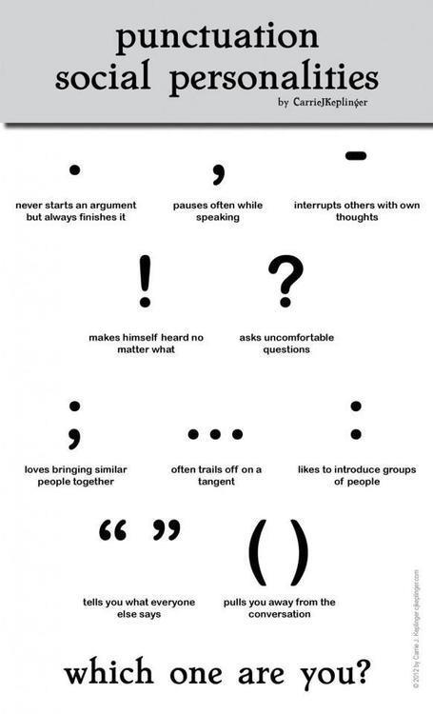

Slide 45
  Use of Parallel Construction

Slide 46
  Unparallel:
  Locusts denuded fields in Utah, rural Iowa was washed away by torrents, and in Arizona the cotton was shriveled by the blazing heat.
  Vs.
  Parallel:
  Locusts denuded fields in Utah, torrents washed away rural Iowa, and blazing heat shriveled Arizona’s cotton.

Slide 47
Parallel writing
  Pairs of ideas—two ideas joined by “and”, “or”, and “but”—should be written in parallel form.
  Example:
  We hoped to increase the response and
  to improve survival.
  Infinitive phrase and infinitive phrase.

Slide 48
Parallel writing
  Example:
  Cardiac input decreased by 40% but
  blood pressure decreased by only 10%.
  SVX but SVX

Slide 49
Parallel writing
  Lists of ideas (and number lists of ideas) should be written in parallel form.

Slide 50
Parallel writing
  Not Parallel:
  If you want to be a good doctor, you must study hard, critically think about the medical literature, and you should be a good listener.
  Parallel:
  If you want to be a good doctor you must study hard, listen well, and think critically about the medical literature. (verb, verb, verb)
  Parallel:
  If you want to be a good doctor, you must be a good student, a good listener, and a critical thinker about the medical literature. (noun, noun, noun)

Slide 51
Parallel writing
  Not Parallel:
  This research follows four distinct phases: (1) establishing measurement instruments (2) pattern measurement (3) developing interventions and (4) the dissemination of successful interventions to other settings and institutions.
  Parallel:
  This research follows four distinct phases: (1) establishing measurement instruments (2) measuring patterns (3) developing interventions and (4) disseminating successful interventions to other settings and institutions.

Slide 52
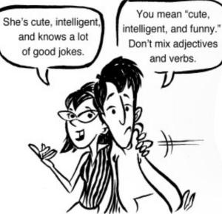

Slide 53
And finally…
This week’s top 5 countdown:

Slide 54
1. Farther v. further
Farther is used for distance. (think far)
Further is used for time or quantity. (think future)
I can throw a ball farther than you.
I am pursuing that research further.

Slide 55
Other similar words:
FORWARD v. FORWARDS v. FOREWORD
TOWARD v. TOWARDS
→ Some sources prefer adverbs forward and toward to forwards and towards (a bit more formal without the s; s more common in UK); foreword = preface to a book

Slide 56
2. Die of v. die from
People and animals die of, not from, specific diseases.
She died of a heart attack.

Slide 57
3. compliment v. complement
Compliment is to praise or to present with a token of esteem.
Complement is to mutually complete each other.
She complimented his haircut.
That dress complements your eyes.
In complement, think of “complete-ment”

Slide 58
A comic interlude, for illustration:
A man walks into a bar and sits down. He orders a beer and begins to drink it, when he hears a mysterious voice: “You're looking very handsome this evening.” The man looks around, but there’s no one else nearby. “That suit is quite magnificent," continues the voice. “And what a delightful tie!”
The man calls the bartender over and confides, somewhat sheepishly, “I keep hearing voices but I don't seem to be able to work out where they're coming from!“
The bartender replies, "It's the nuts, sir. They're complimentary."

Slide 59
4. Comprise v. compose
Comprise means to contain. “Comprise” implies a complete listing, whereas “include” may signal an incomplete listing.
Compose means to make up.
The parts compose (make up) the whole; the whole comprises (contains) the parts.
The dimer comprises 2 monomers. (the whole contains the parts)
Two monomers compose the dimer. (the parts make up the whole)
The dimer is composed of 2 monomers. (the whole is made up of the parts)
Two monomers are comprised in the dimer. (the parts are contained in the whole)

Slide 60
5. locate v. localize
Locate is to determine the position of something; to find its location.
Localize is to confine or fix in a particular area or part.
The police located the suspect at the edge of town.
Iodine tends to localize in the thyroid.

