Slide 1

Scientific writing (81-933) Lecture 4: Figures and Tables
Dr. Avraham Samson
Faculty of Medicine in the Galilee

Slide 2
Tables and Figures
Editors (and readers) look first (and maybe only) at titles, abstracts, and Tables and Figures!
Like the abstract, figures and tables should stand alone and tell a complete story.

Slide 3
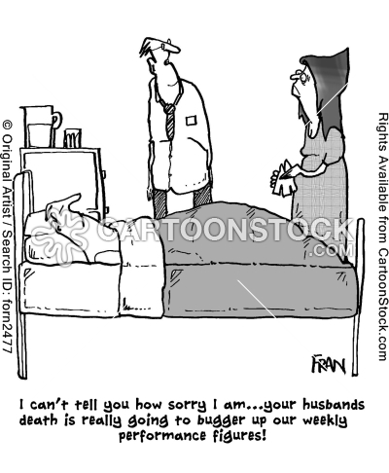

Slide 4
Table Titles and Footnotes
Titles:
Identify the specific topic or point of the table
Use the same key terms in the title, the column headings, and the text of the paper
Keep it brief

Slide 5
Table Titles and Footnotes
Footnotes:
Use superscript symbols to identify footnotes, according to journal guidelines:
A standard series is: *, †,‡,¶,#,**,††, etc.
Use footnotes to explain statistically significant differences
E.g., *p < 0.01 vs. control by ANOVA
Use footnotes to explain experimental details or abbreviations
E.g., EDI is the Eating Disorder Inventory (reference)
Amenorrhea was defined as 0-3 periods per year

Slide 6
Table Formats
Format:
Model your tables from already published tables! Don’t re-invent the wheel!!
Use (at least) three horizontal lines: one above the column headings, one below the column heading, and one below the data
Use a short horizontal line to group subheadings under a heading
Follow journal guidelines RE:
roman or arabic numbers;
centered or flush left table number, title, column, headings, and data;
capital letters and italics;
the placement of footnotes;
the type of footnote symbols

Slide 7
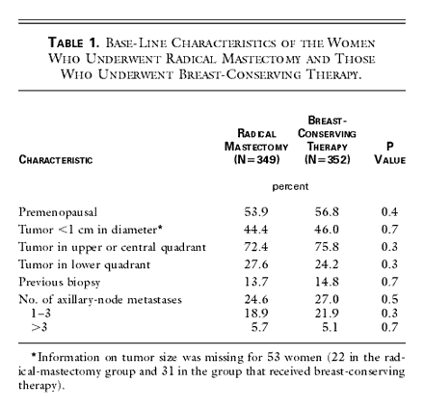
Tables: baseline, descriptive data
Three horizontal lines
Table 1. Base-Line Characteristics of the Women Who Underwent Radical Mastectomy and Those Who Underwent Breast-Conserving Therapy.
Veronesi et al. Twenty-Year Follow-up of a Randomized Study Comparing Breast-Conserving Surgery with Radical Mastectomy for Early Breast Cancer NEJM 347:1227-1232; October 17, 2002

Slide 8
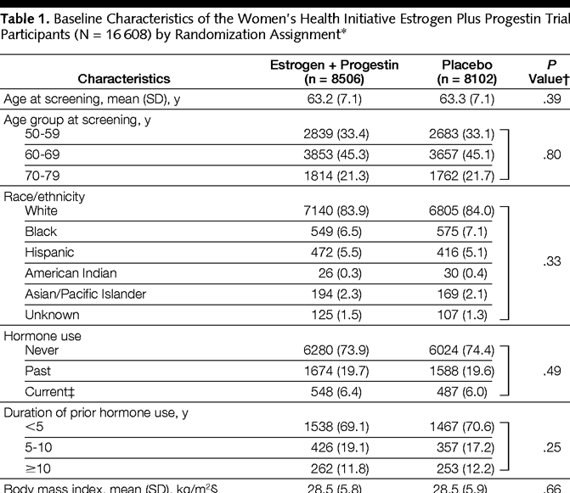
Tables: baseline, descriptive data
Women’s health Initiative, JAMA, 2002
n
%

Slide 9
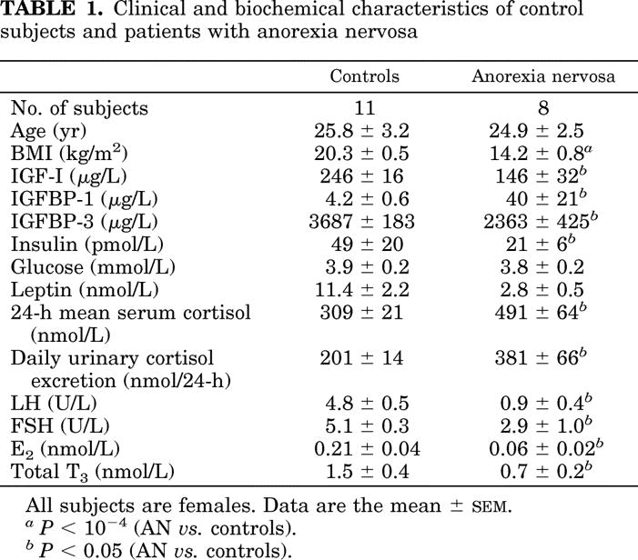
TABLE 1. Clinical and biochemical characteristics of control subjects and patients with anorexia nervosa From: Stoving: J Clin Endocrinol Metab, Volume 84(6).June 1999.2056-2063

Slide 10
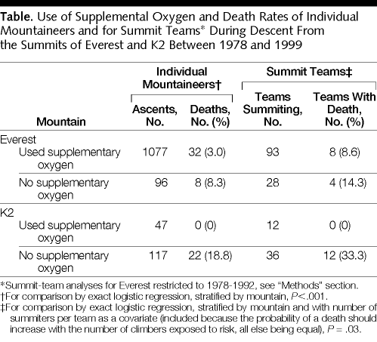
Tables: To illustrate a point…

Slide 11
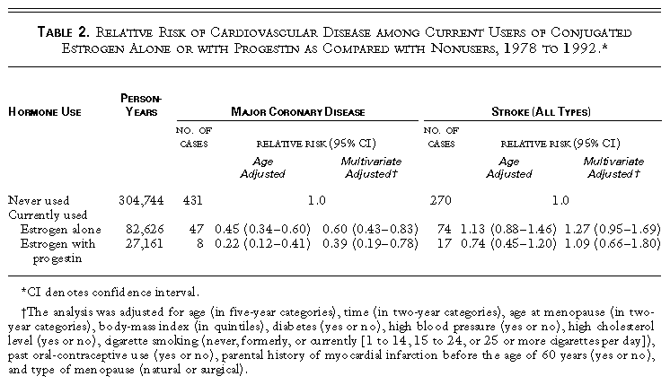
Tables: To illustrate a point…
From: nurses health study

Slide 12
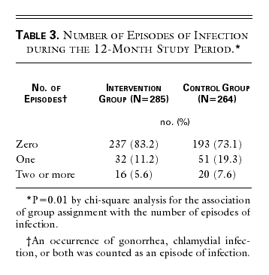
Tables: to illustrate a point
NEJM: Shain et al. 340 (2): 93, January 14, 1999

Slide 13
Figures
Use few figures ($$$) and tables to tell the story
Do not present the same data in both a figure and a table

Slide 14
Figures
Three varieties of Figures:
Primary evidence
electron micrographs, gels, photographs, spectra, etc.
indicates data quality
Graphs
line graphs, bar graphs, scatter plots, histograms, boxplots, etc.
Drawings and diagrams
illustrate experimental set-up
indicate flow of experiments or participants
indicate relationships or cause and effect or a cycle
give a hypothetical model

Slide 15
Figure Legends
Allows the figure to stand alone.
Contains:
1. Brief title
2. Experimental details
3. Definitions of symbols or line/bar patterns
4. Short explanation or Statistical information

Slide 16
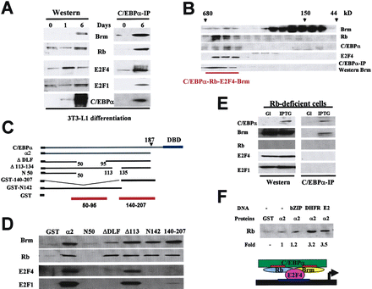
Figures: Primary Evidence

Slide 17
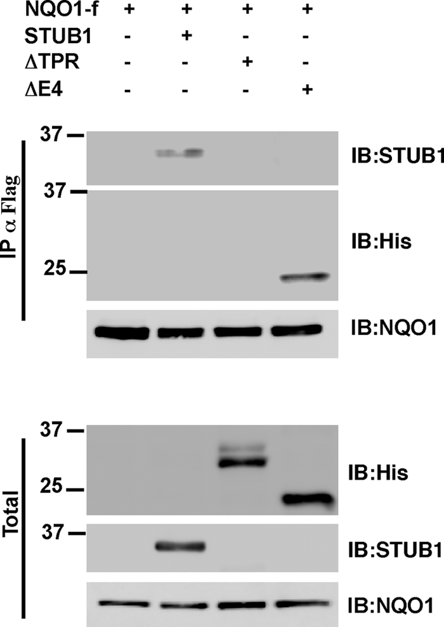
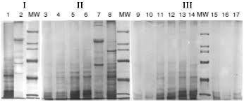
Elliott E, Laufer O, Ginzburg I (2009) BAG-1M is upregulated in Alzheimer's Disease patients and associates with APP and tau proteins. Journal of Neurochemistry 109(4):1168-1178

Slide 18
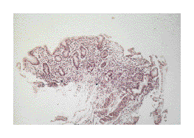
Figure 1. Histologic Patterns in the Evolution from Chronic Gastritis to Gastric Lymphoma.
NEJM Zucca et al. 338 (12): 804, Figure 1 March 19, 1998

Slide 19
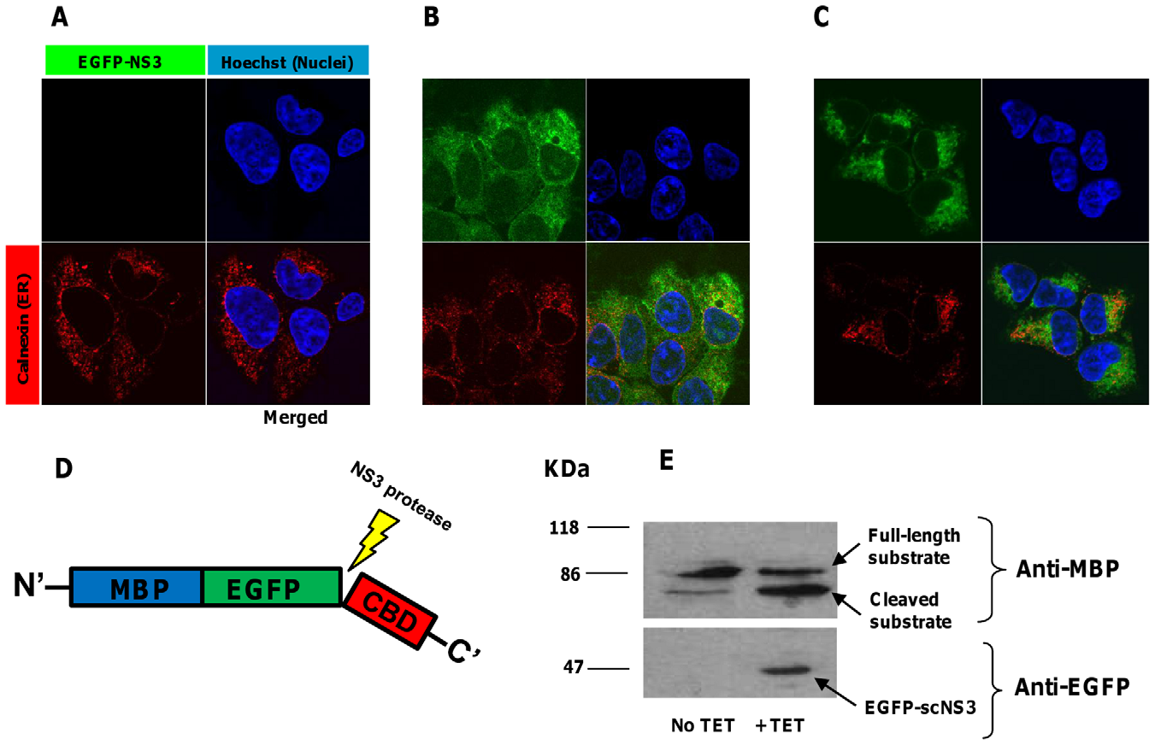

Slide 20
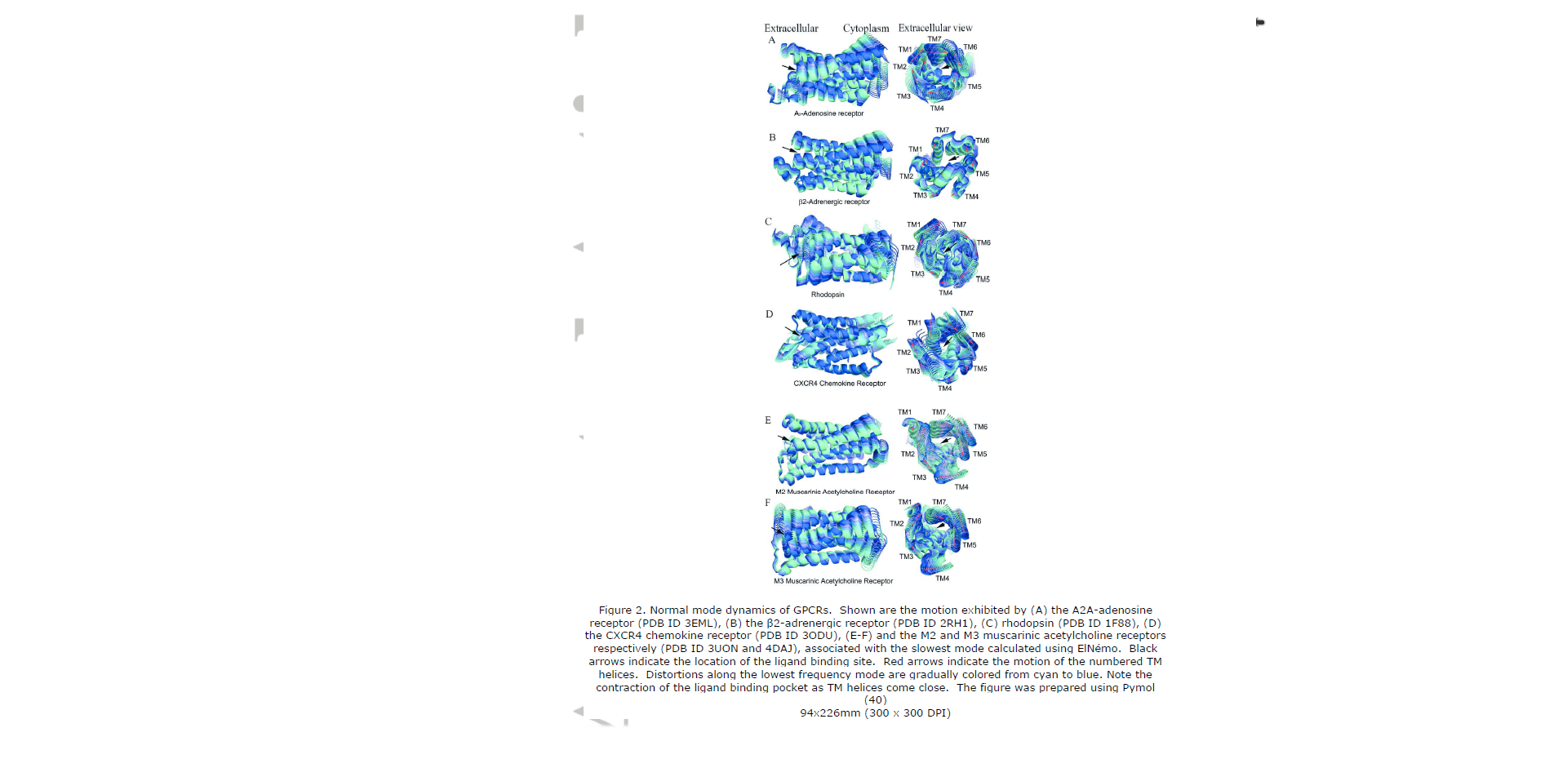
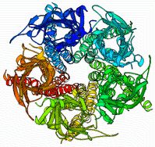
Molecular motion

Slide 21
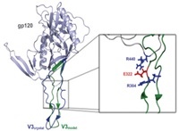

Slide 22
Figures
Graphs
line graphs
scatter plots
bar graphs
individual-value bar graphs
histograms
box plots
relative risks
survival curves

Slide 23
Graphs
Exercise:
Which graphs work and why?
Which graphs confuse and why?
**Does the graph tell a simple story?

Slide 24
Figures
Graphs
line graphs
*Used to show trends over time or age
(can display group means or individuals)

Slide 25
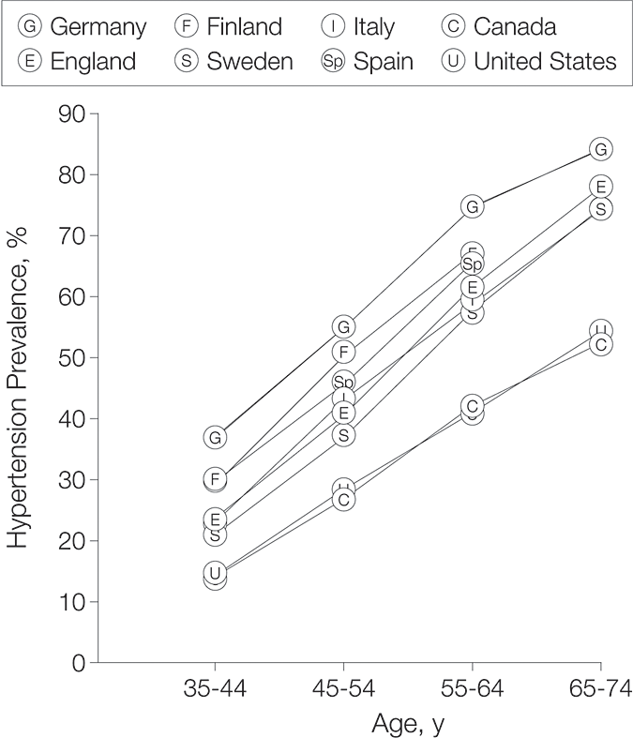
Figure 3. Hypertension Prevalences in 6 European and 2 North American Countries, Men and Women Combined, by Age Group
JAMA Vol. 289 No. 18, May 14, 2003

Slide 26
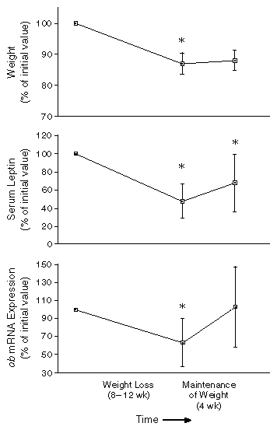
Figure 3. Effect of Weight Loss on Serum Leptin Concentrations and Expression of the ob Gene in Seven Obese Subjects, Expressed as a Percentage of the Initial Value.
Considine et al. NEJM 334: 292; February 1, 1996

Slide 27
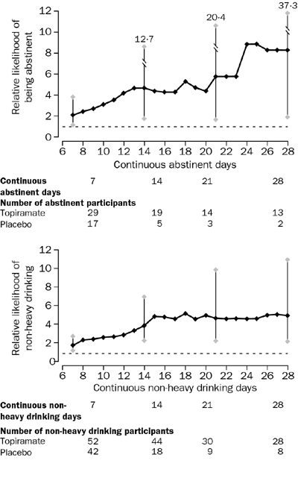
From:
Oral topiramate for treatment of alcohol dependence: a randomised controlled trial
Johnson et al. The Lancet. Volume 361;17 May 2003

Slide 28
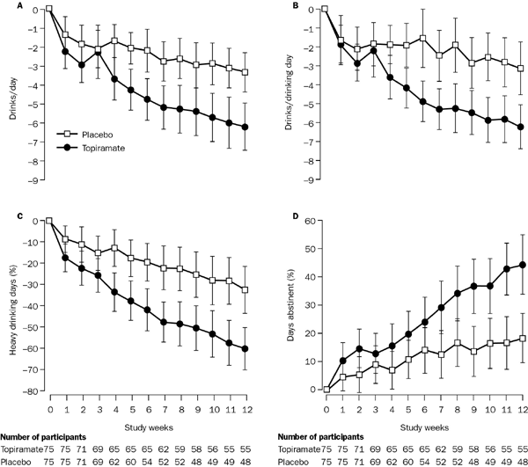
Tables and Figures
Figure 2: Change in self-reported drinking outcomes from baseline (week 0) by study week

Slide 29
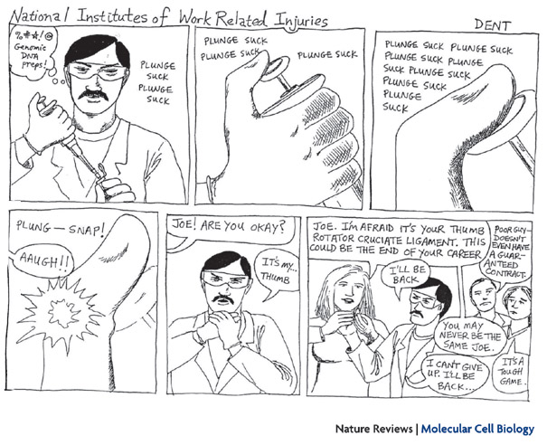

Slide 30
Figures
Graphs
bar graphs
*Used to compare groups at one time point
*Tells a quick visual story

Slide 31
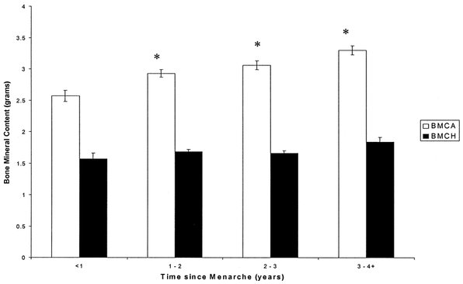
FIGURE 2- Relationship between BMC of the forearm/heel and time since menarche. *Significantly different than forearm BMC of group 1 (< 1 yr since menarche); BMCA: forearm BMC; BMCH: heel BMC.
Medicine & Science in Sports & Exercise 2003; 35(5):720-729

Slide 32
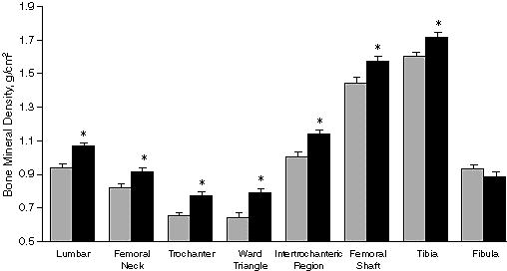
Figures: bar graphs
Figure 1. Bone mineral density of amenorrheic (gray bars) and eumenorrheic athletes (black bars). Asterisk indicates P<.01; error bars indicate SE. From: Rencken: JAMA, Volume 276(3).July 17, 1996.238-240

Slide 33
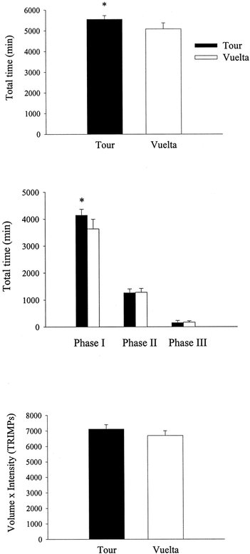
Comparison of the total loads accumulated in Tour and Vuelta. Phases I, II, and III are intensity phases below the ventilatory threshold (VT), between VT and the respiratory compensation point (RCP), and above RCP, respectively….
Medicine & Science in Sports & Exercise 2003; 35(5):872-878

Slide 34
Figures
Graphs
scatter plots
*Used to show relationships between two variables (particularly linear correlation)
*Allows reader to see individual data points=more information!

Slide 35
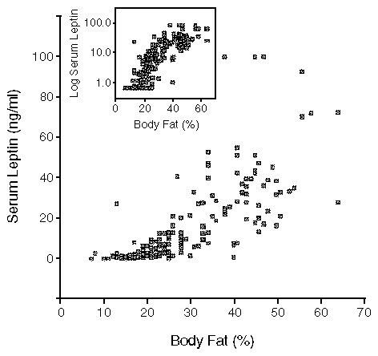
Figure 1. The Relation between the Percentage of Body Fat and the Serum Leptin Concentration in 136 Normal-Weight and 139 Obese Subjects.
Considine et al. Serum Immunoreactive-Leptin Concentrations in Normal-Weight and Obese Humans NEJM 334: 292; February 1, 1996

Slide 36
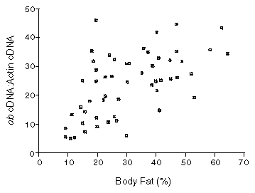
Figure 2. Correlation between Expression of the ob Gene in Adipocytes and the Percentage of Body Fat in 27 Normal-Weight and 27 Obese Subjects.
The data are expressed as the ratio of ob cDNA to actin cDNA. There was no difference in the amount of actin cDNA among the subjects studied.
Considine et al. NEJM 334: 292; February 1, 1996

Slide 37
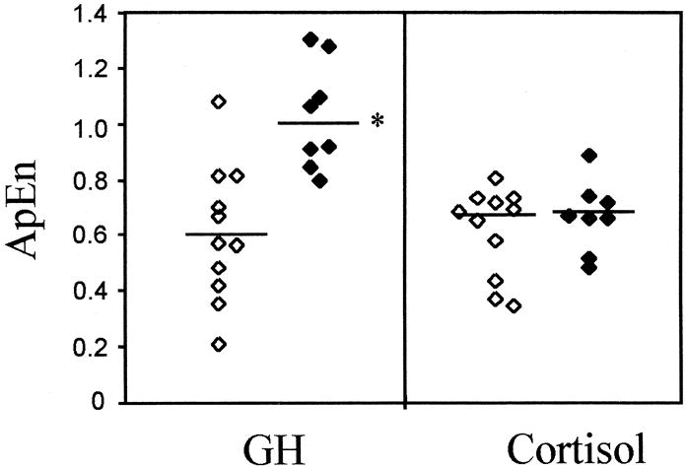
Fig. 4. Individual subject ApEn scores of GH secretion (m = 1; r = 20% sd) and cortisol secretion (m = 1; r = 80% sd) in normal weight women ([white four pointed star]) and in women with AN ([white diamond suit]). Horizontal lines represent the median values. *, P 0.05 (AN vs. controls). From: Stoving: J Clin Endocrinol Metab, Volume 84(6).June 1999.2056-2063

Slide 38
Figures
Graphs
Boxplots and histograms
To show or compare data distributions

Slide 39
Box Plot
x
maximum (163.9)
whisker
75th percentile (138.6)
interquartile range
median (127.0)
A quartile = a quarter of the data
25th percentile (115.5)
minimum (93.9)
Notes:
Does everybody know what I mean when I say percentiles?
What is the median? Anyone?

Slide 40
Histogram
Percent of total that fall in the 10-pound interval.
Data are divided into 10-pound groups (called “bins”).
With only one woman <100 lbs, this bin represents <1% of the total 120-women sampled.
125-135
115-125
135-145
105-115
155-165
95-105
145-155
85-95
Notes:
1. Bin sizes may be altered.
2. How many people do you think are in bin 125-135?
3. Where do you think the center of the data are (what's your best guess at the average weight)?
4. On average, how far do you think a given woman is from 127 -- the center/mean?

Slide 41
Figures
Graphs
Confidence intervals/relative risks
To show dose-response of a protective or harmful factor

Slide 42
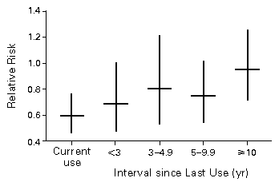
Nurse’s Health Study

Slide 43
Drawings and Diagrams

Slide 44
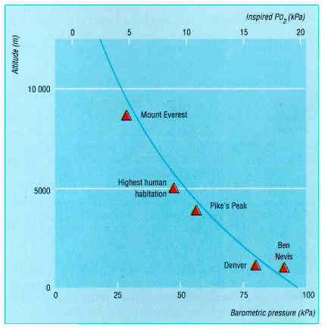
Diagrams and Drawings
Figure 2. Relation between altitude and inspired oxygen pressure From: Peacock: BMJ, Volume 317(7165).October 17, 1998.1063-1066

Slide 45
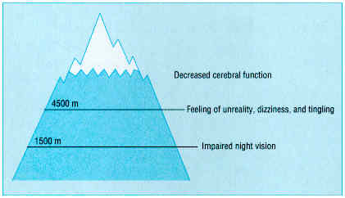
Diagrams and Drawings
Figure 5. Effect of hypoxia on central nervous system From: Peacock: BMJ, Volume 317(7165).October 17, 1998.1063-1066

Slide 46
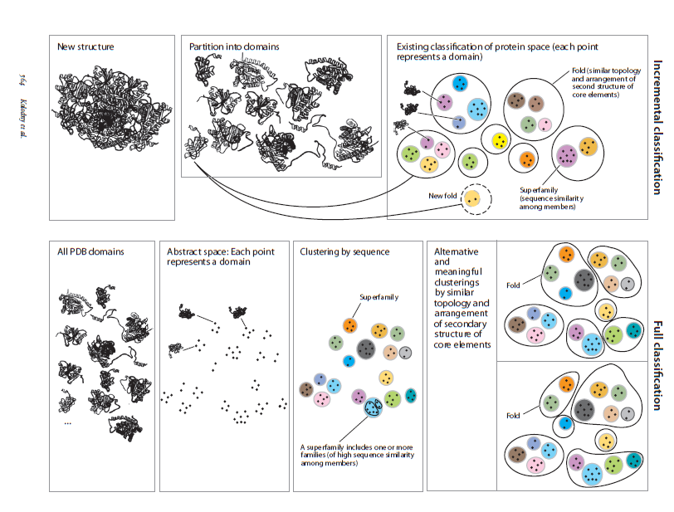

Slide 47
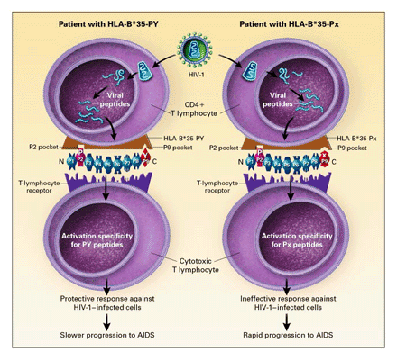
Xiaojiang Gao
Figure 3. Model of the Difference in the Rate of Progression to AIDS between Patients with HLA-B*35-Px and Those with HLA-B*35-PY.
Gao et al. Effect of a Single Amino Acid Change in MHC Class I Molecules on the Rate of
Progression to AIDS NEJM 344:1668-1675; May 31, 2001

Slide 48
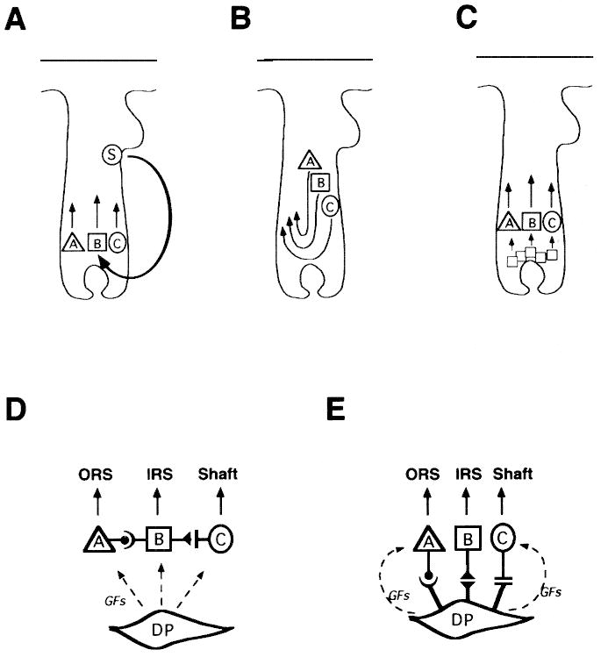
Figure 6. Possible origin of partially committed keratinocyte stem cells, and their specific association. We have demonstrated that the three concentric regions of the hair follicle (ORS, IRS, and shaft) originate from distinct progenitor cells. As discussed in the text, three possibilities can be envisaged for the origin of these cells: (A) they may derive from a totipotent keratinocyte stem cell that is still present and operative in the mature hair follicle; (B) they may derive from a totipotent progenitor cell during development, but exist as independent entities in the mature hair follicle; (C) they may be intrinsically the same, but become committed to differentiate along different pathways in response to stimuli from the local environment. For three progenitor cells to come together and originate a hair follicle, they must either interact specifically with each other (D), or use a specific anchoring mechanism, which could be provided by dermal papilla cells and/or their extracellular matrix (E). This latter mechanism could contribute to the hair-inducing capability of dermal papilla cells (DP), together with the likely, but as yet elusive release of hair-inducing growth factors (GF). From: Kamimura: J Invest Dermatol, Volume 109(4).October 1997.534-540

Slide 49
ALLUDE v. ELUDE
allude: to reference indirectly
She frequently alluded to her distrust of lawyers without explicitly stating her opinion.
He impressed the crowd with his allusions to Greek mythology. (n.b.: versus “illusion”)
elude: to evade
The stealthy cat-burglar eluded the police all winter.
The elusive protein, which our team has been trying to characterize for months, has baffled labs across the country.

Slide 50
ARRANT v. ERRANT
arrant: being notoriously without moderation; extreme
We are arrant knaves, all; believe none of us. (Shakespeare)
errant: given to travelling; straying outside the proper path or bounds; moving aimlessly or irregularly; deviating from a standard; fallible
The errant toddler found his way into all sorts of mischief.

Slide 51
AMONG v. BETWEEN
Among: collective and undefined relations (three or more)
You’re among friends.
Agreement was reached among all four neighbors.
Between: one-to-one relationships of pairs within a group or the sense “shared by.”
Diplomatic relationships between the United States and France ceased.
There is close friendship between the members of the club.

Slide 52
LAY v. LIE
Lay is a transitive verb (takes an object)
forms: lay, laid, has laid, is laying
The hen lays an egg. (laid, had laid, is laying)
“The best laid schemes o’ mice an’ men / Gang aft a-gley.” (“To a Mouse,” Robert Burns)
Lie is an intransitive verb (does not take an object)
forms: lie, lay, has lain, is lying
The llama lies down.
→ Q: What about “Now I lay me down to sleep”???

Slide 53
DISINTERESTED v. UNINTERESTED
Disinterested: impartial.
Uninterested: not interested in.
Let a disinterested person judge our dispute.
This man is obviously uninterested in our dispute.

Slide 54
e.g. v. i.e. (informal)
e.g. = “for example”
from Latin: exempli gratia = ‘for the sake of an example’
→ Many animals (e.g., mountain lions, panthers, etc.) are quite good hunters.
i.e. = “in other words”
from Latin: id est = ‘that is’
→ That walking boot is synthetic (i.e., not leather or suede).

