Slide 1

Scientific writing (81-933)
Lecture 6: References
Dr. Avraham Samson
Faculty of Medicine in the Galilee

Slide 2
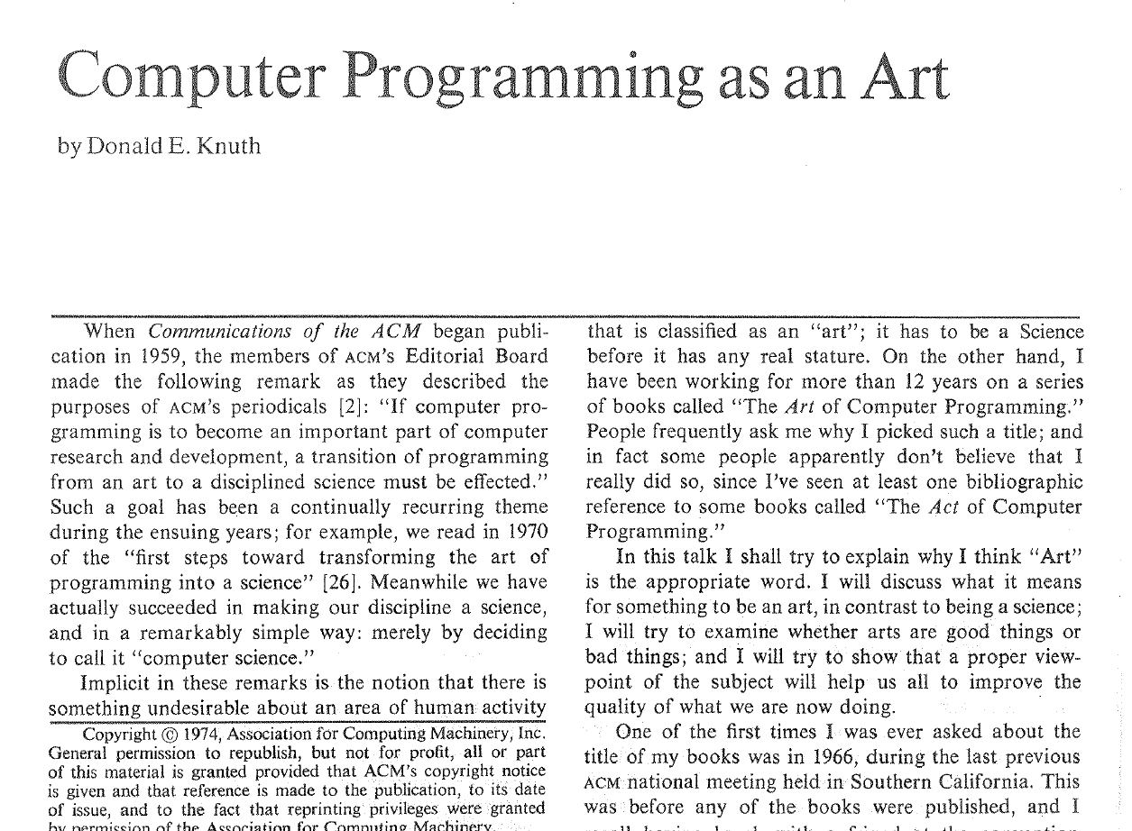

Slide 3
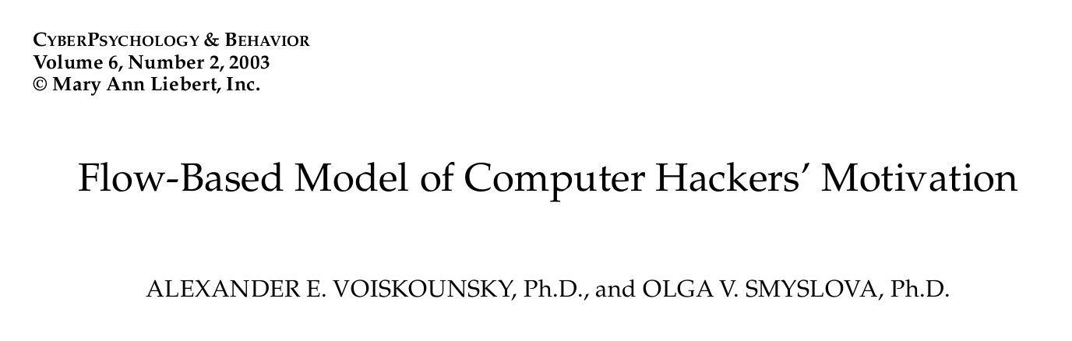
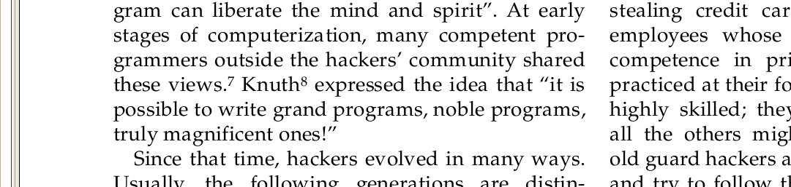
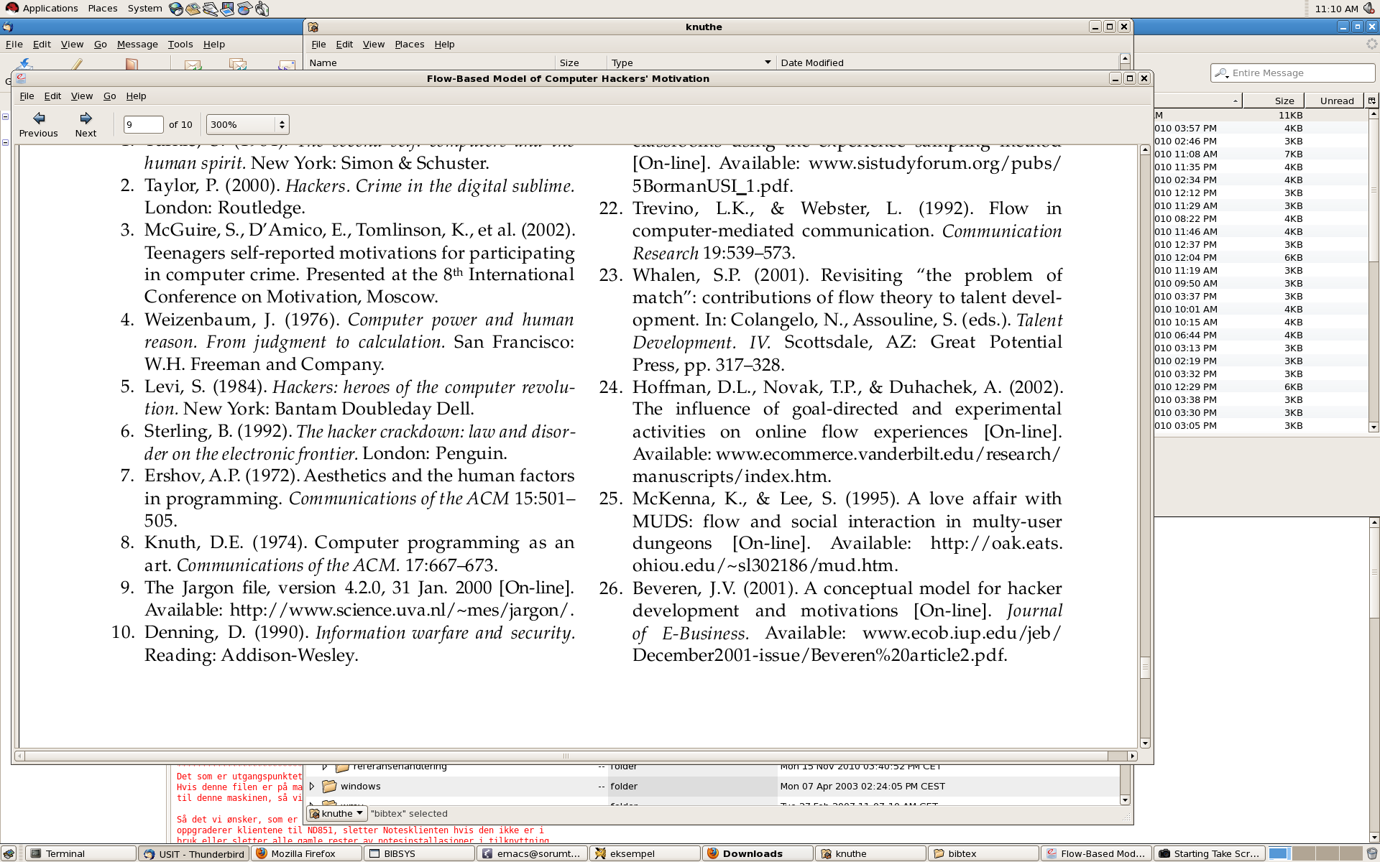
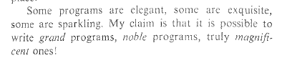

Slide 4
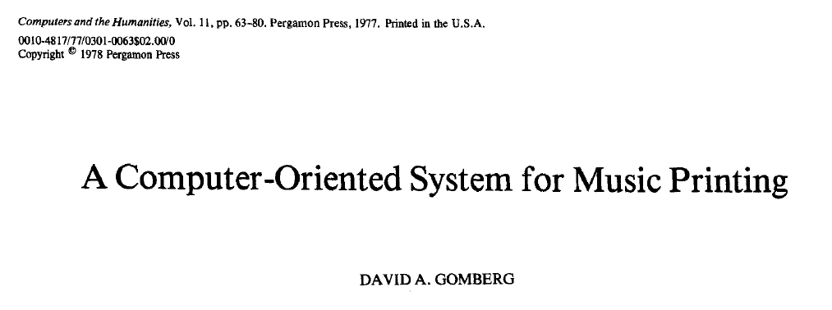
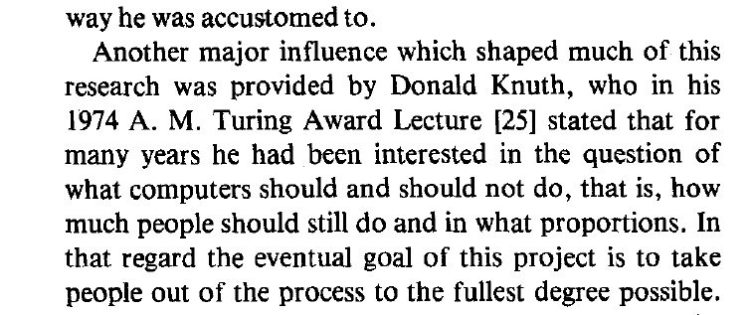
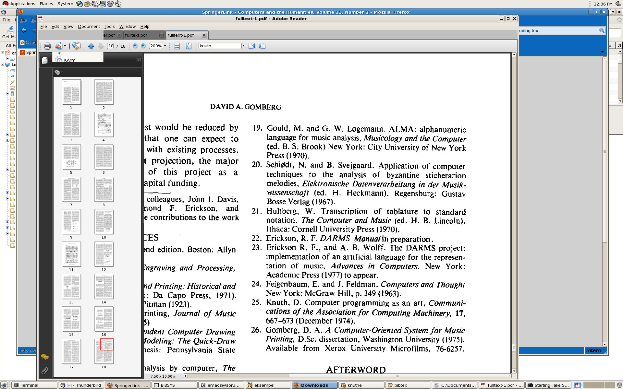

Slide 5
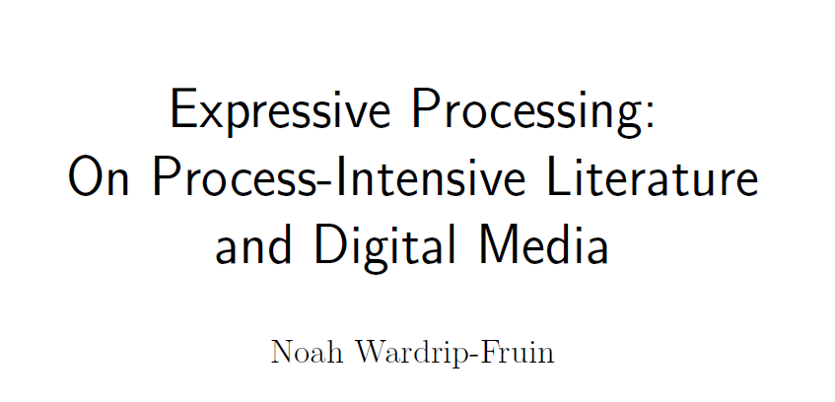
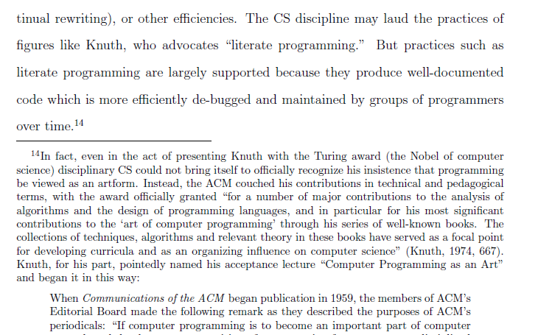
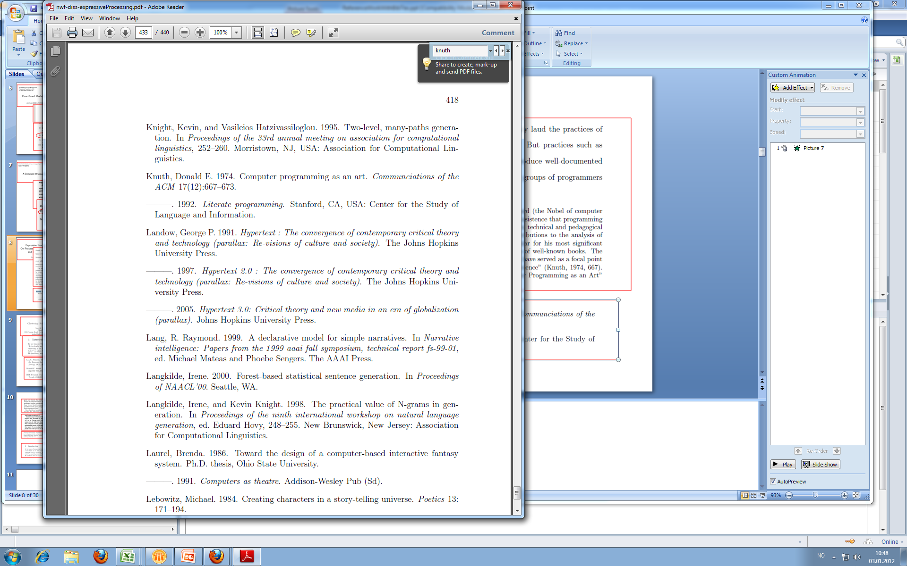

Slide 6
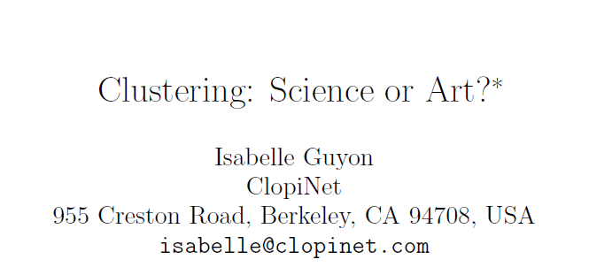
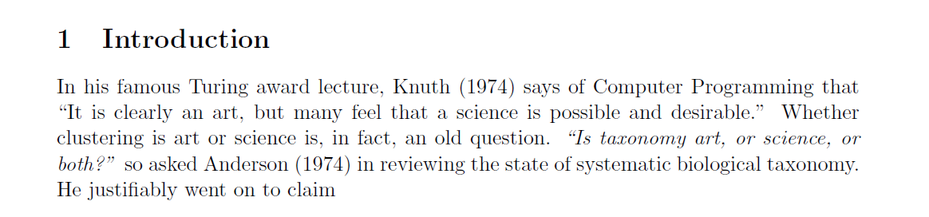
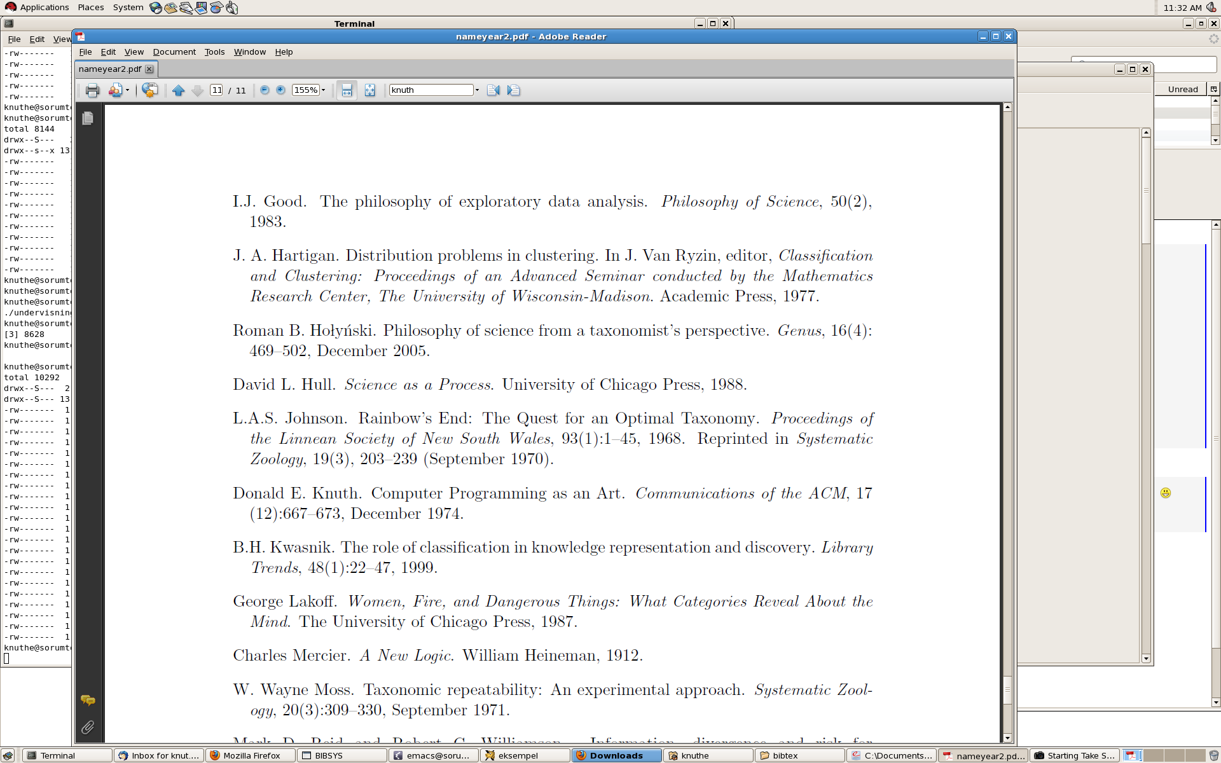

Slide 7
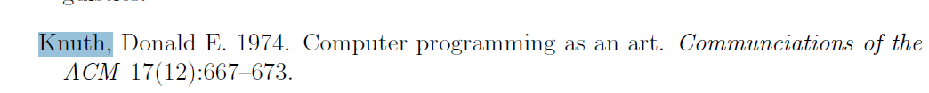

Slide 8
References
Use a computerized bibliographic program, i.e. Endnote ($$$), Mendeley (free), Refworks (free), and Zotero (free)
Follow journal guidelines (may request alphabetical listing or order of appearance in the text).
Follow standard abbreviations (can be found online).
Some journals limit number of references allowed.

Slide 9
Taking a few hours to learn EndNote is a very good choice! Two hours spent on this before writing a thesis saves hours, or even days, of work towards the end.

Slide 10
EndNote Demo (1 of 2)
Create a new EndNote library
Add a Reference
  Manually
  Direct export
  Connection files
  Import filters
Add Items to a Reference
  Insert pictures
  Insert objects
  Insert links to PDF files

Slide 11
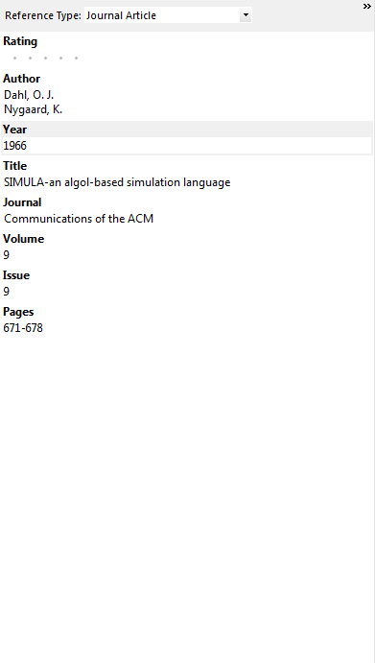
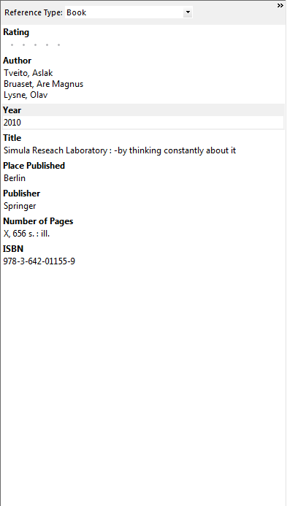
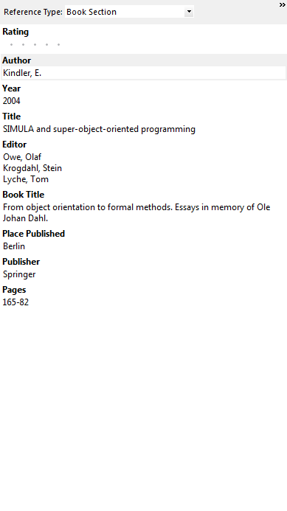

Slide 12
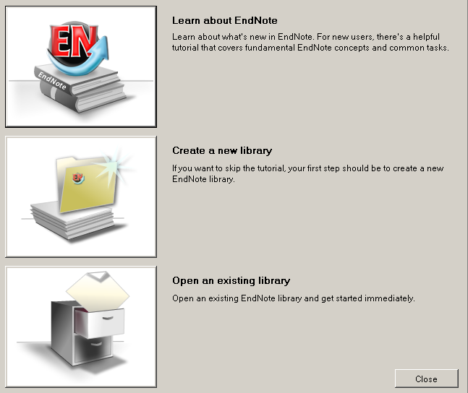
Creating/Opening an
EndNote Library (2 of 2)
First time:
  Create New
  Open Existing
Notes:
Not appearing.

Slide 13
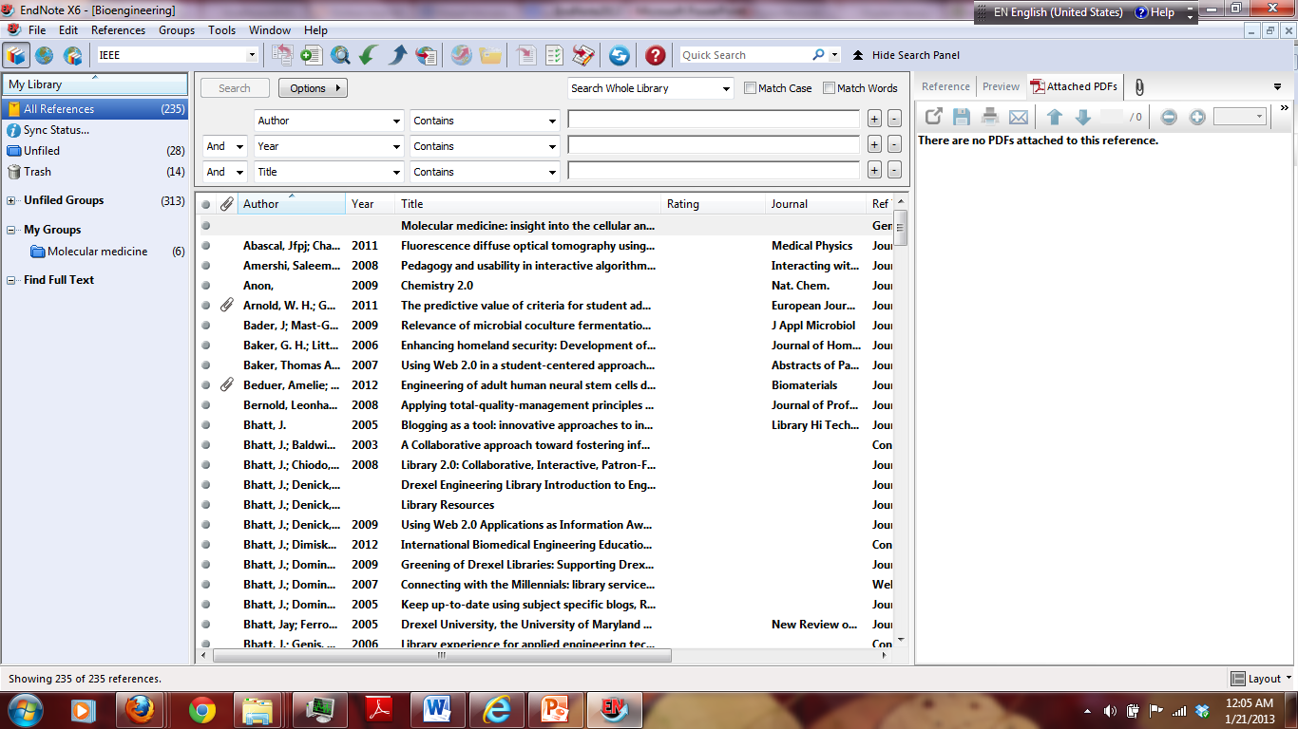

Slide 14
Adding a Reference
Manually (1 of 4)
Go to References → New Reference
Change Reference Type from Journal Article, if necessary
Author names: enter as First Middle Last or Last, First Middle
  Ex: Jean-Claude Bradley or
  Bradley, Jean-Claude or Smith, A B or Smith, A.B.
  Individual author names must be entered one per line, so hit Enter if there is a second author
Notes:
p. 54 of Getting Started Guide
Author: Bradley, J.C.
Bhatt, Jay
Year: 2003
Title: The use of SMIRP for the rapid design and implementation of pedagogical constructs
Journal: Educational Technology & Society
Volume: 6
Issue: 1
Keywords: SMIRP
Web-Based
Procrastination
Abstract: The use of SMIRP, a web-based collaborative tool, is described.

Slide 15
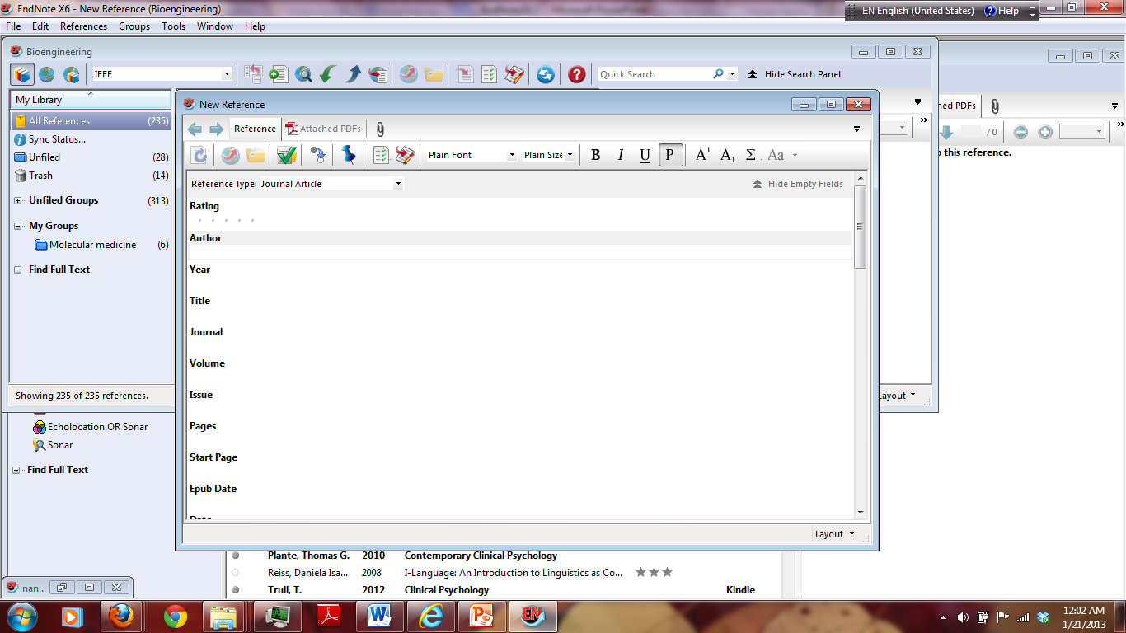
Adding a Reference

Slide 16
Adding a Reference
Manually (3 of 4)
Color coding
  Black = information is already in library
  Red = information is new to library
Tab to go to next field; Shift+Tab to go to previous field
Titles: capitalize only first word and proper nouns
  Output style will apply necessary changes

Slide 17
Adding a Reference
Manually (4 of 4)
No extra punctuation or formatting should be entered
  EndNote will do this automatically
When you close the reference, it is automatically saved (or go to File → Save to save manually)

Slide 18
Performing a Direct Export
Direct export is available for many databases:
  Using Summon
  Ei Compendex
  INSPEC
  OVID
  Science Direct,
  Web of Science
  IEEE Xplore
  In Ei Compendex: Download records RIS, EndNote, ProCite, Reference Manager option; Export to EndNote or EndNote Web
Notes:
If there is no connection file for a particular database…
Direct export: Google Scholar or Engineering Village
Import filter: RefWorks

Slide 19
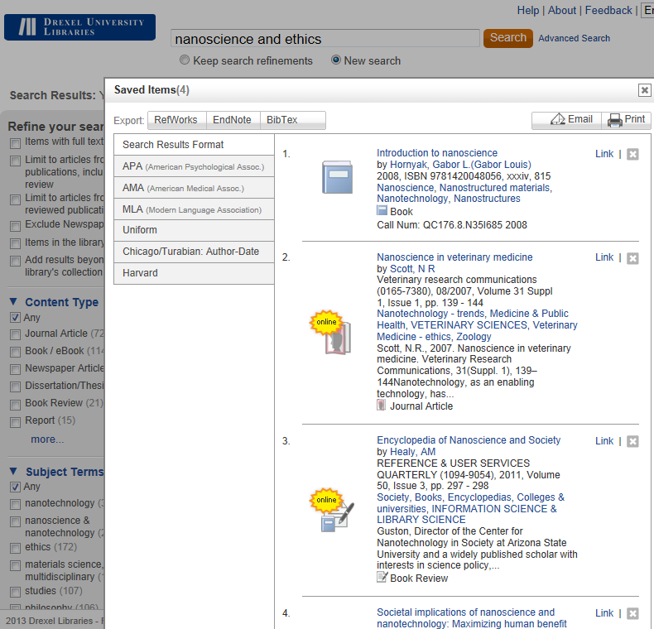
Using Summon

Slide 20
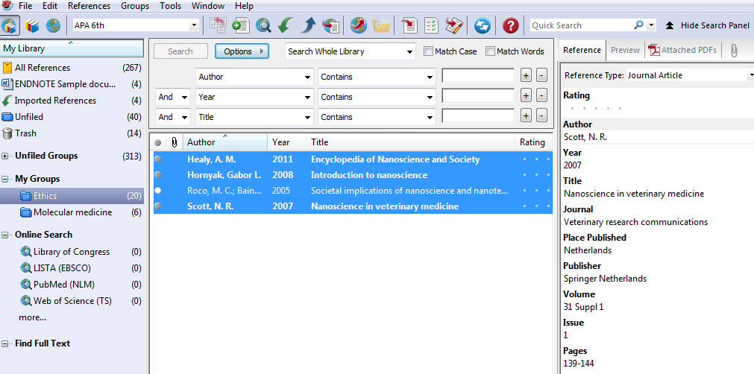
Exporting using Summon

Slide 21
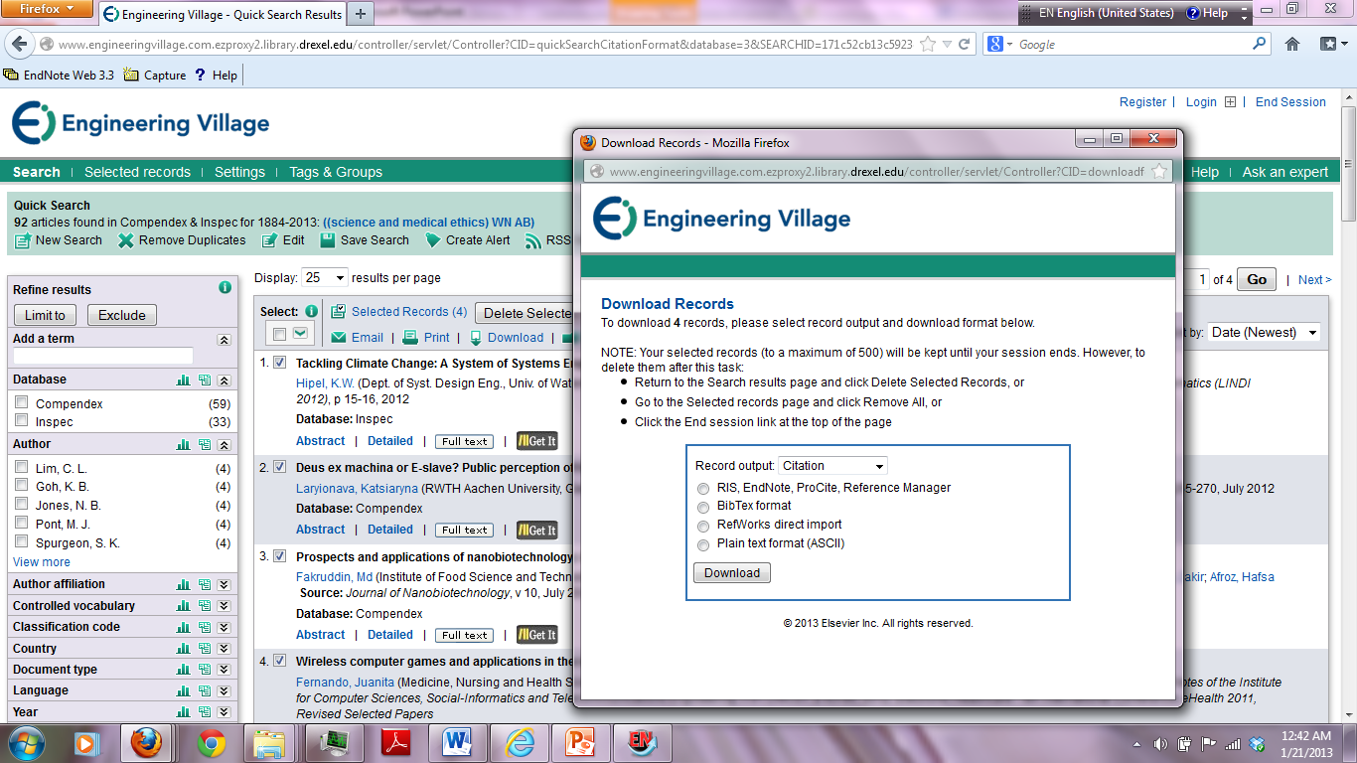
Performing a Direct Export using Ei Compendex
EASIEST
HARDEST
Perform direct export from information provider’s web site (if available)
Connect to an online database using an EndNote “connection file”
Download and import text file into EndNote using appropriate import filter
Notes:
Connection file: (PubMed)
Direct export: (Google Scholar or Engineering Village)
Import filters: (RefWorks)

Slide 22
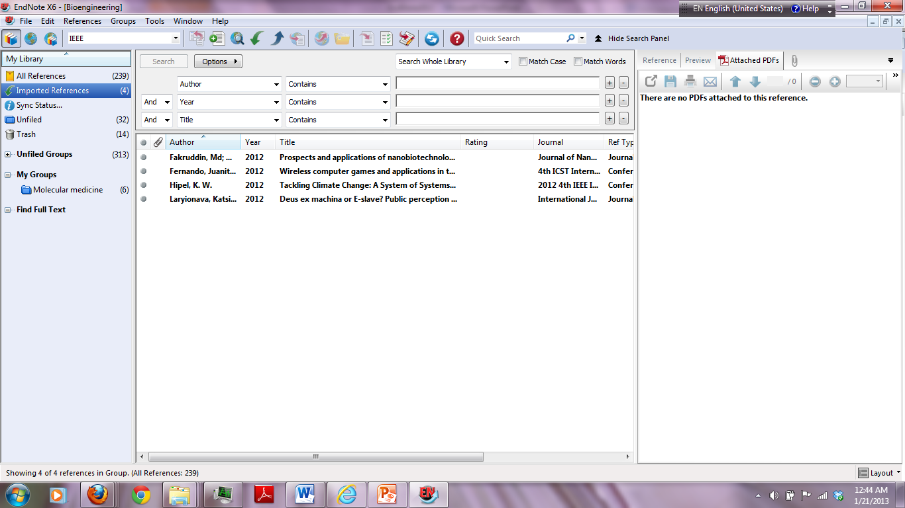

Slide 23
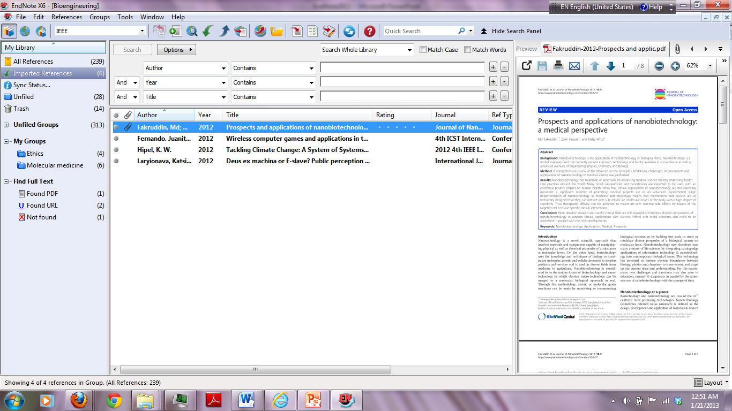

Slide 24
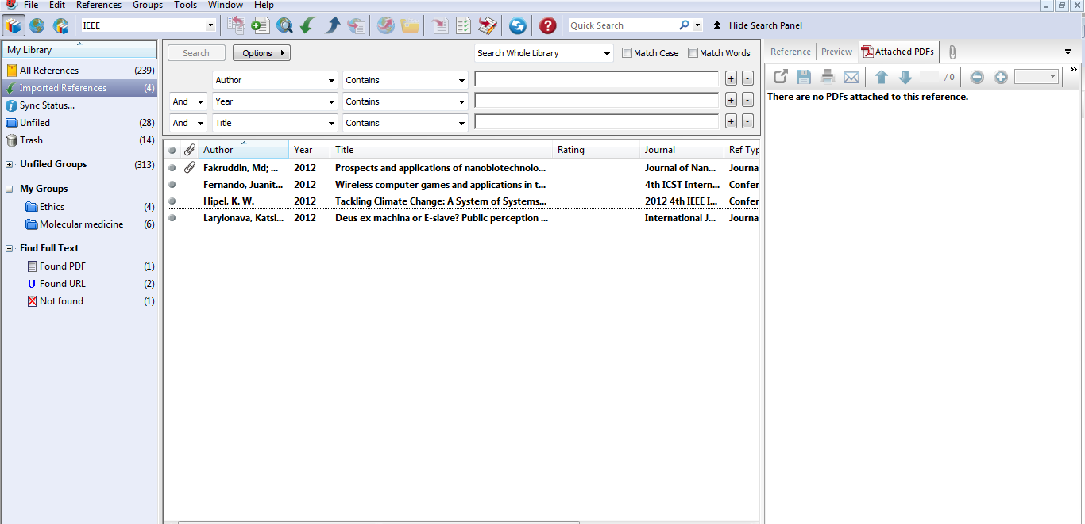

Slide 25
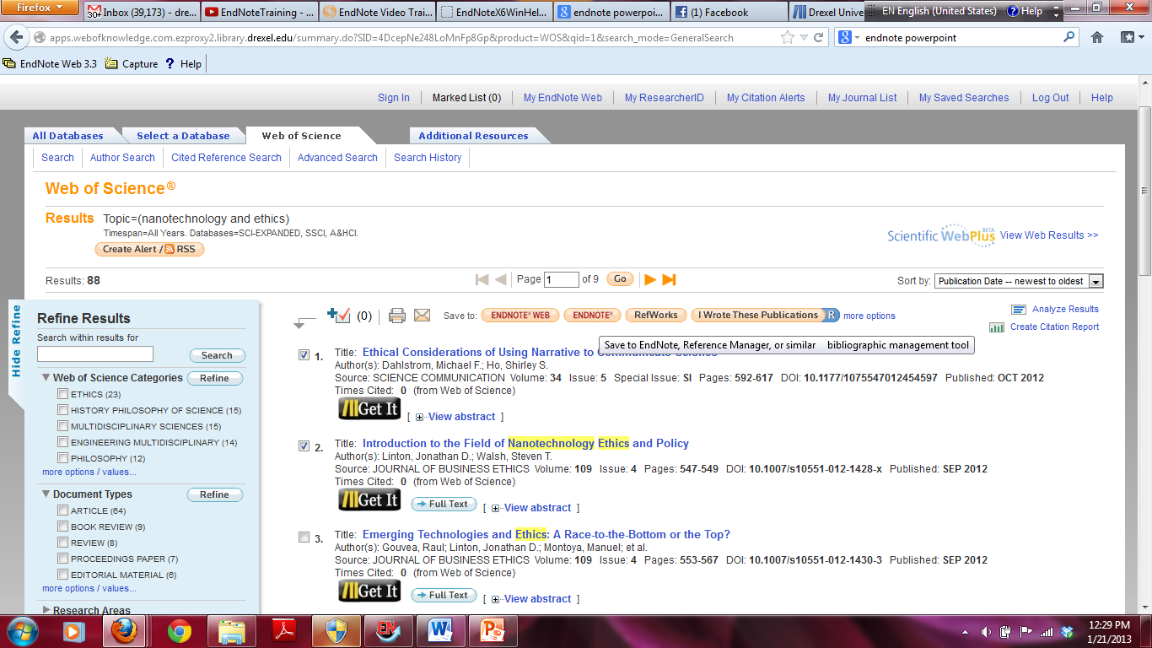
Performing a Direct Export using Web of Science

Slide 26
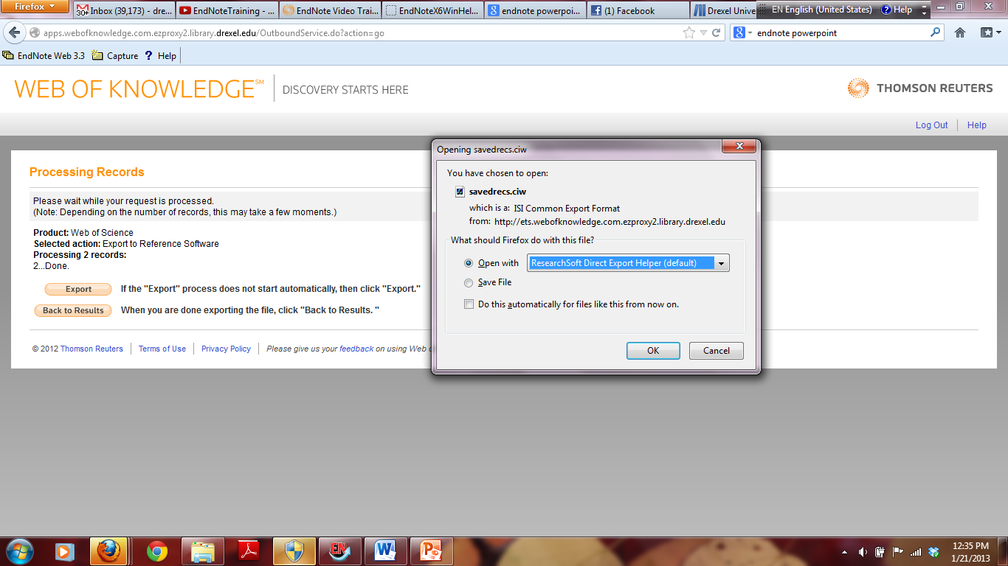
Performing a Direct Export using Web of Science

Slide 27
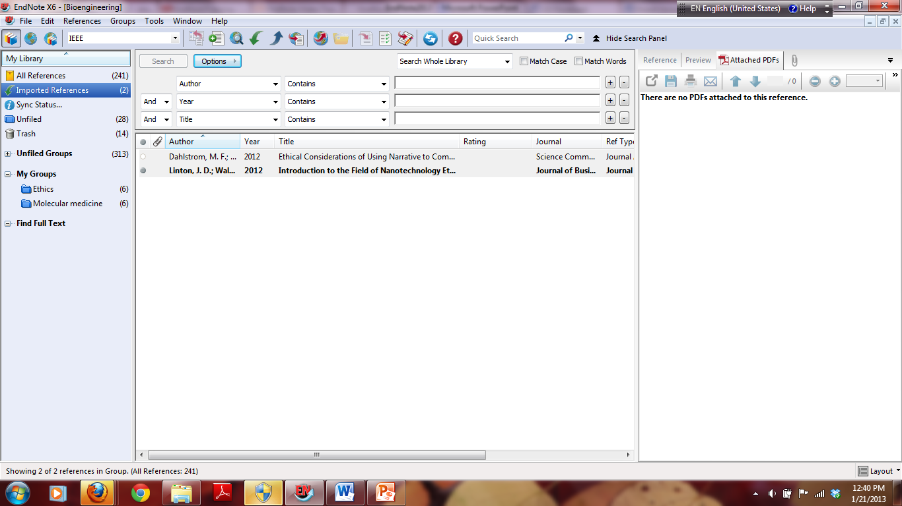
Performing a Direct Export using Web of Science

Slide 28
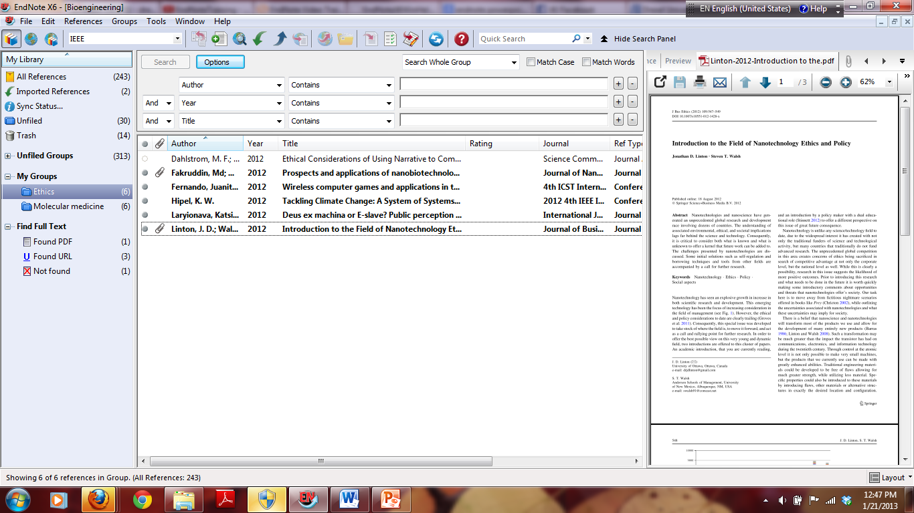

Slide 29
Download and import text file into EndNote using appropriate import filter – Scifinder Scholar Web
In ENDNOTE:
File->Import->File
Browse to find your .txt file.
Select Import Option Scifinder (CAS)
If you do not see Scifinder, go to Import Option. Then choose SciFinder(CAS).
Click on Import.

Slide 30
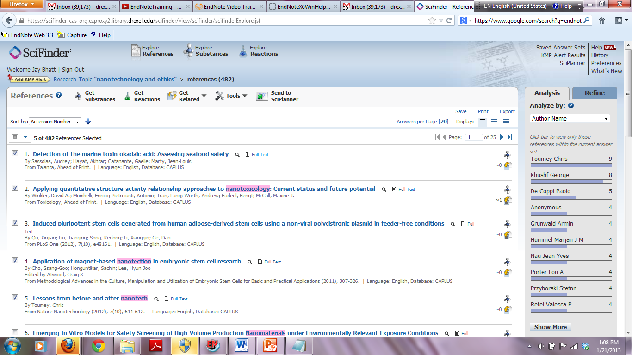
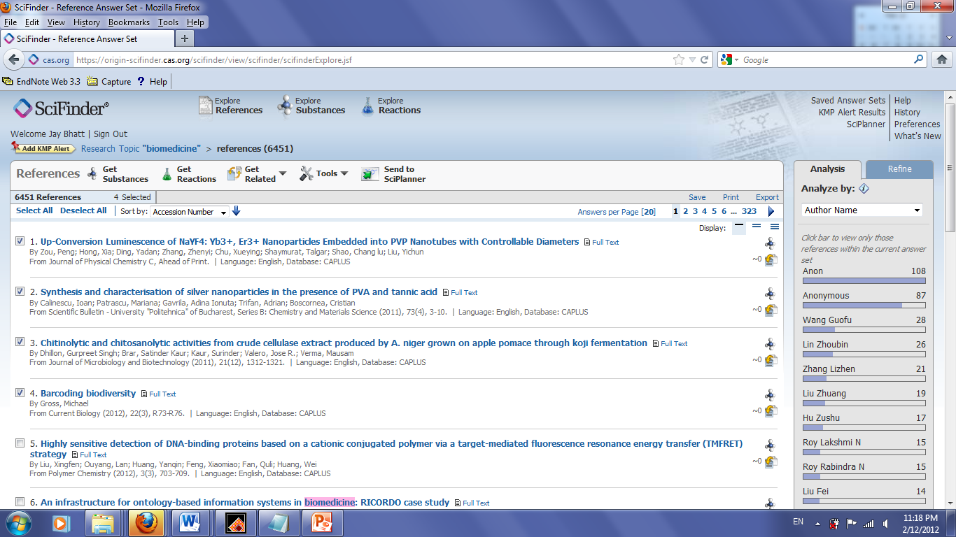
Download and import text file into EndNote using appropriate import filter – Scifinder Scholar Web

Slide 31
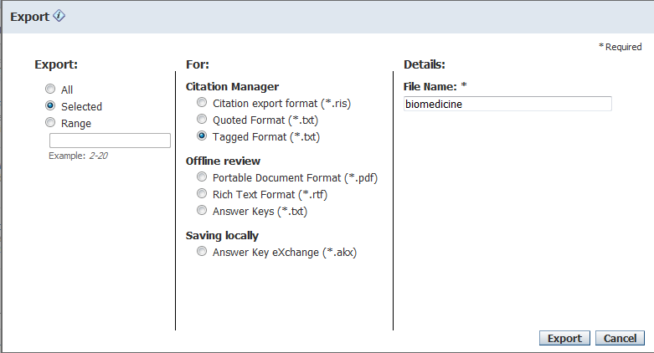
Scifinder Scholar

Slide 32
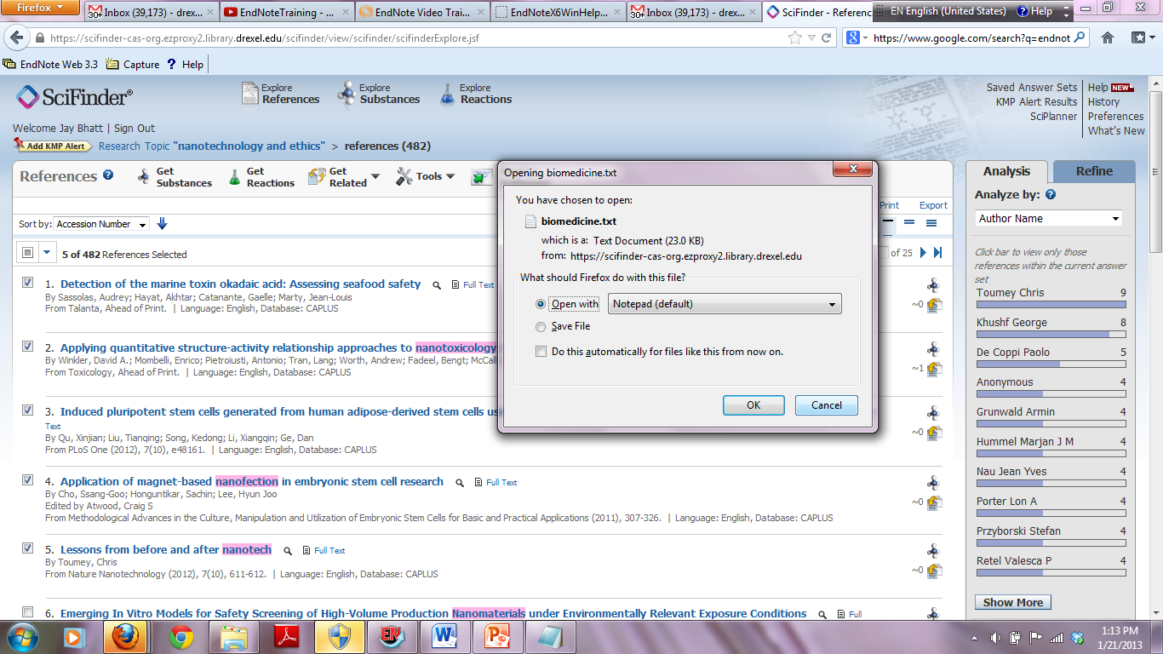
Citations into ENDNOTE from Scifinder
Open and then save this file. Import it into ENDNOTE.

Slide 33
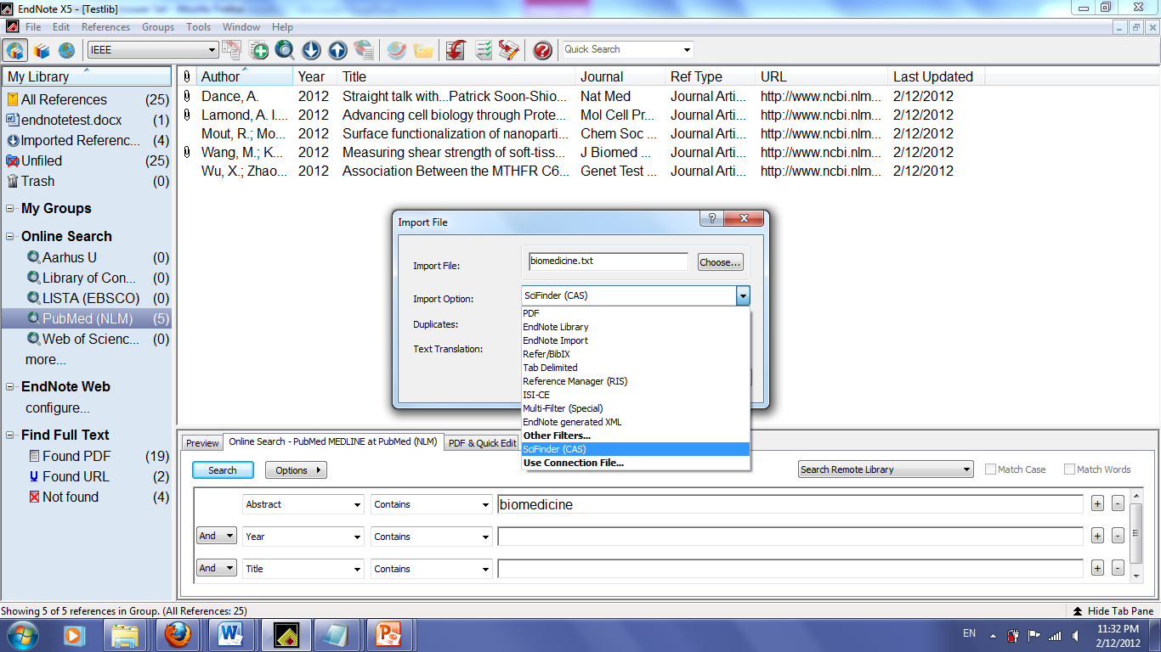
Scifinder Scholar

Slide 34
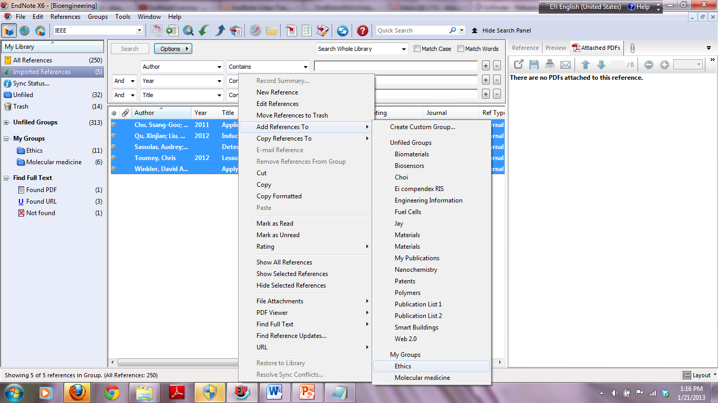
Scifinder

Slide 35
Connecting to a Remote Database
Using a Connection File (1 of 2)
Connection files available for some databases
  Example: PubMed
You must have Internet access on your computer to use a connection file
Go to Tools → Online Search → PubMed
  Favorite databases will appear in Connect submenu at the bottom of the page
  Start typing connection file name to jump to it in
Notes:
To connect to a remote database, first try using a “connection file”

Slide 36
Connecting to a Remote Database
Using a Connection File (2 of 2)
Enter search terms and click Search
Click OK to retrieve matching references or Cancel to return to search window
To copy the references to a library:
  Select all or a portion of the references
  Click Copy References To button and select a library
Close the Retrieved References window
  Disconnects you from database
Close the Search window

Slide 37
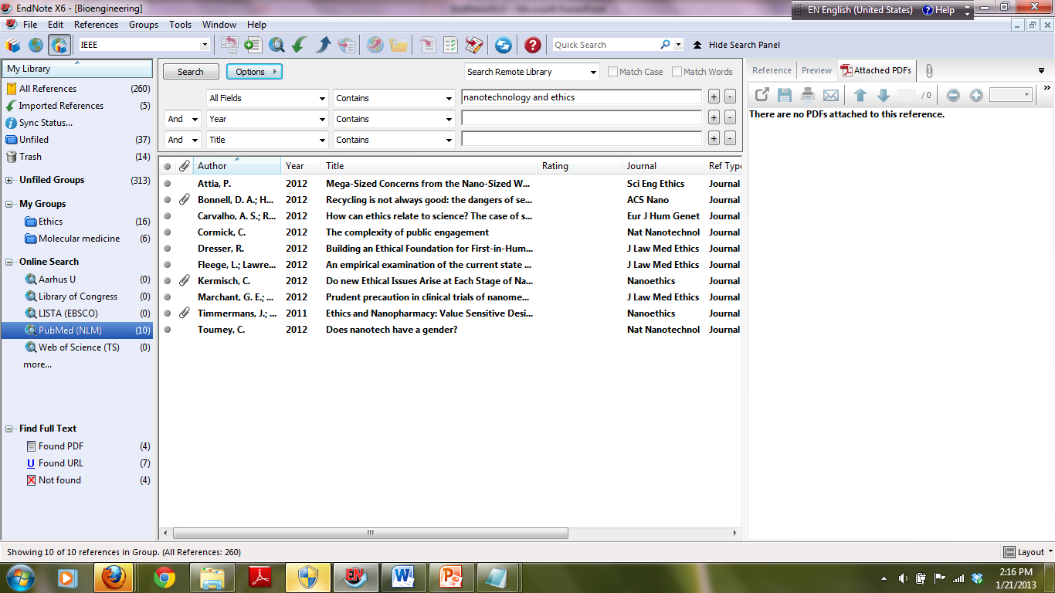
Using PubMed(NLM)

Slide 38
Adding an Object to a
Reference (1 of 2)
Object: any attached file that’s not a picture
To attach an object: References → Figure → Attach Figure
The file will appear as an attachment in the Figure field
Can be added to any reference type
Notes:
p. 55-56 of Getting Started Guide: double-click on Glangchai reference and add “SMIRP Data Points.xls.”
Caption: SMIRP Data Points
An object is basically any attached file that’s not a picture. Image file is copied to a .DATA folder stored with the library.

Slide 39
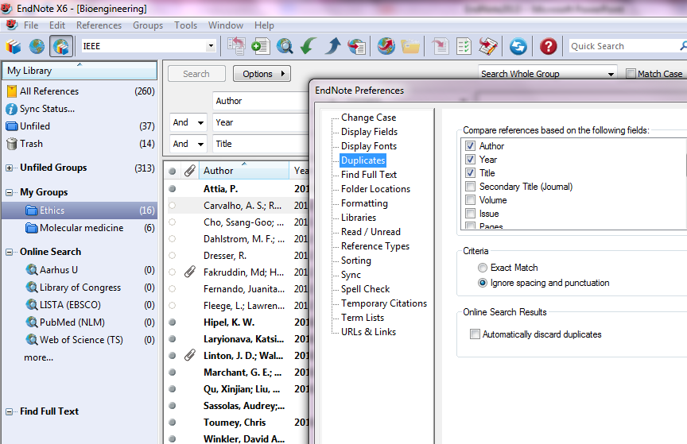
ENDNOTE preferences

Slide 40
Other EndNote Preferences
Can do the following:
  Set default Reference Type (i.e. journal article, book, etc.)
  Instruct EndNote to ignore articles when sorting
  Customize display fields in Library Window
  Set duplicate detection options
  Set spell check preferences

Slide 41
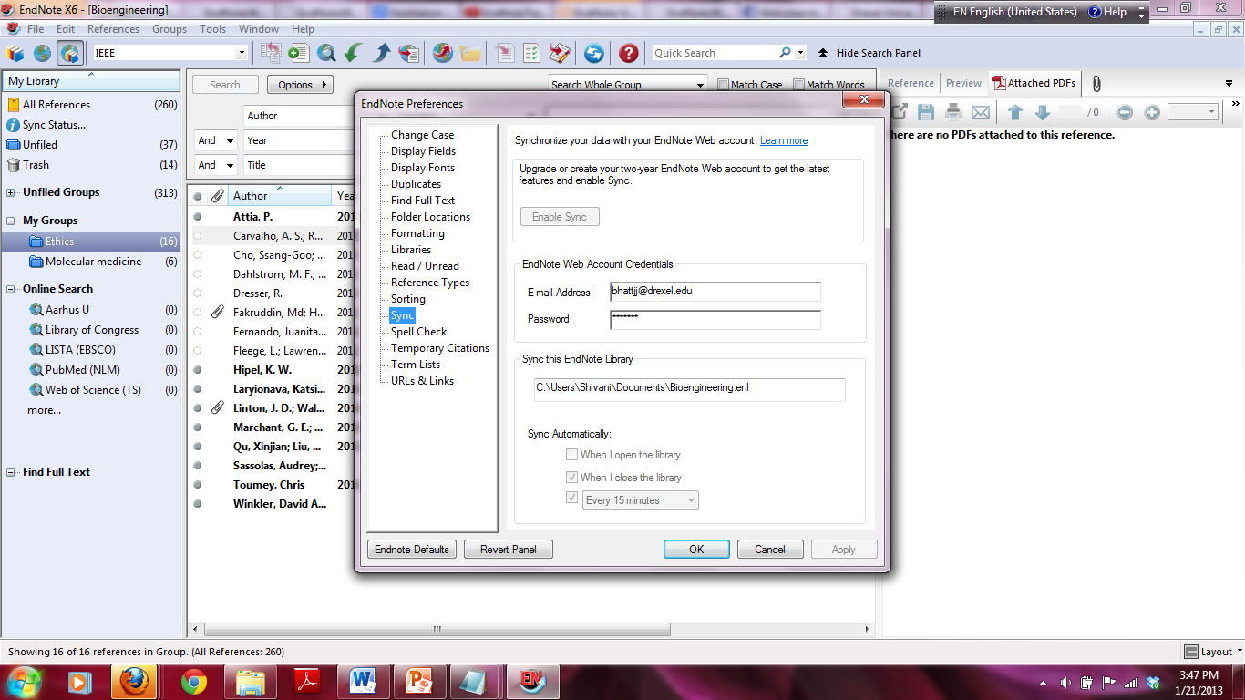
Syncing ENDNOTE and ENDNOTEWEB

Slide 42
Cite While You Write (CWYW)
In Word 2010, start typing your paper
To insert a citation, go to
  EndNote X6 →
  Insert Citation →
  Find Citation(s)
Type in a search term and click Search
Click the Insert button
EndNote automatically formats the citation according to the currently selected output style
Notes:
p. 88-99
Type: Bradley

Slide 43
Selecting a Bibliographic
Style (1 of 3)
To change the style in which the bibliography is formatted: Click on the arrow next to ‘Bibliography’
Click on the drop-down arrow next to “With output style” or click the Browse button and select a style
Click OK
Notes:
Change to IEEE, then Biomaterials

Slide 44
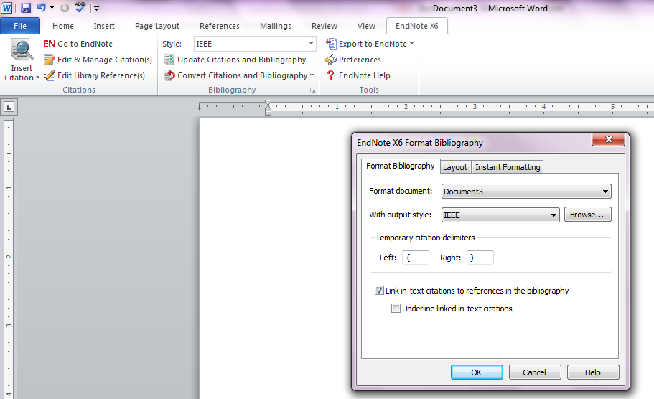
Selecting a Bibliographic
Style (2 of 3)

Slide 45
Selecting a Bibliographic
Style (3 of 3)
Existing citations and bibliography are reformatted according to the new style
NOTE: If you make changes to your citations or bibliography in the text of the paper, DO NOT change the bibliographic style or your changes will be erased

Slide 46
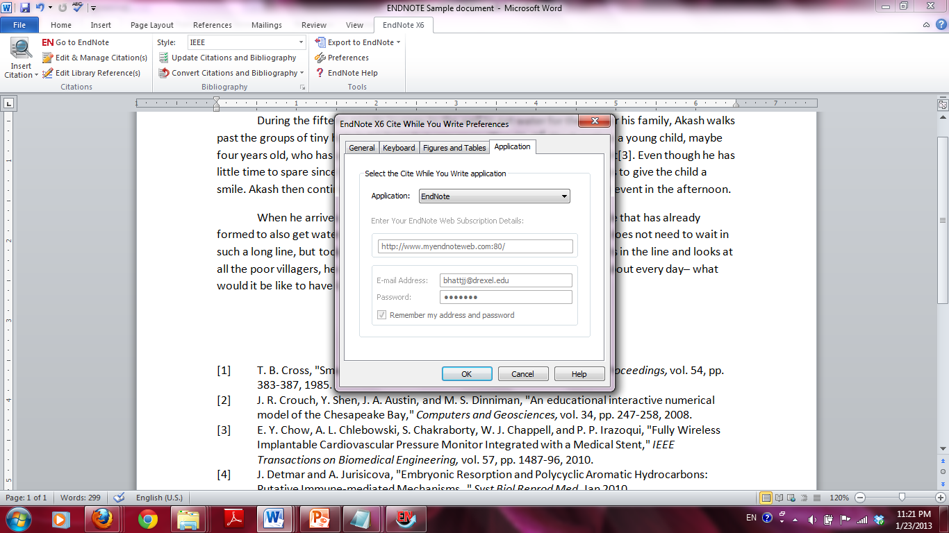
ENDNOTE WEB and ENDNOTE X6 in Word 2010

Slide 47
EndNote Resources
Getting Started Guide for Windows and Mac OS X
Complete EndNote manual (EndNote.pdf) can be found in C:\Program Files(x86)\EndNote X6
PDF of Getting Started Guide located in that folder as well

Slide 48
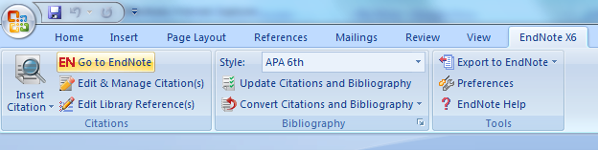
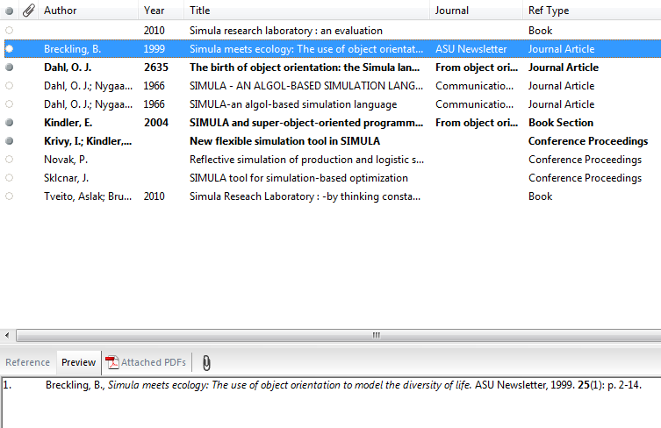
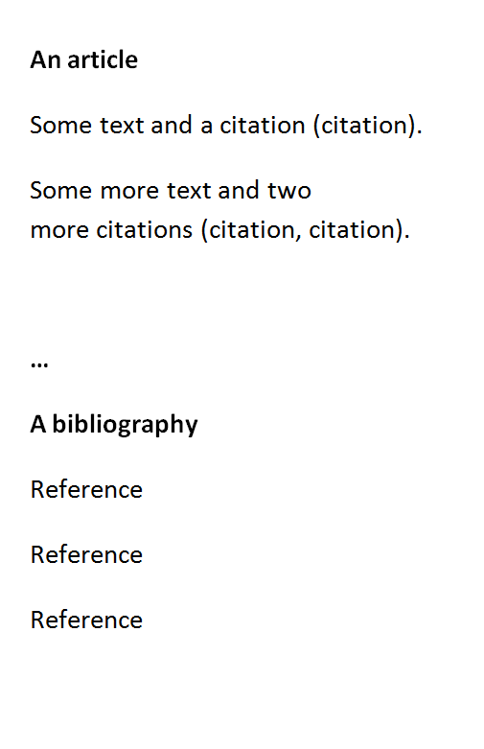
Word/EndNote

Slide 49
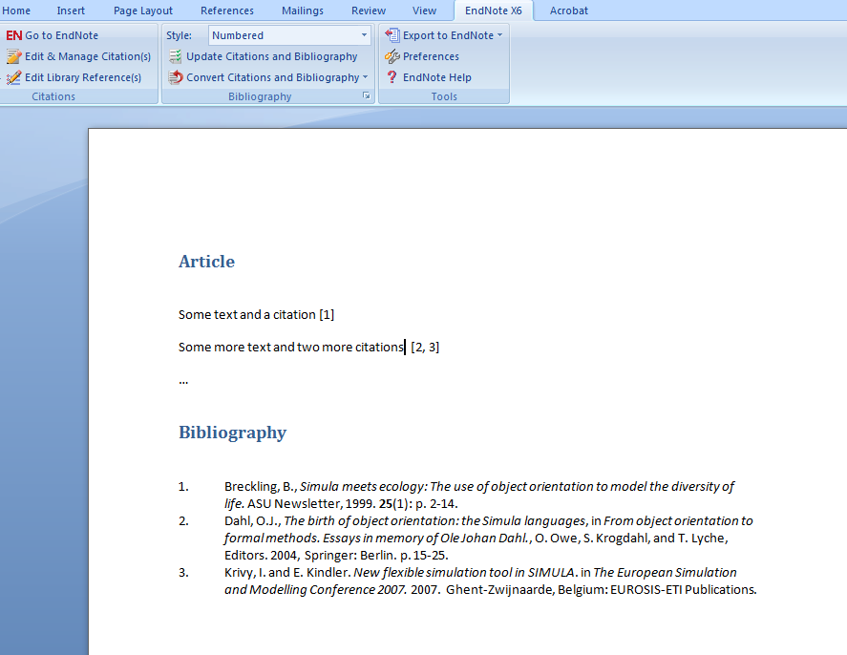
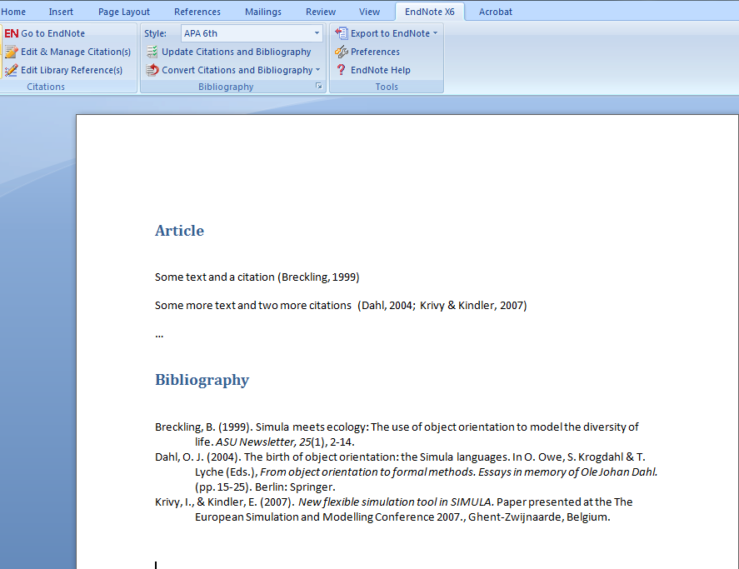

Slide 50
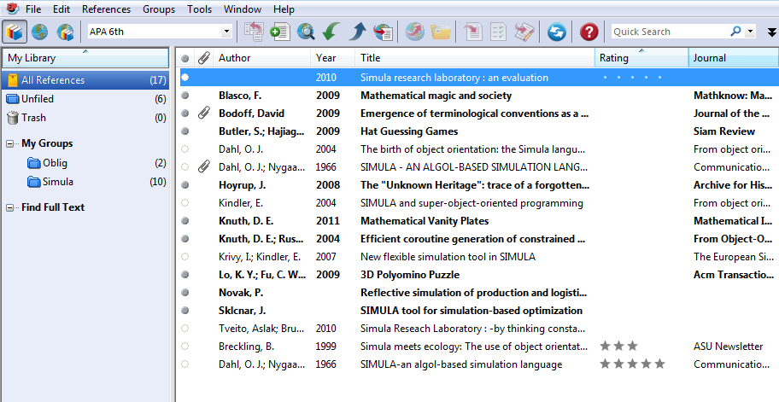

Slide 51
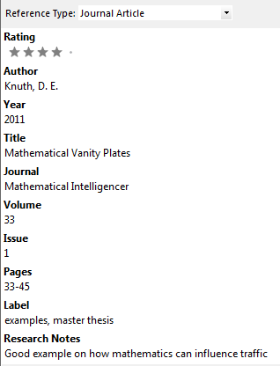
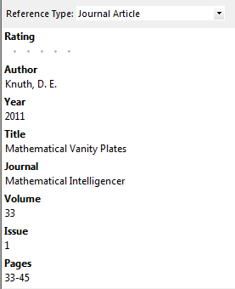

Slide 52




Slide 53


Slide 54


Slide 55
Be aware
EndNote will make mistakes
Proof read your references and remove duplicates
Look at your bibliography to see if you need to make template changes in EndNote
EndNote is not well suited for collaboration (but working on it)

