Slide 1

Scientific writing (81-933) Lecture 7: Abstract
Dr. Avraham Samson
Faculty of Medicine in the Galilee

Slide 2
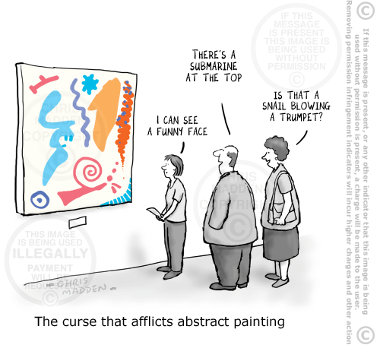
Abstract writing is not abstract art!

Slide 3
Abstracts
Abstracts (ab=out, trahere=pull; “to pull out”)
Overview of the main story
Gives highlights from each section of the paper
Limited length (100-300 words, typically)
Stands on its own
Used, with title, for electronic search engines
Most often, the only part people read

Slide 4
Abstracts
Gives:
Background
Question asked
“We asked whether,” “We hypothesized that,”…etc.
Experiment(s) done
Material studied (molecule, cell line, tissue, organ) or the animal or human population studied
The experimental approach or study design and the independent and dependent variables
Results found
Key results found
Minimal raw data (prefer summaries)
The answer to the question asked
Implication, speculation, or recommendation

Slide 5
Abstracts
Abstracts may be structured (with subheadings) or free-form.

Slide 6
Abstracts
Structured example: (The Lancet, 2006 Feb 11;367(9509):475-81.)
Development of adenoviral-vector-based pandemic influenza vaccine against antigenically distinct human H5N1 strains in mice.
Hoelscher MA, Garg S, Bangari DS, Belser JA, Lu X, Stephenson I, Bright RA, Katz JM, Mittal SK, Sambhara S.

Slide 7
Abstracts
Question
asked
Background
INTRODUCTION: Avian H5N1 influenza viruses currently circulating in southeast Asia could potentially cause the next pandemic. However, currently licensed human vaccines are subtype-specific and do not protect against these H5N1 viruses. We aimed to develop an influenza vaccine and assessed its immunogenicity and efficacy to confer protection in BALB/c mice.
METHODS: We developed an egg-independent strategy to combat the avian influenza virus, because the virus is highly lethal to chickens and the maintenance of a constant supply of embryonated eggs would be difficult in a pandemic. We used a replication-incompetent, human adenoviral-vector-based, haemagglutinin subtype 5 influenza vaccine (HAd-H5HA), which induces both humoral and cell-mediated immune responses against avian H5N1 influenza viruses isolated from people.
Experiments done

Slide 8
Abstracts
Results found
FINDINGS: Immunisation of mice with HAd-H5HA provided effective protection from H5N1 disease, death, and primary viral replication (p<0.0001) against antigenically distinct strains of H5N1 influenza viruses. Unlike the recombinant H5HA vaccine, which is based on a traditional subunit vaccine approach, HAd-H5HA vaccine induced a three-fold to eight-fold increase in HA-518-epitope-specific interferon-gamma-secreting CD8 T cells (p=0.01).
INTERPRETATION: Our findings highlight the potential of an Ad-vector-based delivery system, which is both egg-independent and adjuvant-independent and offers stockpiling options for the development of a pandemic influenza vaccine.
Answer to the question asked
Wider implication

Slide 9
Abstracts
Structured example 2:
N Engl J Med. 2006 Feb 16;354(7):684-96.
Calcium plus vitamin D supplementation and the risk of colorectal cancer.
Wactawski-Wende J, Kotchen JM, Anderson GL, Assaf AR, Brunner RL, O'Sullivan MJ, Margolis KL, Ockene JK, Phillips L, Pottern L, Prentice RL, Robbins J, Rohan TE, Sarto GE, Sharma S, Stefanick ML, Van Horn L, Wallace RB, Whitlock E, Bassford T, Beresford SA, Black HR, Bonds DE, Brzyski RG, Caan B, Chlebowski RT, Cochrane B, Garland C, Gass M, Hays J, Heiss G, Hendrix SL, Howard BV, Hsia J, Hubbell FA, Jackson RD, Johnson KC, Judd H, Kooperberg CL, Kuller LH, LaCroix AZ, Lane DS, Langer RD, Lasser NL, Lewis CE, Limacher MC, Manson JE; Women's Health Initiative Investigators.

Slide 10
Abstracts
Literature gap.
Background
ABSTRACT
BACKGROUND: Higher intake of calcium and vitamin D has been associated with a reduced risk of colorectal cancer in epidemiologic studies and polyp recurrence in polyp-prevention trials. However, randomized-trial evidence that calcium with vitamin D supplementation is beneficial in the primary prevention of colorectal cancer is lacking.
METHODS: We conducted a randomized, double-blind, placebo-controlled trial involving 36,282 postmenopausal women from 40 Women's Health Initiative centers: 18,176 women received 500 mg of elemental calcium as calcium carbonate with 200 IU of vitamin D3 twice daily (1000 mg of elemental calcium and 400 IU of vitamin D3) and 18,106 received a matching placebo for an average of 7.0 years. The incidence of pathologically confirmed colorectal cancer was the designated secondary outcome. Baseline levels of serum 25-hydroxyvitamin D were assessed in a nested case-control study.
Study Design

Slide 11
Abstracts
Results found
RESULTS: The incidence of invasive colorectal cancer did not differ significantly between women assigned to calcium plus vitamin D supplementation and those assigned to placebo (168 and 154 cases; hazard ratio, 1.08; 95 percent confidence interval, 0.86 to 1.34; P=0.51), and the tumor characteristics were similar in the two groups. The frequency of colorectal-cancer screening and abdominal symptoms was similar in the two groups. There were no significant treatment interactions with baseline characteristics.
CONCLUSIONS: Daily supplementation of calcium with vitamin D for seven years had no effect on the incidence of colorectal cancer among postmenopausal women. The long latency associated with the development of colorectal cancer, along with the seven-year duration of the trial, may have contributed to this null finding. Ongoing follow-up will assess the longer-term effect of this intervention.
Answer to the question asked
The caveats.

Slide 12
Abstracts
Even more subheadings…
Effect of Rimonabant, a Cannabinoid-1 Receptor Blocker, on Weight and Cardiometabolic Risk Factors in Overweight or Obese Patients RIO-North America: A Randomized Controlled Trial
F. Xavier Pi-Sunyer, MD; Louis J. Aronne, MD; Hassan M. Heshmati, MD; Jeanne Devin, MS; Julio Rosenstock, MD; for the RIO-North America Study Group
JAMA. 2006;295:761-775.

Slide 13
Abstracts
Context: Rimonabant, a selective cannabinoid-1 receptor blocker, may reduce body weight and improve cardiometabolic risk factors in patients who are overweight or obese.
Objective: To compare the efficacy and safety of rimonabant with placebo each in conjunction with diet and exercise for sustained changes in weight and cardiometabolic risk factors over 2 years.
Design, Setting, and Participants: Randomized, double-blind, placebo-controlled trial of 3045 obese (body mass index 30) or overweight (body mass index >27 and treated or untreated hypertension or dyslipidemia) adult patients at 64 US and 8 Canadian clinical research centers from August 2001 to April 2004.
Intervention: After a 4-week single-blind placebo plus diet (600 kcal/d deficit) run-in period, patients were randomized to receive placebo, 5 mg/d of rimonabant, or 20 mg/d of rimonabant for 1 year. Rimonabant-treated patients were rerandomized to receive placebo or continued to receive the same rimonabant dose while the placebo group continued to receive placebo during year 2.

Slide 14
Abstracts
Results: At year 1, the completion rate was 309 (51%) patients in the placebo group, 620 (51%) patients in the 5 mg of rimonabant group, and 673 (55%) patients in the 20 mg of rimonabant group. Compared with the placebo group, the 20 mg of rimonabant group produced greater mean (SEM) reductions in weight (–6.3 [0.2] kg vs –1.6 [0.2] kg; P<.001), waist circumference (–6.1 [0.2] cm vs –2.5 [0.3] cm; P<.001), and level of triglycerides (percentage change, –5.3 [1.2] vs 7.9 [2.0]; P<.001) and a greater increase in level of high-density lipoprotein cholesterol (percentage change, 12.6 [0.5] vs 5.4 [0.7]; P<.001). Patients who were switched from the 20 mg of rimonabant group to the placebo group during year 2 experienced weight regain while those who continued to receive 20 mg of rimonabant maintained their weight loss and favorable changes in cardiometabolic risk factors. Use of different imputation methods to account for the high rate of dropouts in all 3 groups yielded similar results. Rimonabant was generally well tolerated; the most common drug-related adverse event was nausea (11.2% for the 20 mg of rimonabant group vs 5.8% for the placebo group).

Slide 15
Abstracts
Conclusions: In this multicenter trial, treatment with 20 mg/d of rimonabant plus diet for 2 years promoted modest but sustained reductions in weight and waist circumference and favorable changes in cardiometabolic risk factors. However, the trial was limited by a high drop-out rate and longer-term effects of the drug require further study.

Slide 16
Abstracts
Science. 2006 Feb 17;311(5763):1020-2. Causal reasoning in rats. Blaisdell AP, Sawa K, Leising KJ, Waldmann MR.
Empirical research with nonhuman primates appears to support the view that causal reasoning is a key cognitive faculty that divides humans from animals. The claim is that animals approximate causal learning using associative processes. The present results cast doubt on that conclusion. Rats made causal inferences in a basic task that taps into core features of causal reasoning without requiring complex physical knowledge. They derived predictions of the outcomes of interventions after passive observational learning of different kinds of causal models. These competencies cannot be explained by current associative theories but are consistent with causal Bayes net theories.

Slide 17
Keywords
Used to classify papers in databases (i.e. Pubmed).
Usually limited to around 5.
Informative and non-repetitive

Slide 18
Funding
Acknowledge money for research.

Slide 19
Acknowledgement
Thank non-authors, that reviewed manuscript.
Thank providers of materials, software.

Slide 20


Slide 21
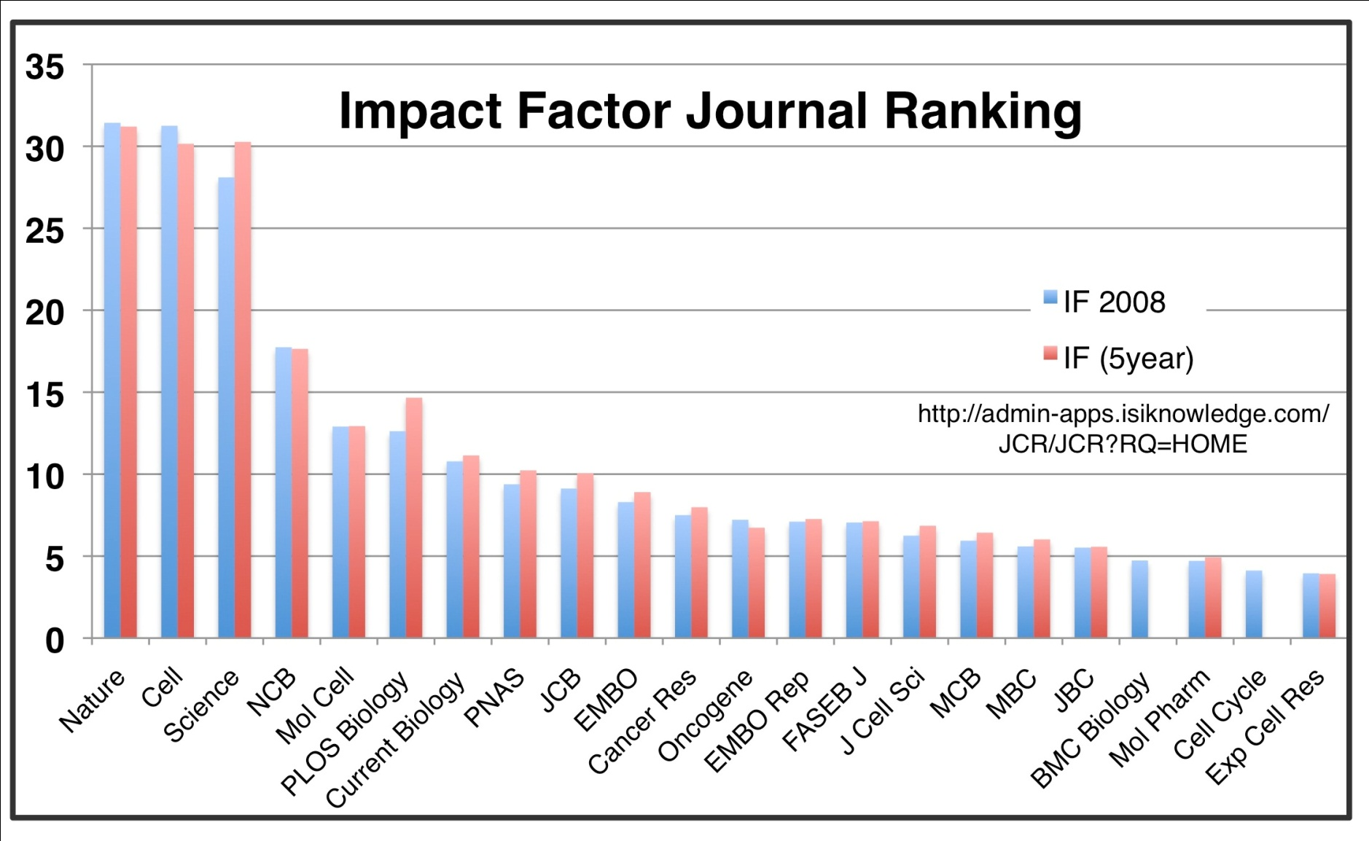

Slide 22
Impact factor (IF)
Citations = the yearly number of citations of all journal articles published in 2 years.
Publications = the total number of journal articles published in 2 years.
Impact factor = Citations/Publications

Slide 23
In favor of IF
Against IF
Good measure of importance of a journal
Not a good measure of importance of a paper
Not a good measure of importance of researcher
Not a good measure to compare journals of different fields

Slide 24
Artificial impact factors
Physicists publish more than biologists, thus physics journals have higher impact factor that biology journals.
In 2008, Acta Crystallographica had 6,600 citations for one paper, raising it IF to 50 above Nature (31).
in 2007, the journal Folia Phoniatrica et Logopaedica, with an impact factor of 0.66, published an editorial that cited all its articles from 2005 to 2006 , thus raising its IF to 1.4.

Slide 25
In England, hiring panels routinely consider impact factors
By Spanish law, researchers are rewarded for publishing in journals defined by ISI as prestigious (upper third of impact factor listings)
In China, scientists get cash bonuses for publishing in high-impact journals. In some schools, physics students must publish at least 2 articles with a combined Impact Factor of 4 to get their PhD
From the Chronicle of Higher Education (2005) “The Number that is Devouring Science”

Slide 26
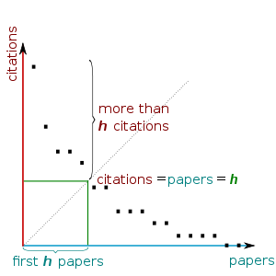
H-index
A scientist has index h, if h of his N_{p} papers have at least h citations each, and the other (N_{p} − h) papers have no more than h citations each.
From h-index, http://en.wikipedia.org/wiki/H-index

Slide 27
Evaluator of researcher ability
Based on typical h .. values found, it was suggested (with large error bars) that for faculty at major research universities, h ≈ 12 might be a typical value for advancement to tenure (associate professor) and that h ≈ 18 might be a typical value for advancement to full professor. Fellowship in the American Physical Society might occur typically for h ≈ 15–20. Membership in the National Academy of Sciences of the United States of America may typically be associated with h ≈ 45 and higher, except in exceptional circumstances

Slide 28
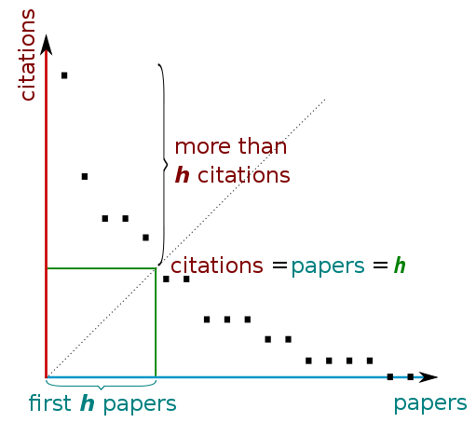
Determining h-index Manually
From h-index, http://en.wikipedia.org/wiki/H-index

Slide 29
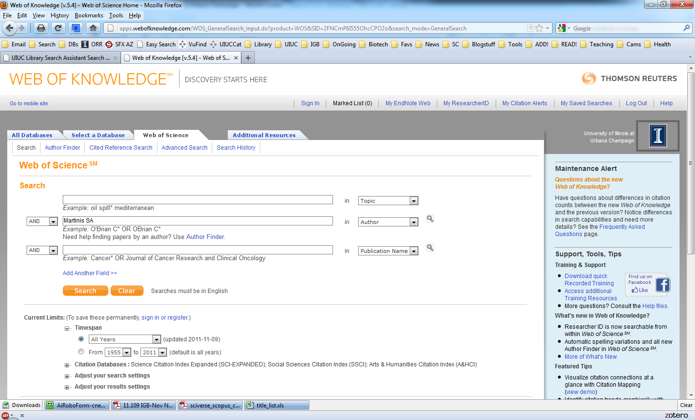
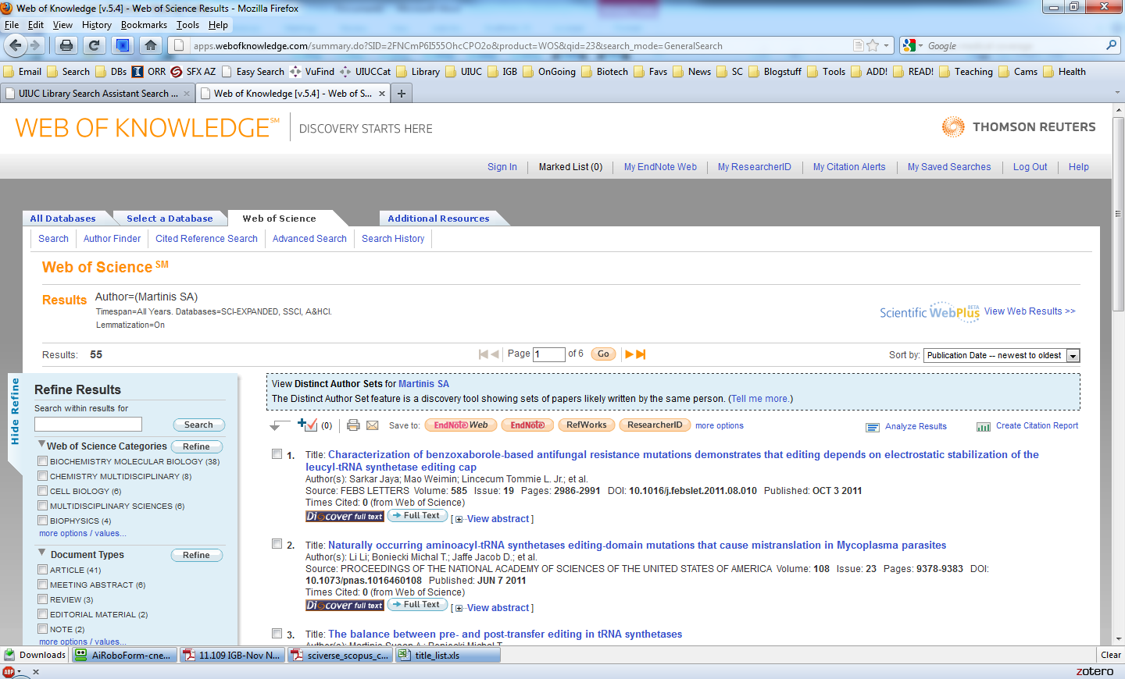
Finding a h-index value in Web of Science

Slide 30
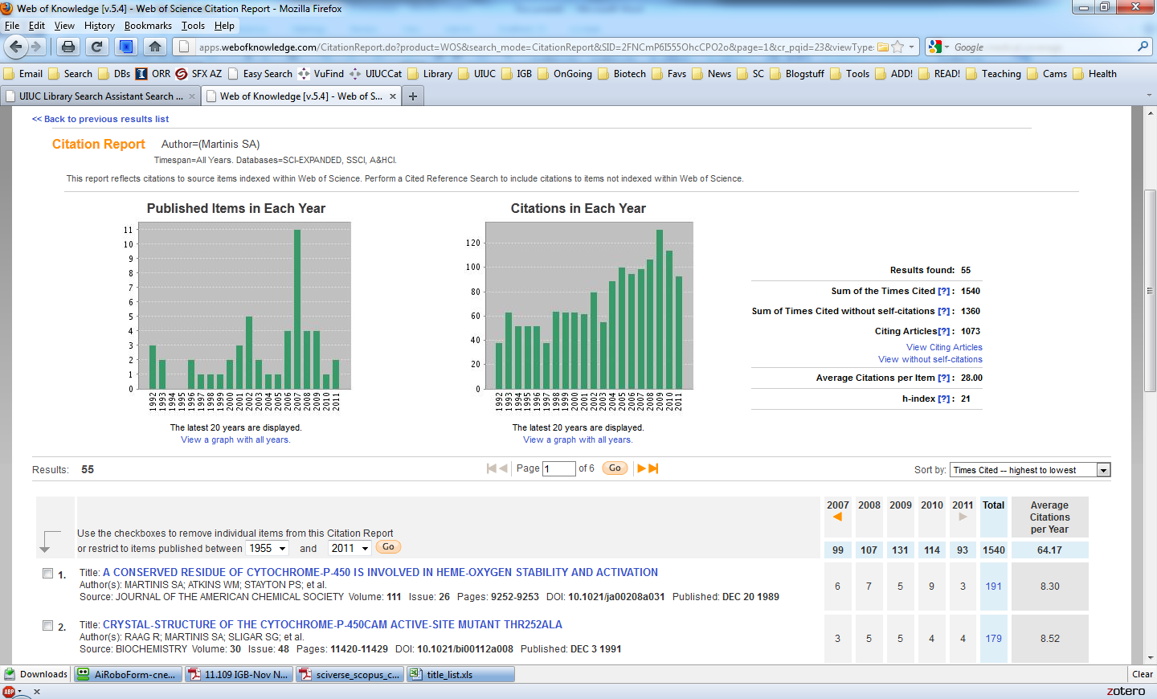
Citation Report (h-index) from Web of Science

Slide 31
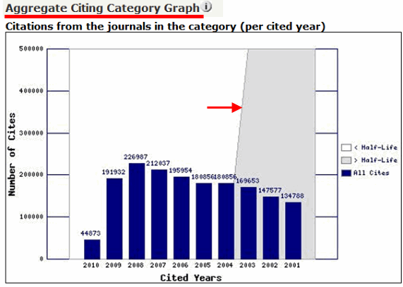
Cited half life

Slide 32
Comparison of h-index Values from Several Sources for Several Authors
Author | From Scopus | From Web of Science | From Google Scholar via “Publish or Perish”
Robinson, GE | 54 [193 docs] | 55 [202 docs] | 55 [381 docs]
Chancellor Wise, PM | 44 [178 docs] | 51 [204 docs] | 50 [333 docs]
Garfield, E | 22 [211 docs] | 288 [815 docs] | 45 [>1000 docs]
Pres. Hogan, MJ | -- [1 doc] | 6 [33 docs] | 14 [65 docs]
Pres. Easter, RA | 23 [87 docs] | 25 [107 docs] | 38 [276 doc, many duplicates]

Slide 33
Eminent, imminent, immanent
Eminent: outstanding, famous
Imminent: about to happen
Immanent: inherent (often religious context)
The book was written by an eminent authority.
Given the latest clashes, the war was clearly imminent.
He believed in the immanent unity of nature taught by the Hindus.

Slide 34
Emigrate and immigrate
Emigrate is to move out of a country.
Immigrate is to move into a country.
She emigrated from Poland and immigrated to the United States.

Slide 35
Epidemic, endemic, pandemic
Epidemic: describes a disease that quickly and severely affects lots of people and then subsides (From Greek: epi= upon + demos=people: literally ‘upon the people’)
Endemic: describes a disease that is continually present in an area and affects a relatively small number of people (en=within + demos=people; means ‘native’)
Pandemic: describes a widespread epidemic that may affect entire continents or even the world (pan=all + demos=people: literally ‘all people’)
There was an epidemic of SARS in Hong Kong last month.
Malaria is endemic to that part of South Africa.
AIDS is a pandemic.

Slide 36
Flaunt and flout
Flaunt is to display ostentatiously
Flout is to openly disregard
The dot-com millionaires liked to flaunt their wealth.
The pharma industry flouts authorship rules for medical journals. (recent headline)

Slide 37
Sex and gender
Use sex for biological differences
Use gender for cultural or social differences
They determined the sex of the organism from a karyotype.
He flouted traditional gender roles by being a stay-at-home dad.

Slide 38
Redundancy
Which are redundant?
HIV virus
G6PD deficiency
ROC curve
SAS software
And with a little international flair…
Rio Grande river
Sierra Nevada mountains

Slide 39
Redundancy
YES:
HIV virus—human immunodeficiency virus virus
Rio Grande river—Big River river
Sierra Nevada mountains—Sawtoothed Mountain Range Covered in Snow mountains
NO:
G6PD deficiency—glucose-6-phosphate dehydrogenase deficiency
ROC curve—receiver operator characteristic curve
SAS software—statistical analysis system software

Slide 40


