Slide 1

Scientific writing (81-933)
Lecture 9: Poster
Dr. Avraham Samson
Faculty of Medicine in the Galilee

Slide 2
A poster can be better than giving a talk
More efficient because:
• you totally bomb at giving talks
• can be viewed while you nap
• can hang in the department for years
• can reach folks not in your field of research

Slide 3

Posters serve as…
An advertisement of your hard work
Cool, wow!
Check this out!
You must be smart!

Slide 4
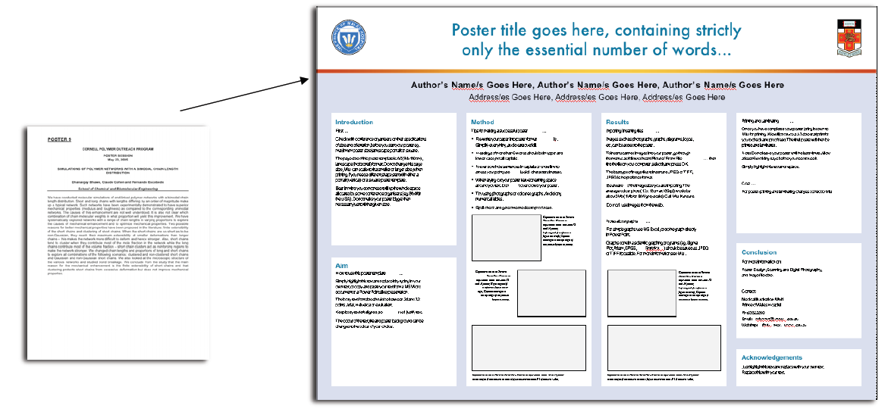
It’s just an illustrated abstract

Slide 5
Is my abstract effective?
• Why should anyone care?
• What am I adding to current knowledge?
• Do I need to explain methods?
• Have I told them what I found and recommend?

Slide 6
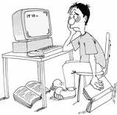
A portrait of a grad student
@#&%!@#$, I have 12 hours to throw this thing together and get it printed before it’s due.

Slide 7
How do I get months and years of research onto my poster?
• Your poster is a short story
• Describe a few major points
• Arouse the reader’s interest to read on
• Limit it to 250 words
• Read in 3-5 minutes

Slide 8

Recite after me: “Less is better!“

Slide 9
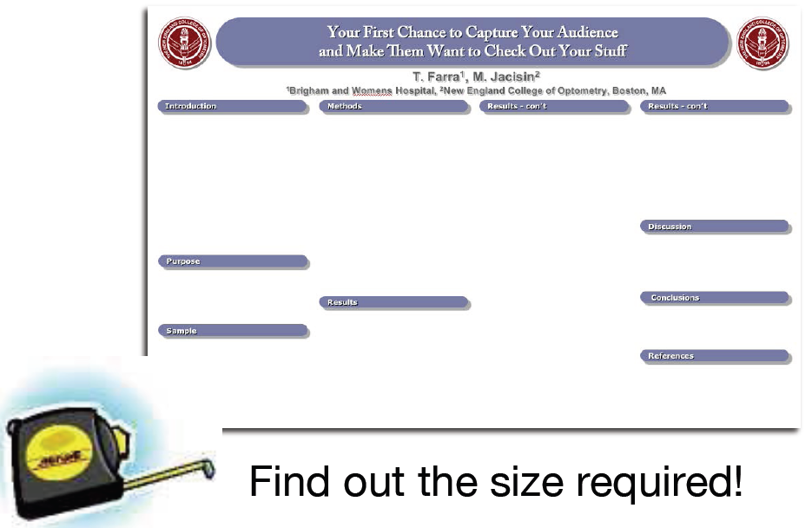
Simplify your paper into poster format

Slide 10
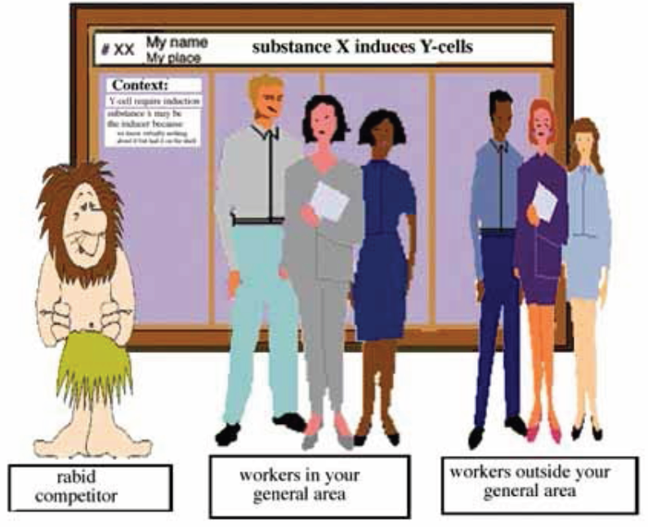
Who’s my audience?
ליל המדענים

Slide 11
Remember, most of the scientists.. come for the free booze
Poster sessions often overlap with lunch
Usually, posters with attractive girls standing next to them, get most visitors.
Usually, your poster is located in the furthest corner.
Your poster is located between two posters showing adorable koala bears, and cool spaceships.

Slide 12
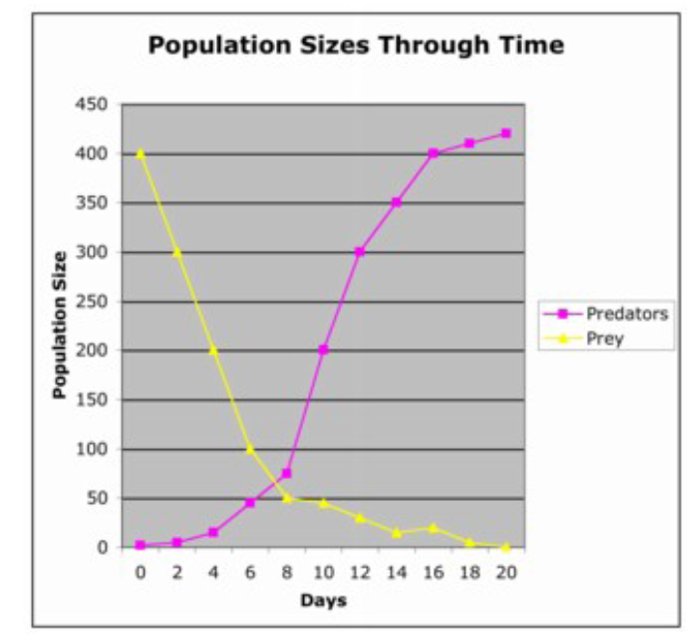
1. Keep figures simple
Don’t make them stand on their head to read your data!

Slide 13
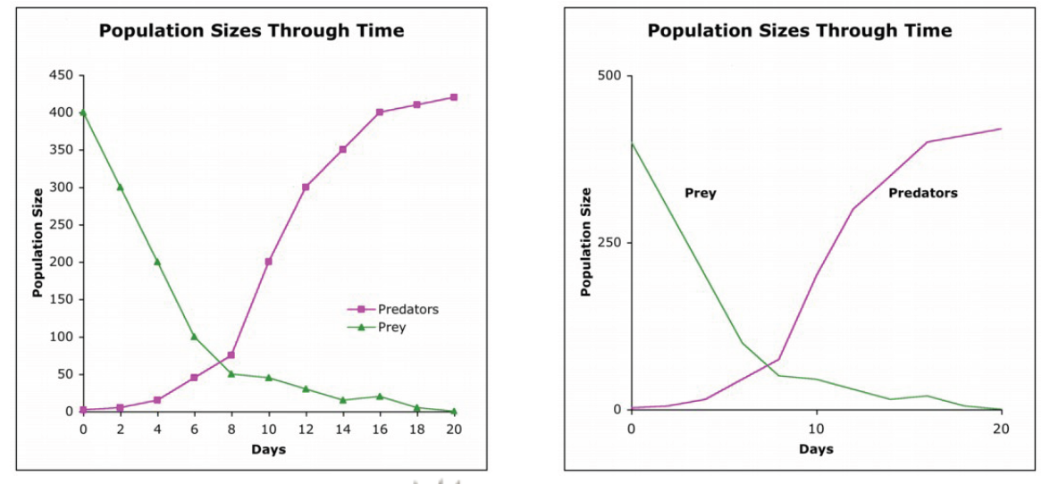
Keep it simple stupid (KISS)

Slide 14
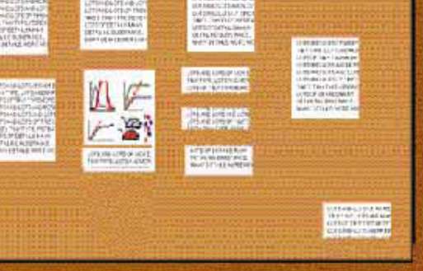
2. Small blocks of supporting text
The need for
chairs in front
of your poster
will not go
over well

Slide 15
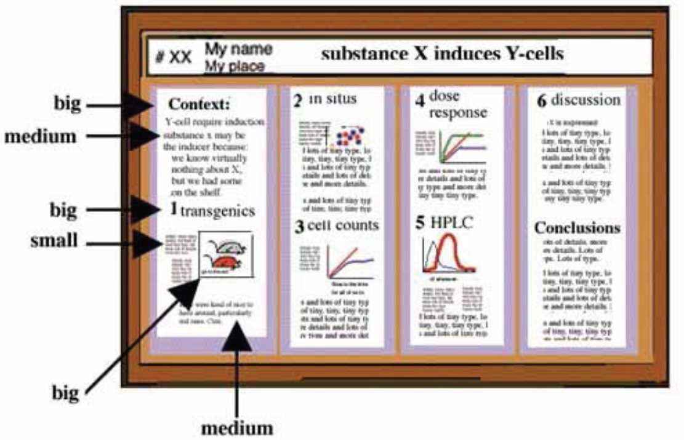
I could actually read this

Slide 16
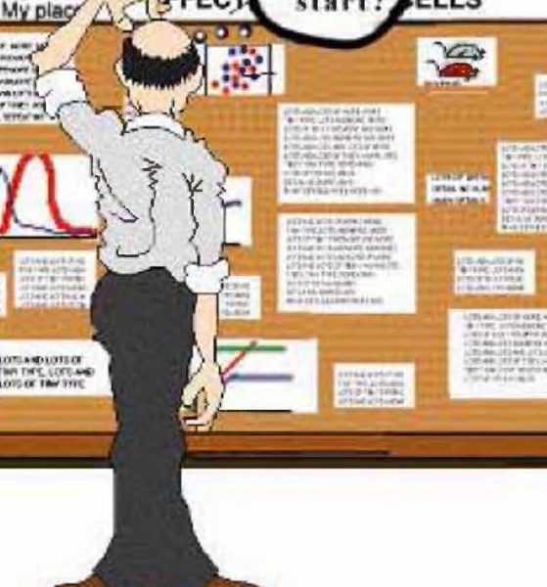

Slide 17
Pick a software program
PowerPoint
Adobe Illustrator or InDesign
Canvas
Publish-It
Corel Draw,
LaTeX, etc.

Slide 18
PowerPoint
You already know it.
Easy to use.
The colors may fool you a bit.
Inflexible, be careful with switching in between operating system, and using symbols.
One idea to circumvent this problem is saving file as PDF.

Slide 19
Others programs
• More difficult to learn.
• What you see is what you get.
Be careful with printer compatibility and colors. (Latex files are not recognized properly by many printers)

Slide 20


Slide 21
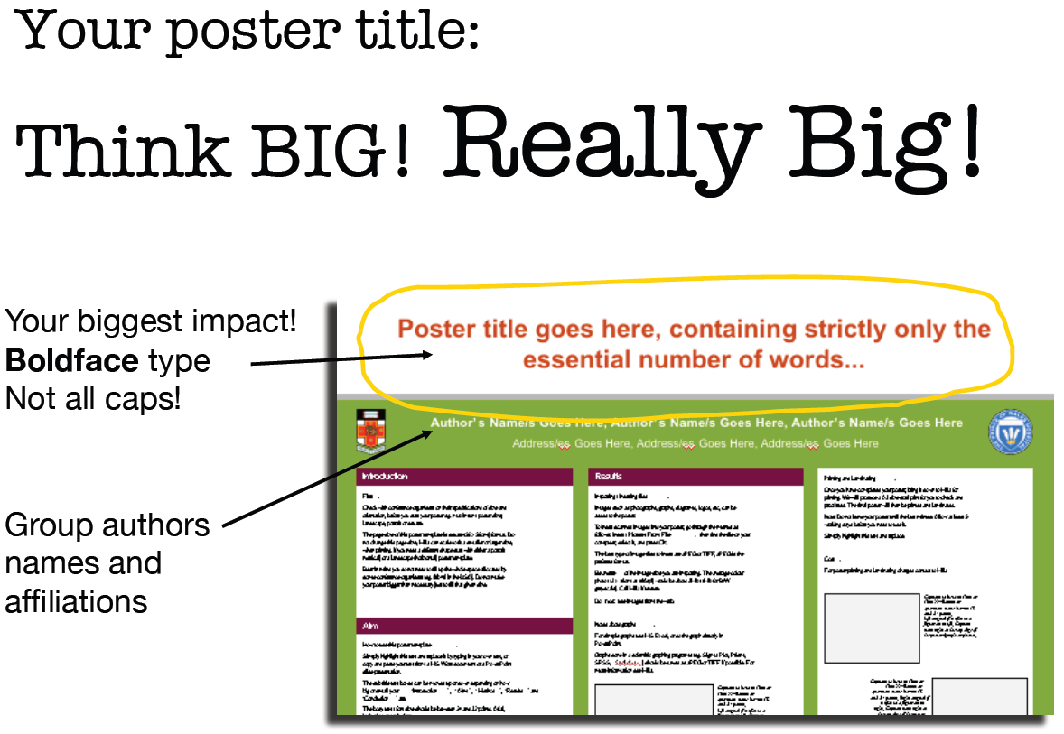

Slide 22
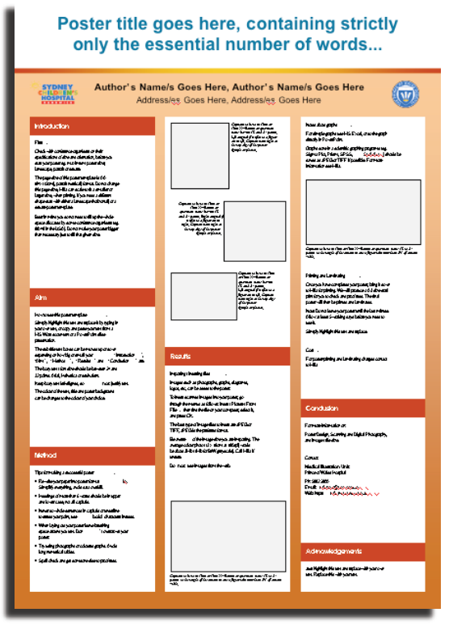
The Secrets of Readable Text:
Leave breathing space around your text !
Split into columns !
Plain fonts !
• Same size and style !
• Left-aligned
The reason is…

Slide 23
Hi there, my name is Abe Lincoln and I would like to tell you about myself and how I got this job at Cornell. Well you see, my uncle had a friend who knew my cousin on the other side and his daughter worked for facilities. I was down on my luck and my sister told me she knew a guy whose nephews wifes kid worked for this guys father and what can I say, he hired me with no questions asked and just told me

Slide 24
Hi there, my name is Abe Lincoln and I would like to tell you about myself and how I got this job at Cornell. Well you see, my uncle had a friend who knew my cousin on the other side and his daughter worked for facilities. I was down on my luck and my sister told me she knew a guy whose nephews wifes kid worked for this guys father and what can I say, he hired me with no questions asked and just told me

Slide 25
Hi there, my name is Abe Lincoln and I would like to tell you about myself and how I got this job at Cornell. Well you see, my uncle had a friend who knew my cousin on the other side and his daughter worked for facilities. I was down on my luck and my sister told me she knew a guy whose nephews wifes kid worked for this guys father and what can I say, he hired me with no questions asked and just told me

Slide 26
Hi there, my name is Abe Lincoln and I would like to tell you about myself and how I got this job at Cornell. Well you see, my uncle had a friend who knew my cousin on the other side and his daughter worked for facilities. I was down on my luck and my sister told me she knew a guy whose nephews wifes kid worked for this guys father and what can I say, he hired me with no questions asked and just told me

Slide 27
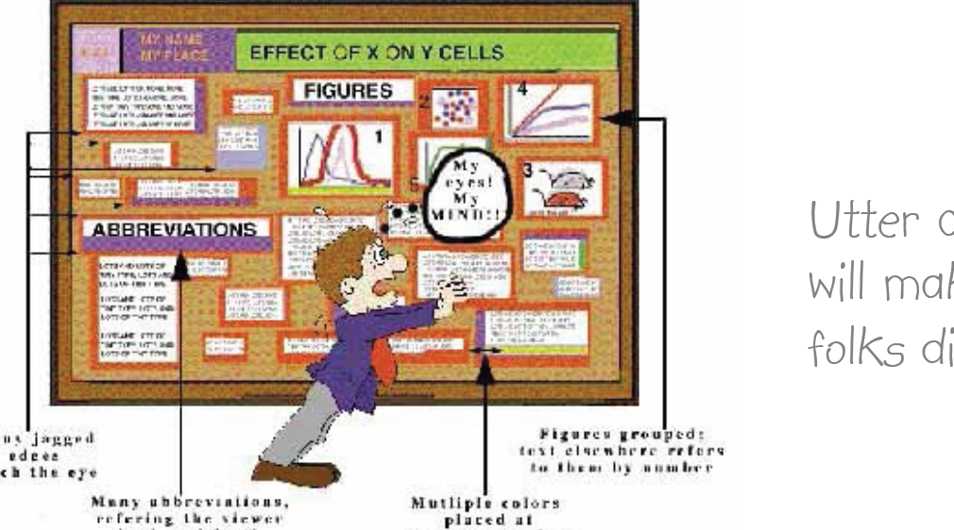

Slide 28
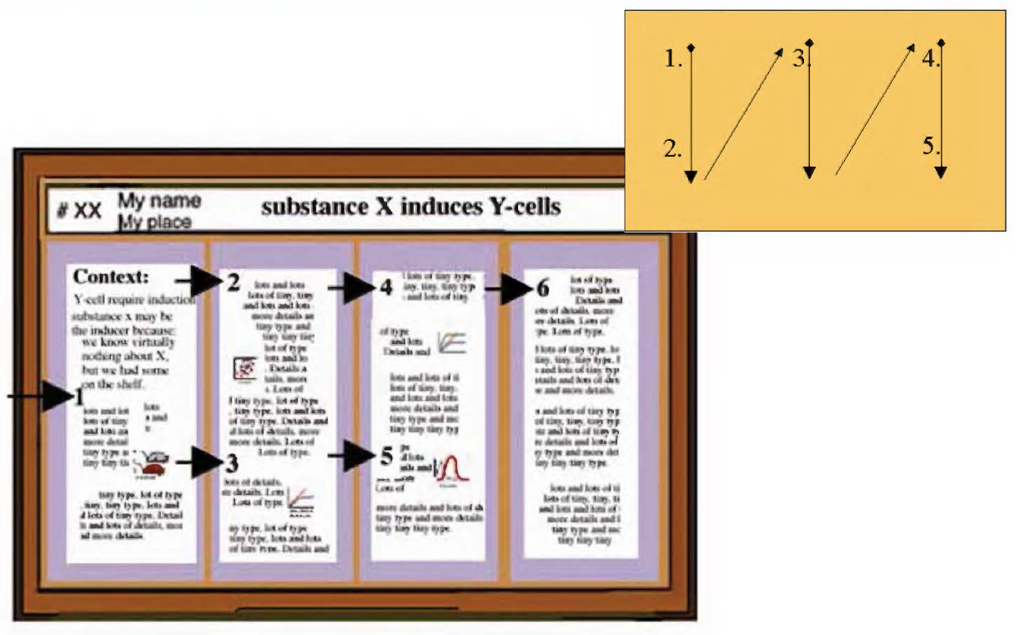

Slide 29
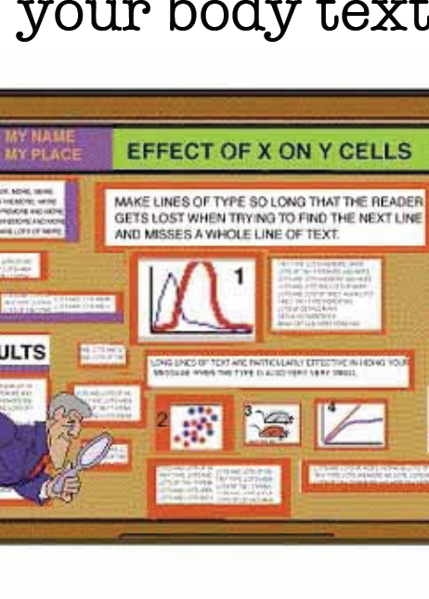

Slide 30
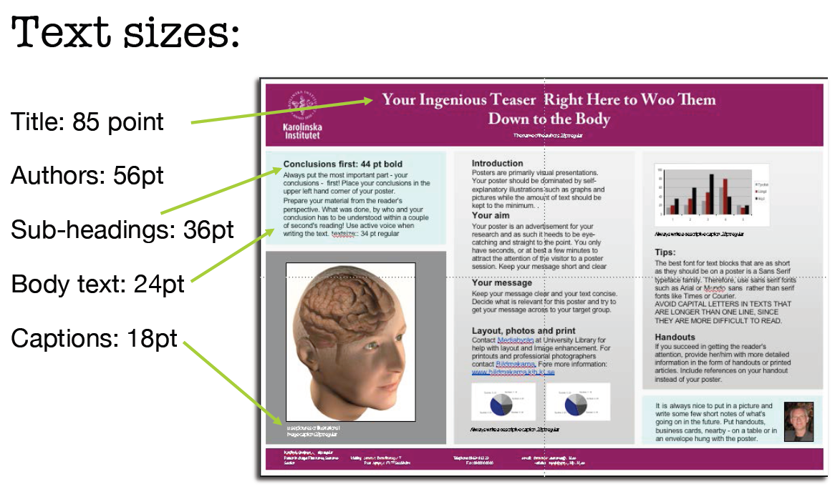

Slide 31
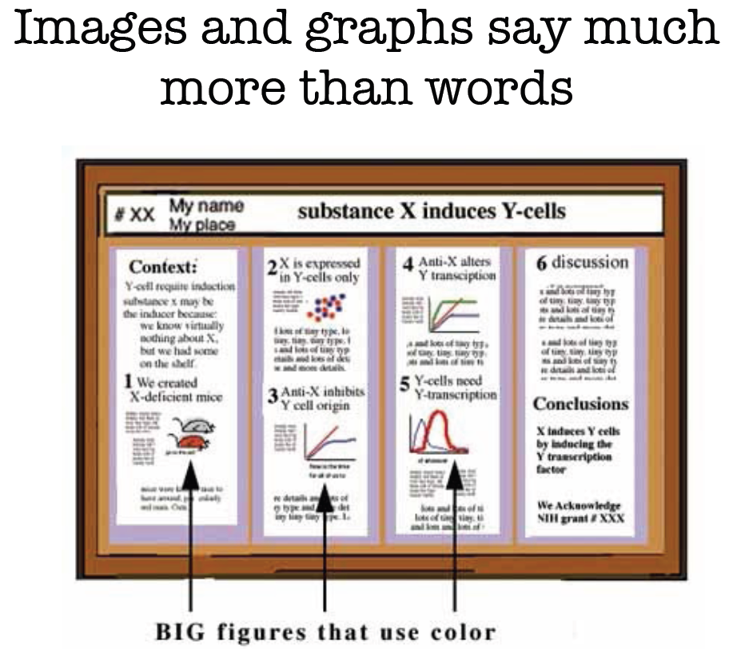

Slide 32
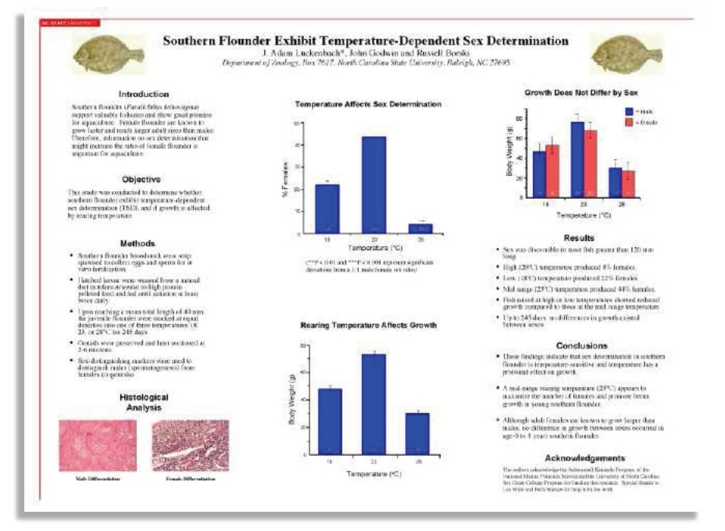
Keep poster visually attractive

Slide 33
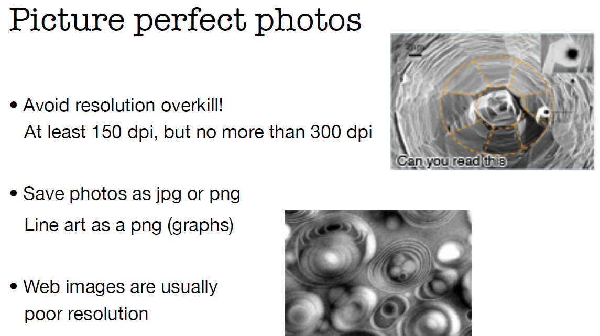

Slide 34
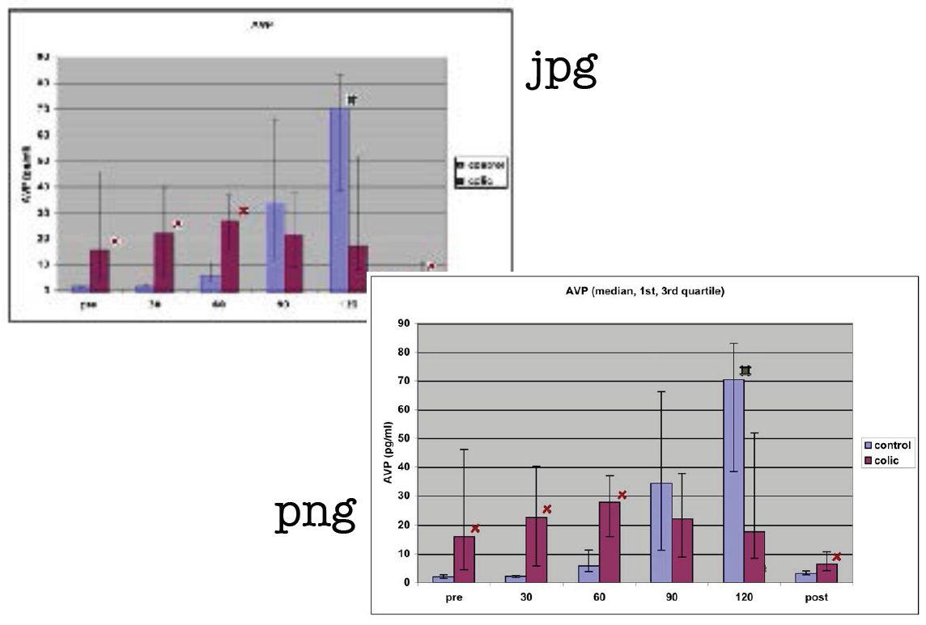

Slide 35
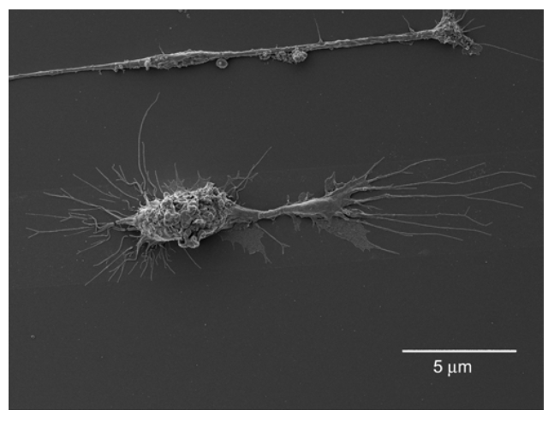
Your cool images mean nothing without a scale bar or a description

Slide 36
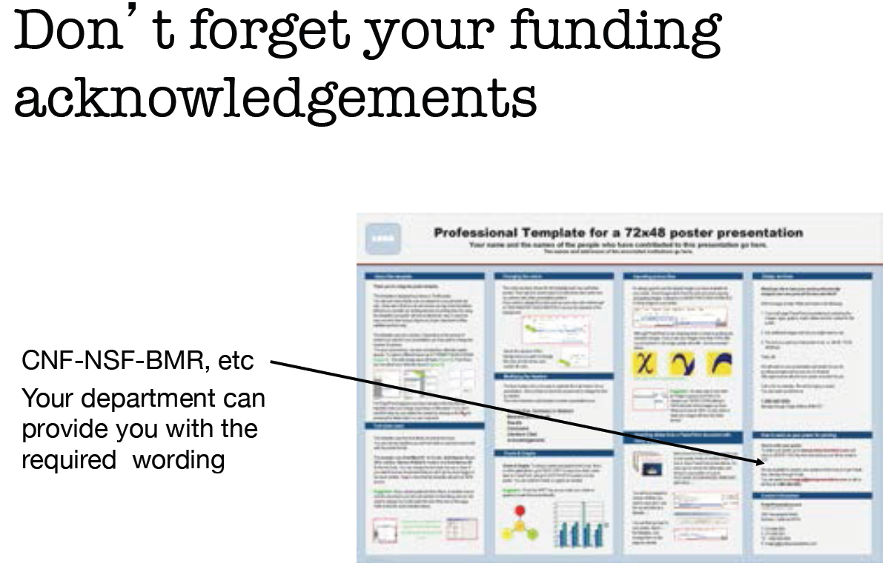

Slide 37
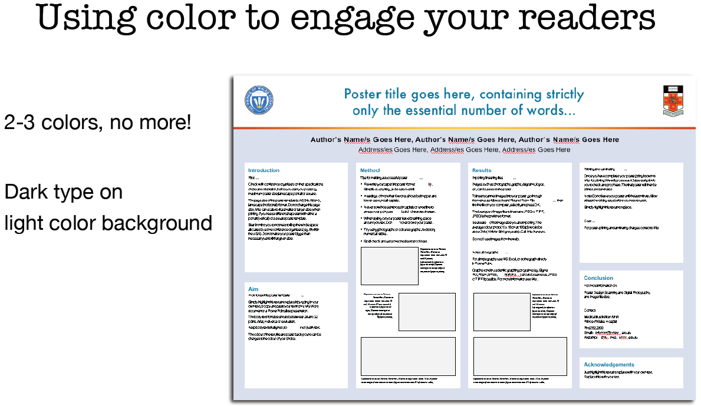

Slide 38
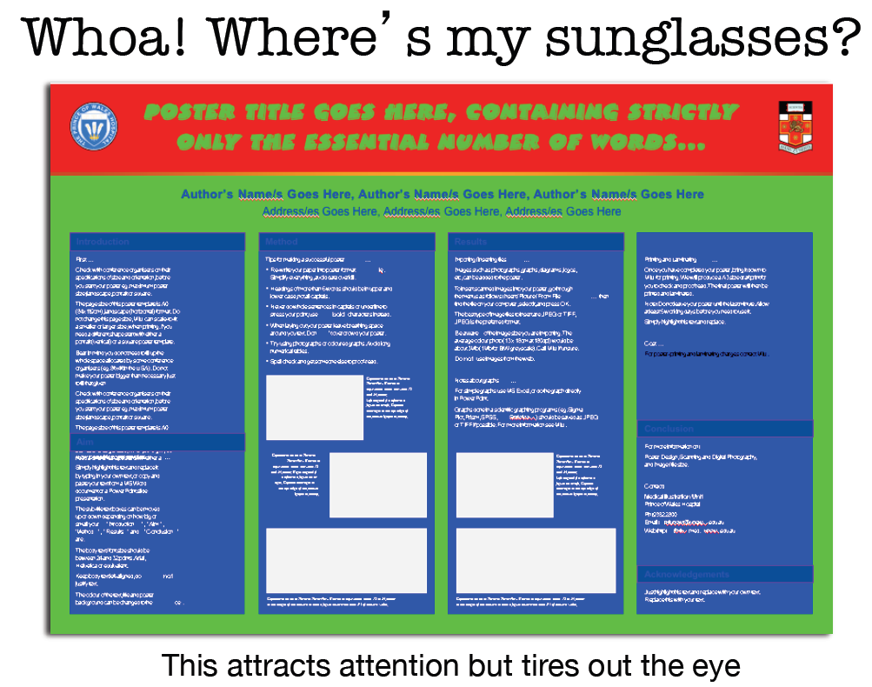

Slide 39
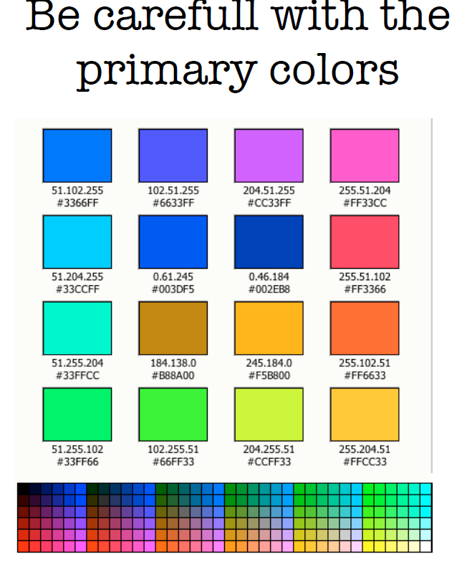

Slide 40
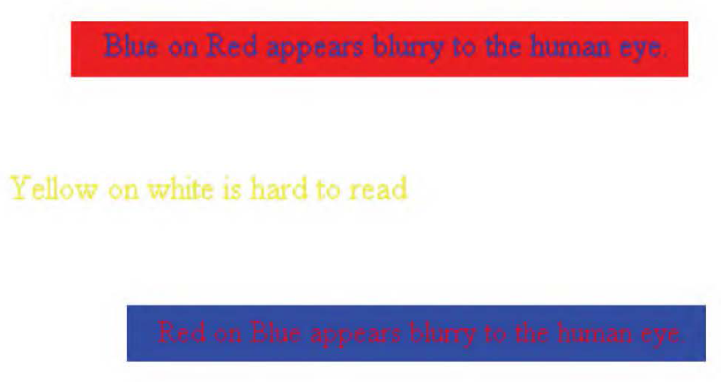

Slide 41
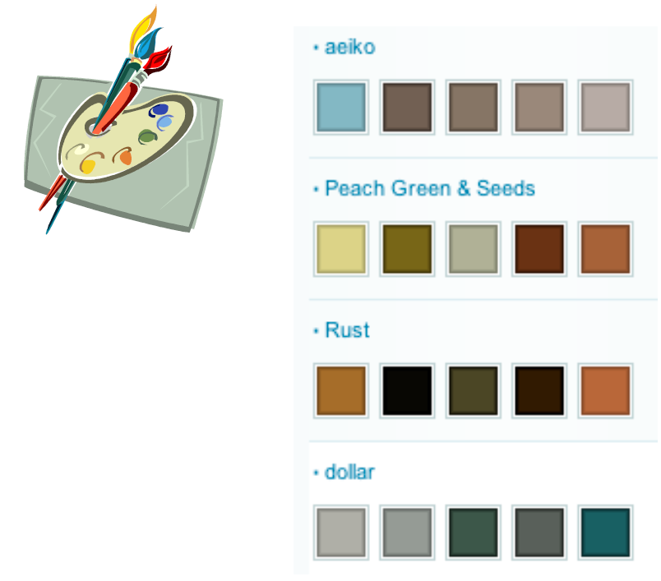
http://www.colorschemer.com

Slide 42
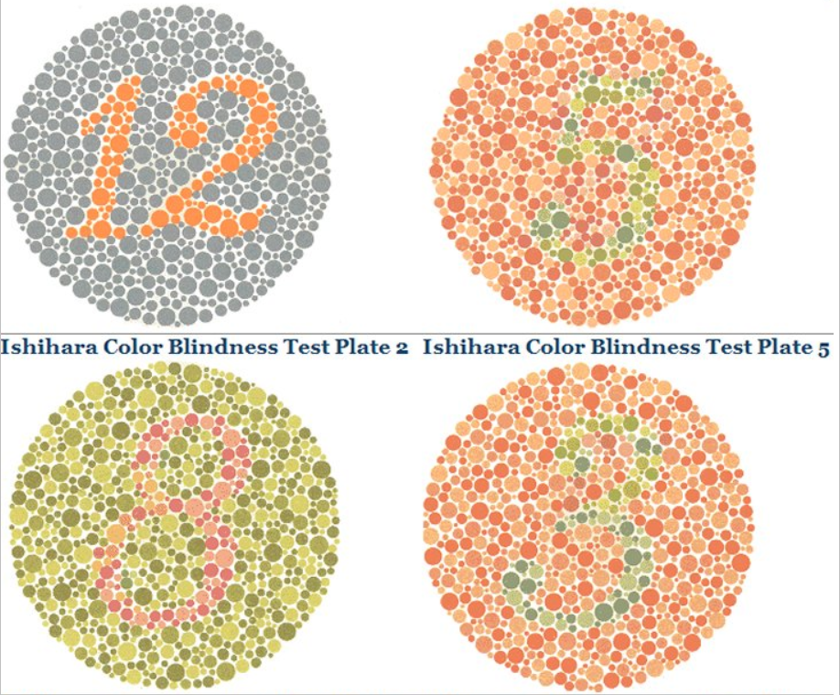

Slide 43
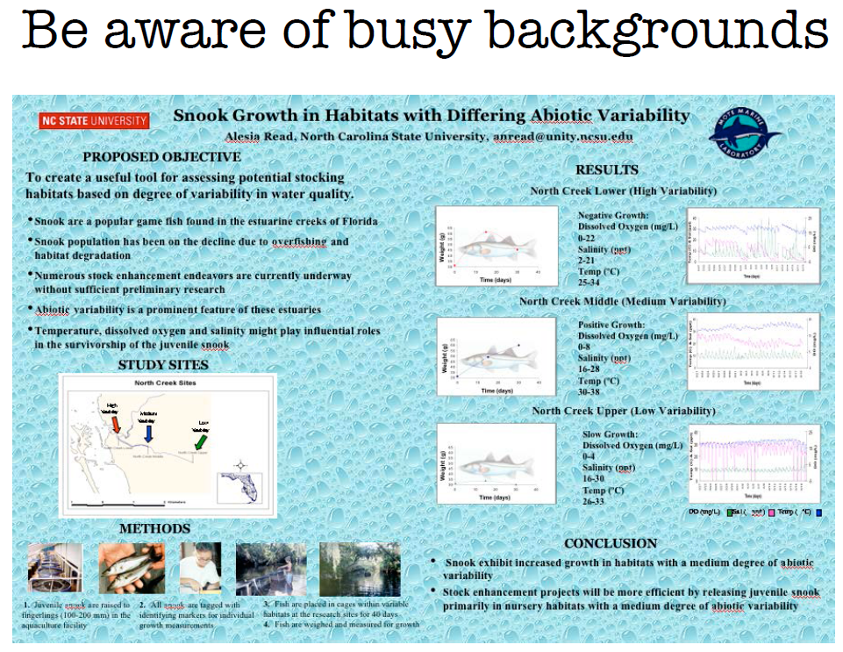

Slide 44
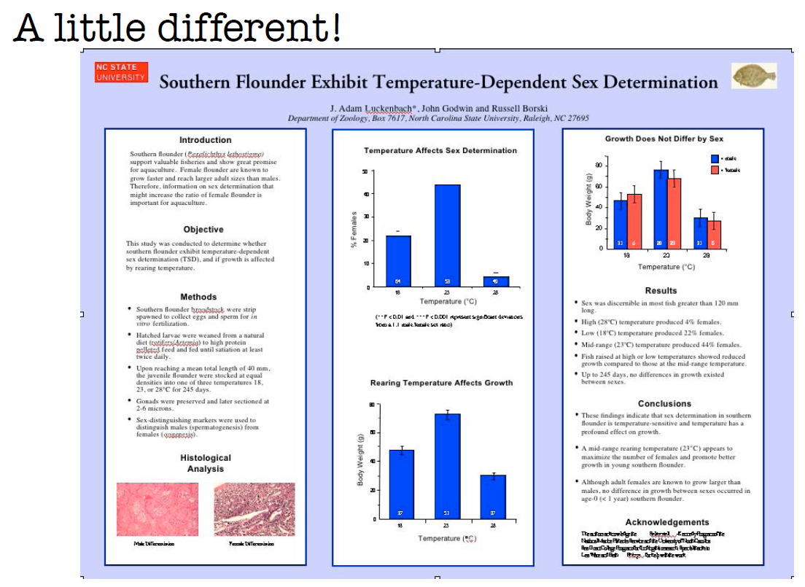

Slide 45
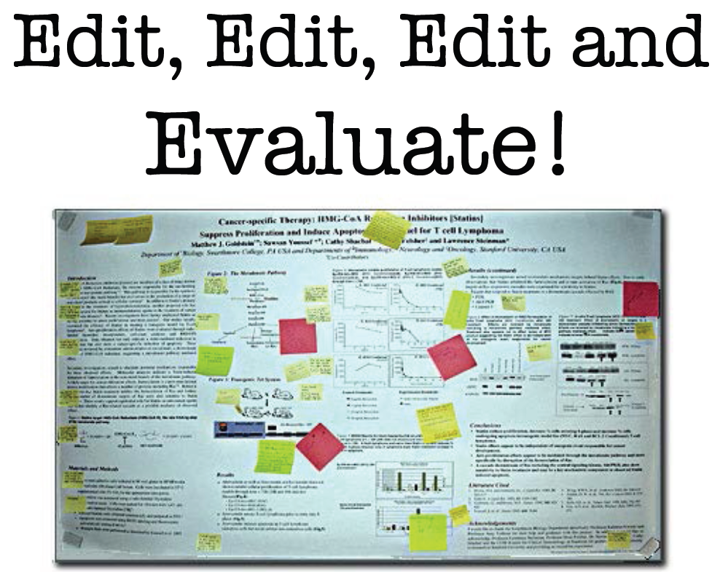

Slide 46
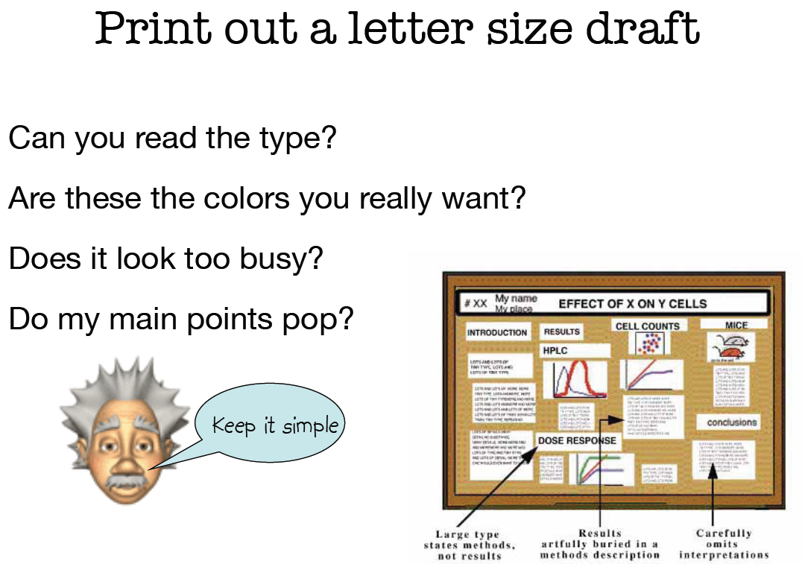

Slide 47
Print poster in Safed:
Defus Hachoshen דפוס החושן
Cell: 054-4572181
Tel 04-6826077

Slide 48
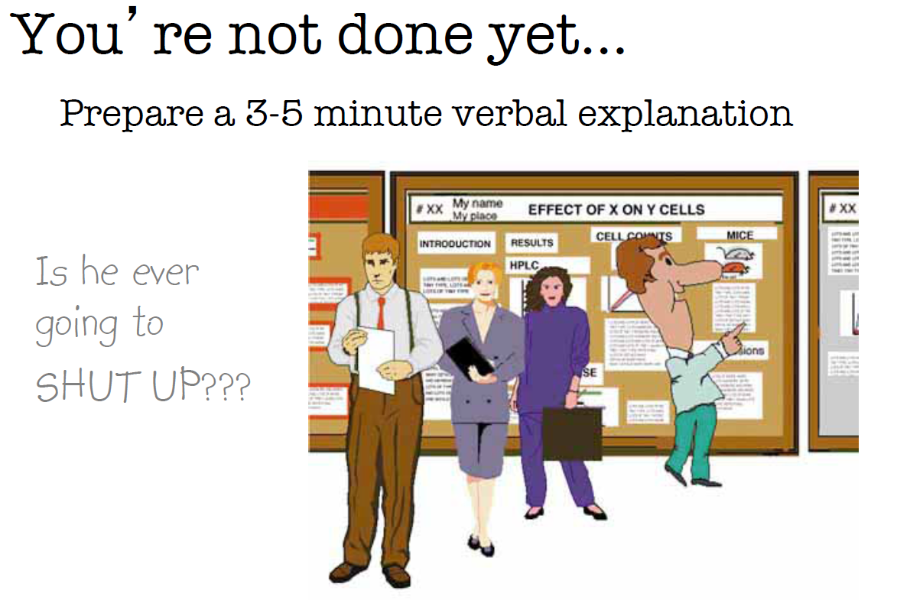

Slide 49
Let’s judge some designs and see what you’ve learned

Slide 50
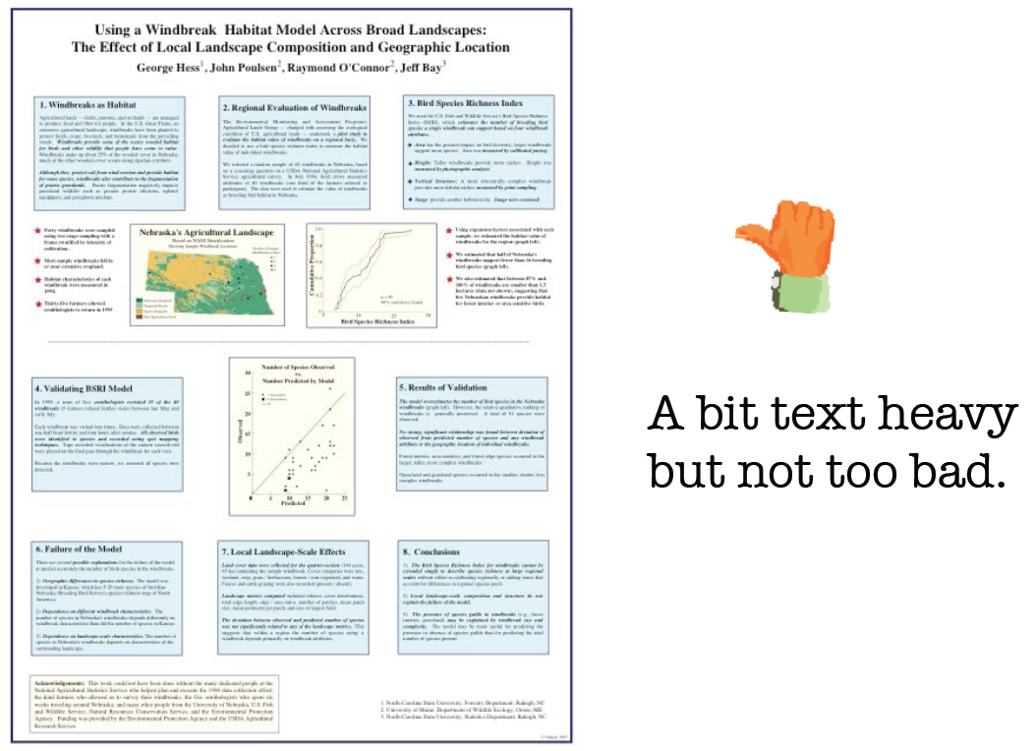

Slide 51
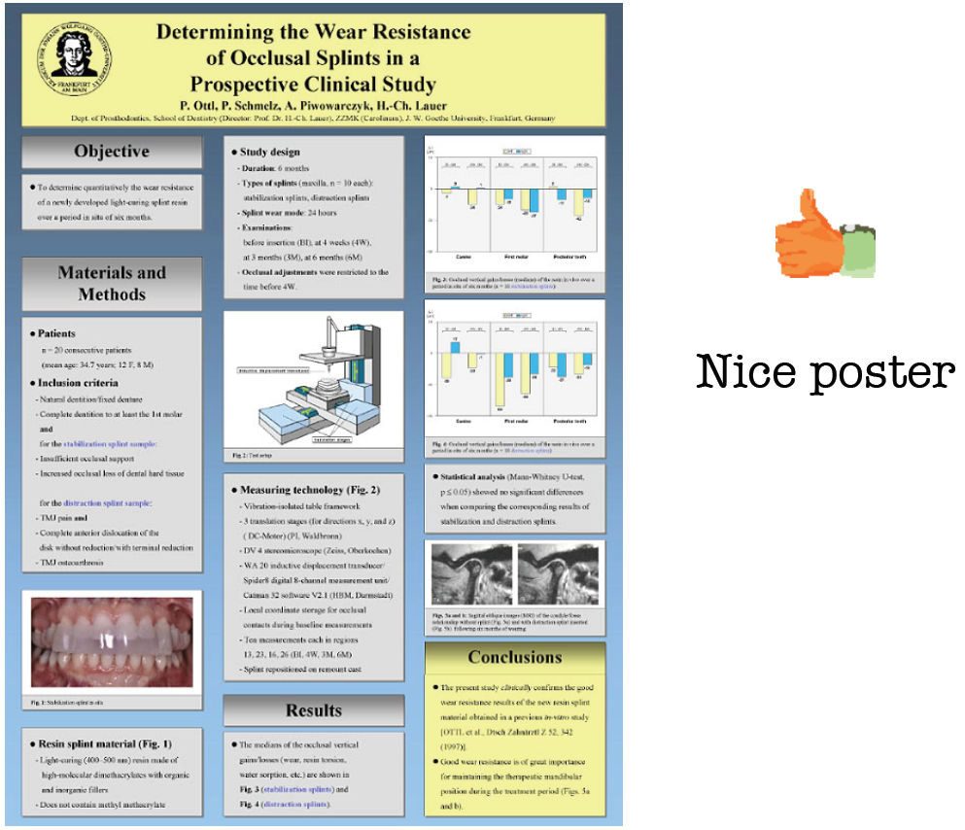

Slide 52
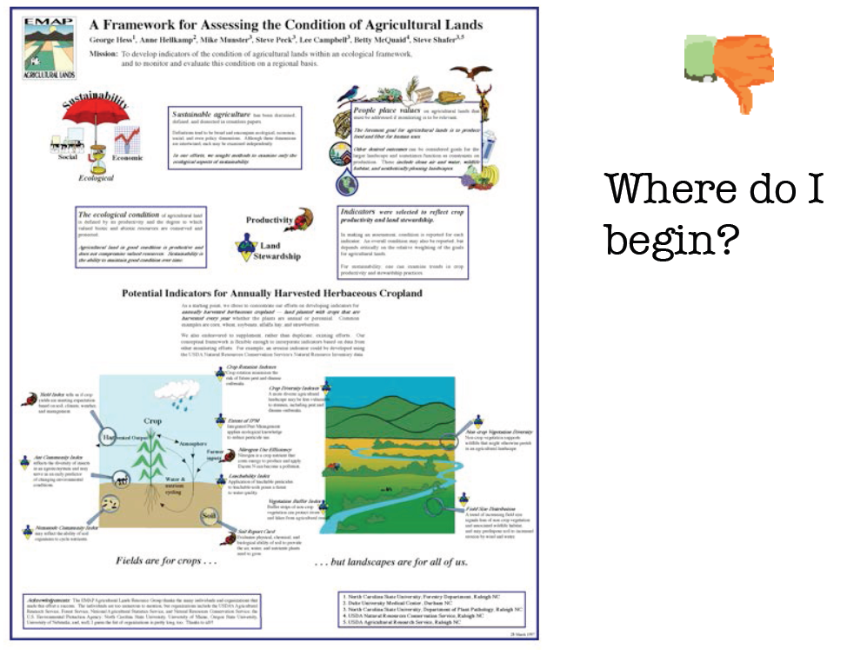

Slide 53


Slide 54
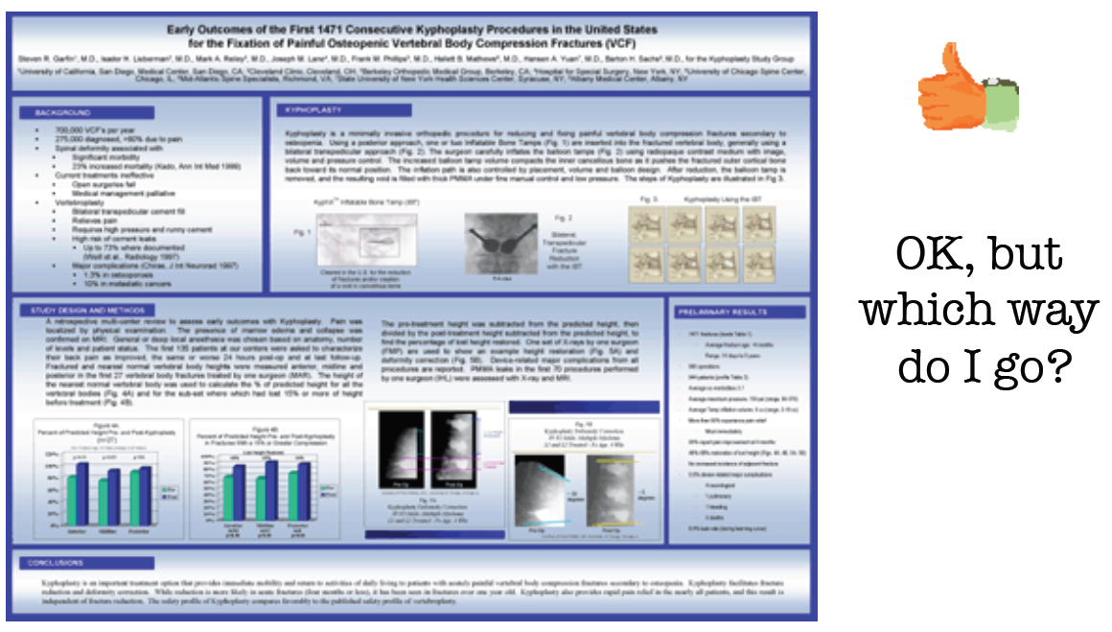

Slide 55
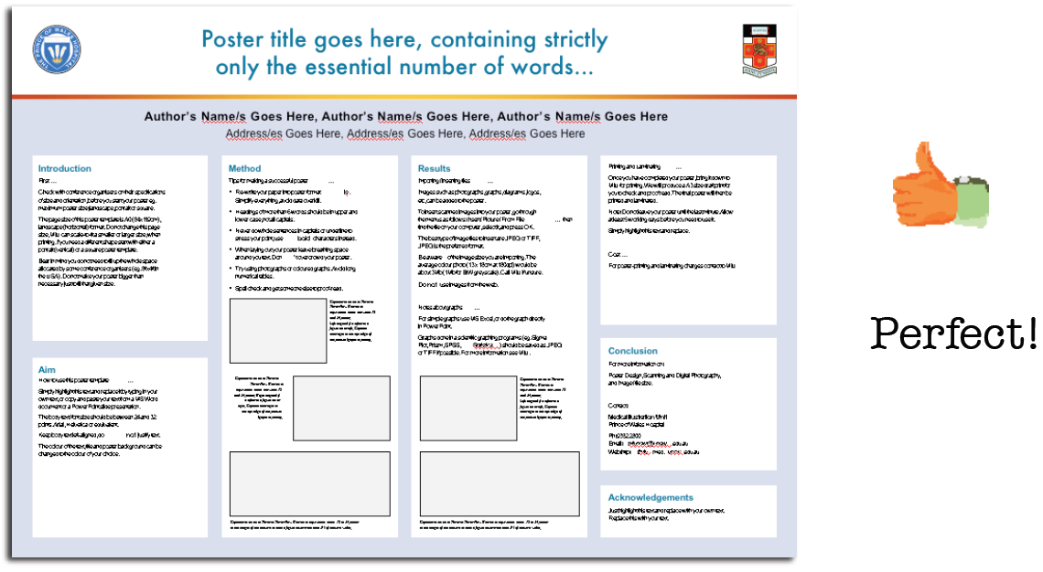

Slide 56
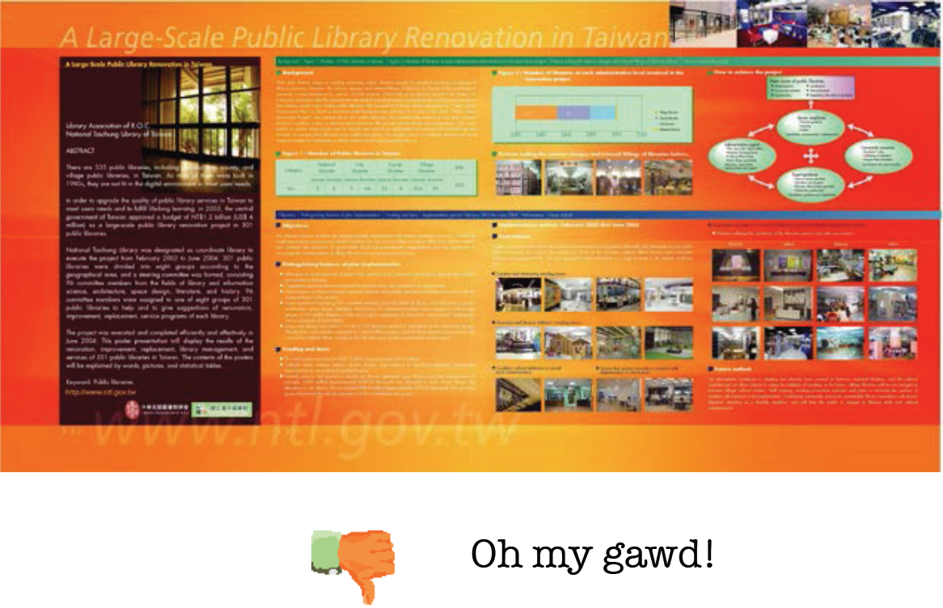

Slide 57
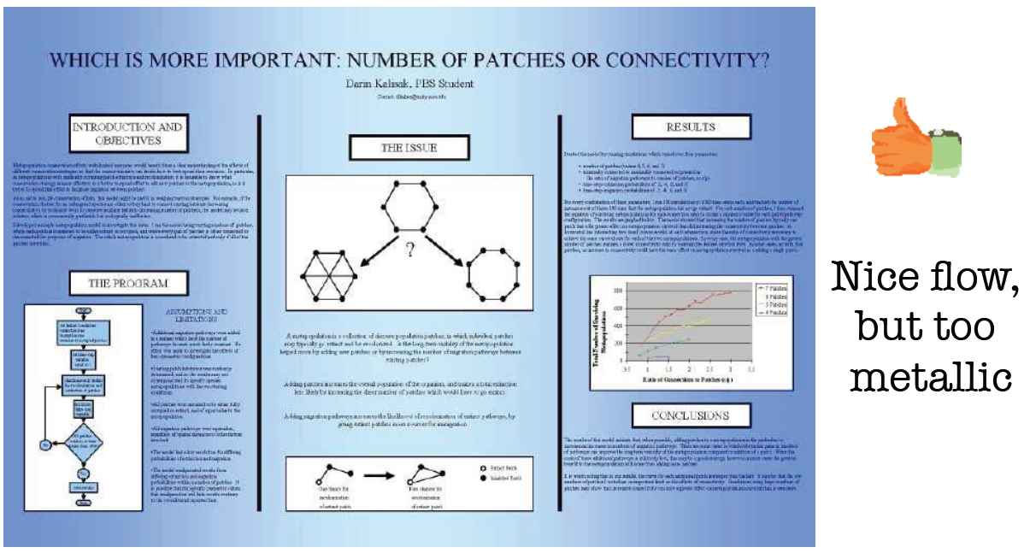

Slide 58
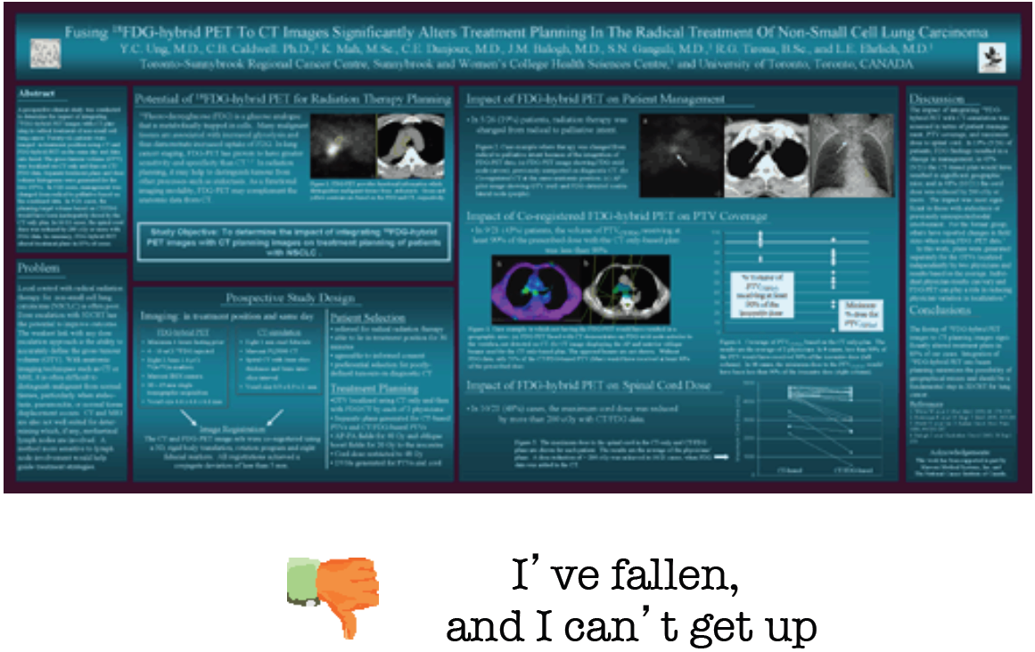

Slide 59
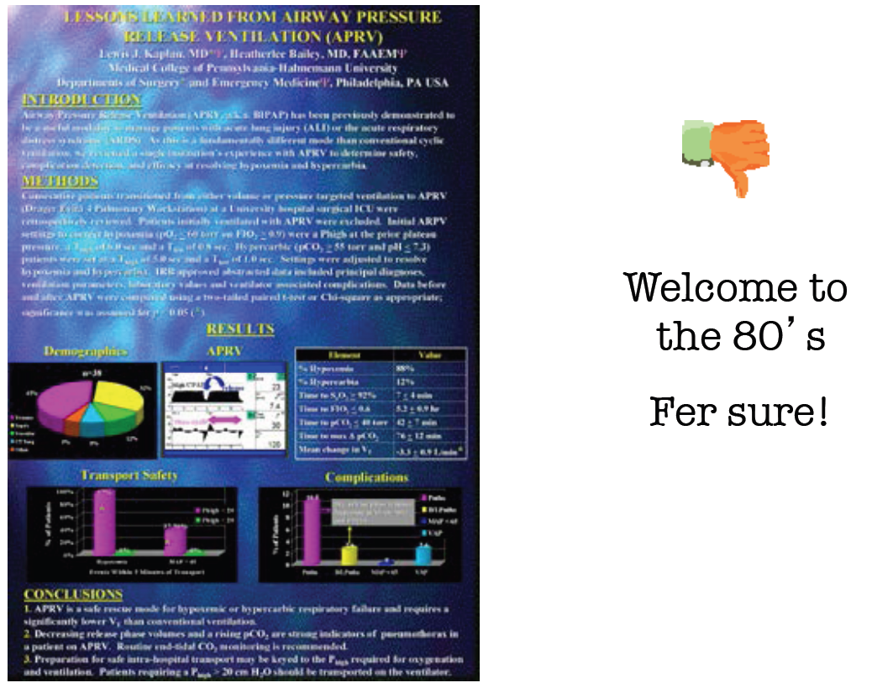

Slide 60
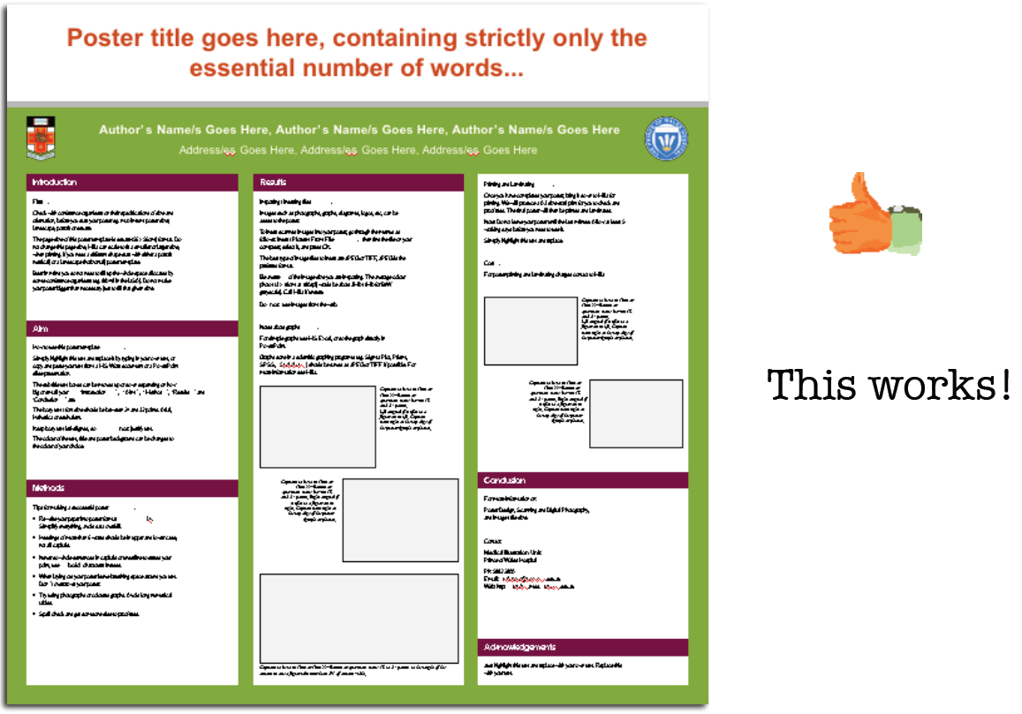

Slide 61

Award winning posters (I)

Slide 62
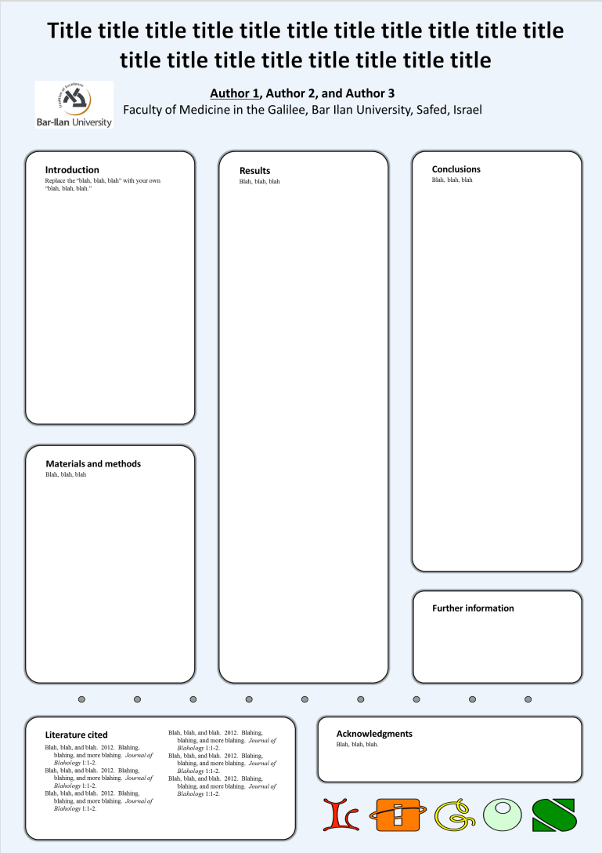
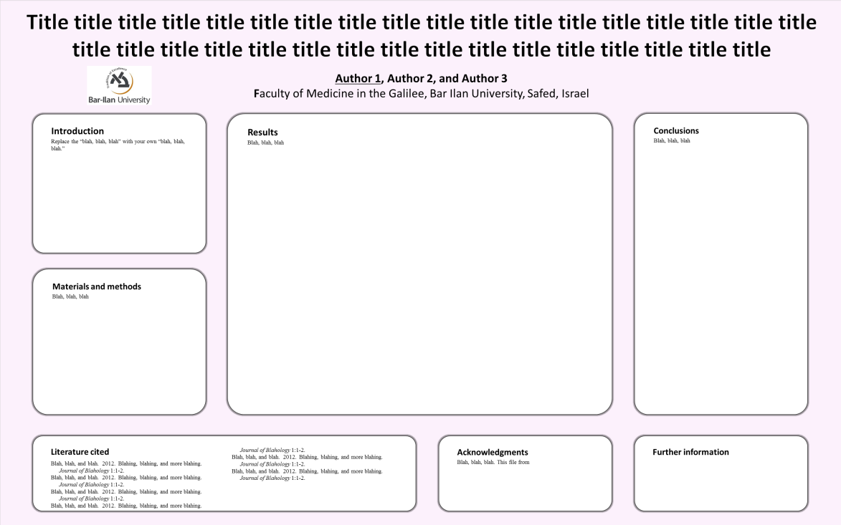
Templates
http://odem.md.biu.ac.il/sw933/poster_template_horizontal.pptx
http://odem.md.biu.ac.il/sw933/poster_template_vertical.pptx

